Slide 1
Weekly Report
程文胜 2021.6.14-6.21

Slide 2
Weekly Report
Abstract
Content
End

Slide 3
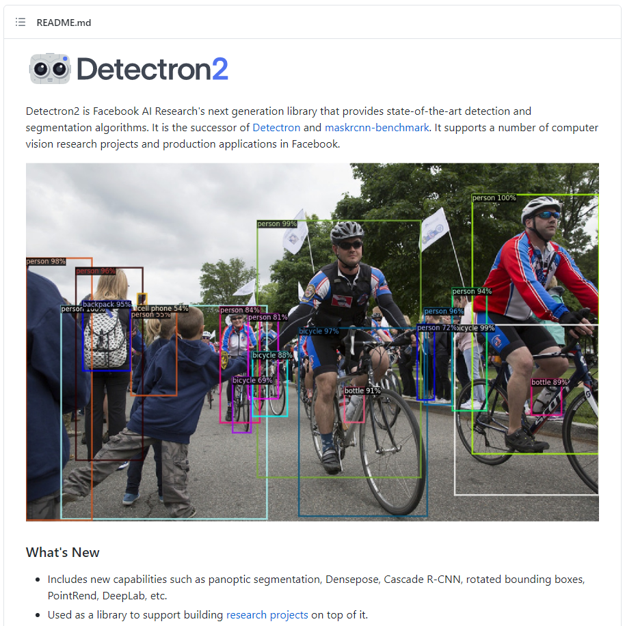
Abstract
Last week I mainly spent time on getting studying with Detectron2 framework, and converting our dataset for the few shot detection method.

Slide 4
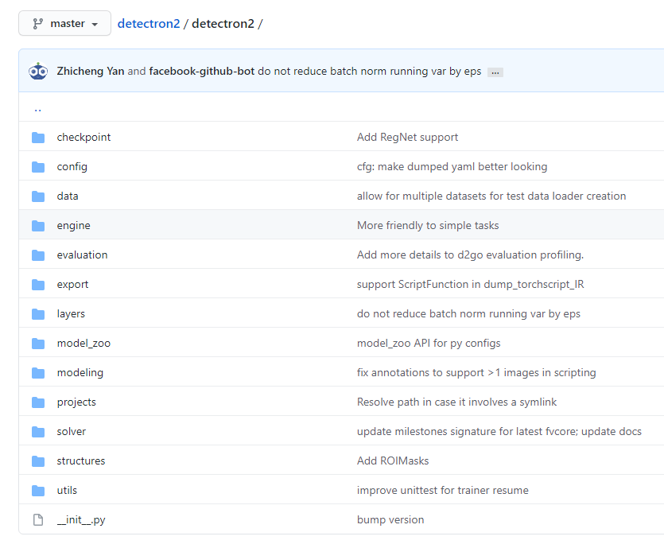
Content
I first studied the Detectron2 codebase. The code design is high-quality and practical. This is a reliable codebase for detection related work.

Slide 5
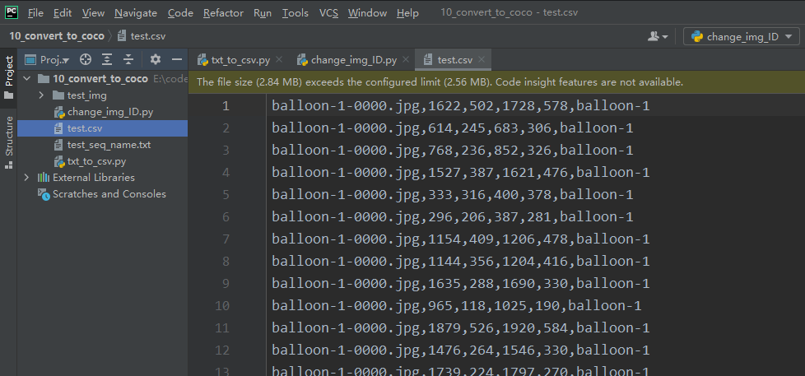
Content
I then changed our dataset format to coco format, since the few shot object detection code base supports coco dataset well. This is to re-use dataset related processing work.

Slide 6
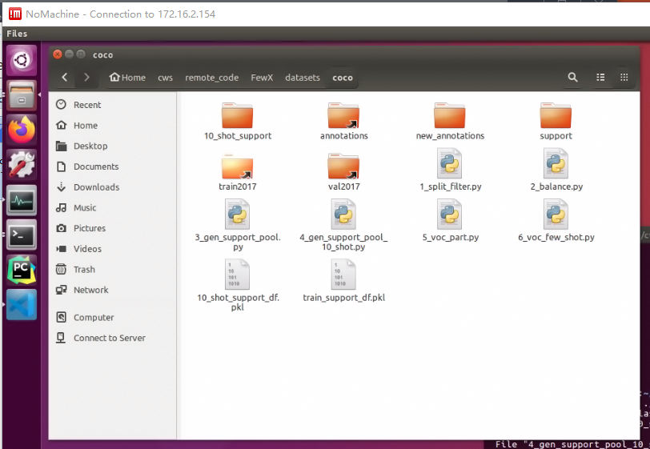
Content
Next week I plan to adapt out dataset to few-shot setting, and generate required data files for the few shot object detection method.

Slide 7
Report End
程文胜 6.21

