Slide 1
Weekly Report
程文胜 2021.10.5-10.12

Slide 2
Weekly Report
Abstract
Content
End

Slide 3
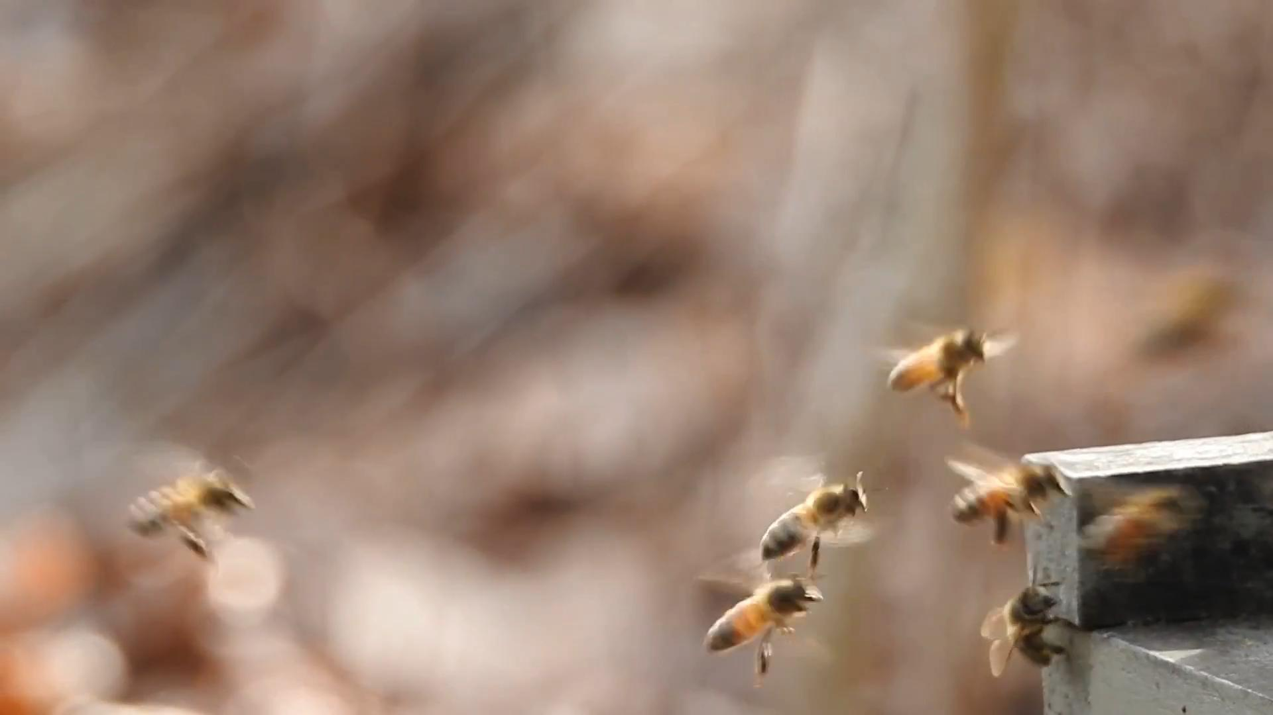
Abstract
Last week I mainly spent time on testing online update ways.

Slide 4
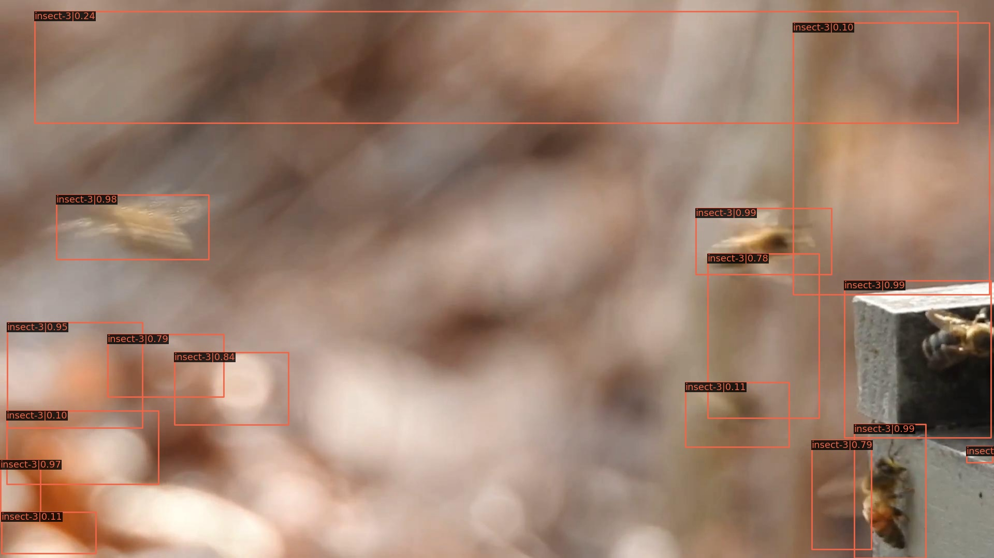
Visual Result Split 1

Slide 5
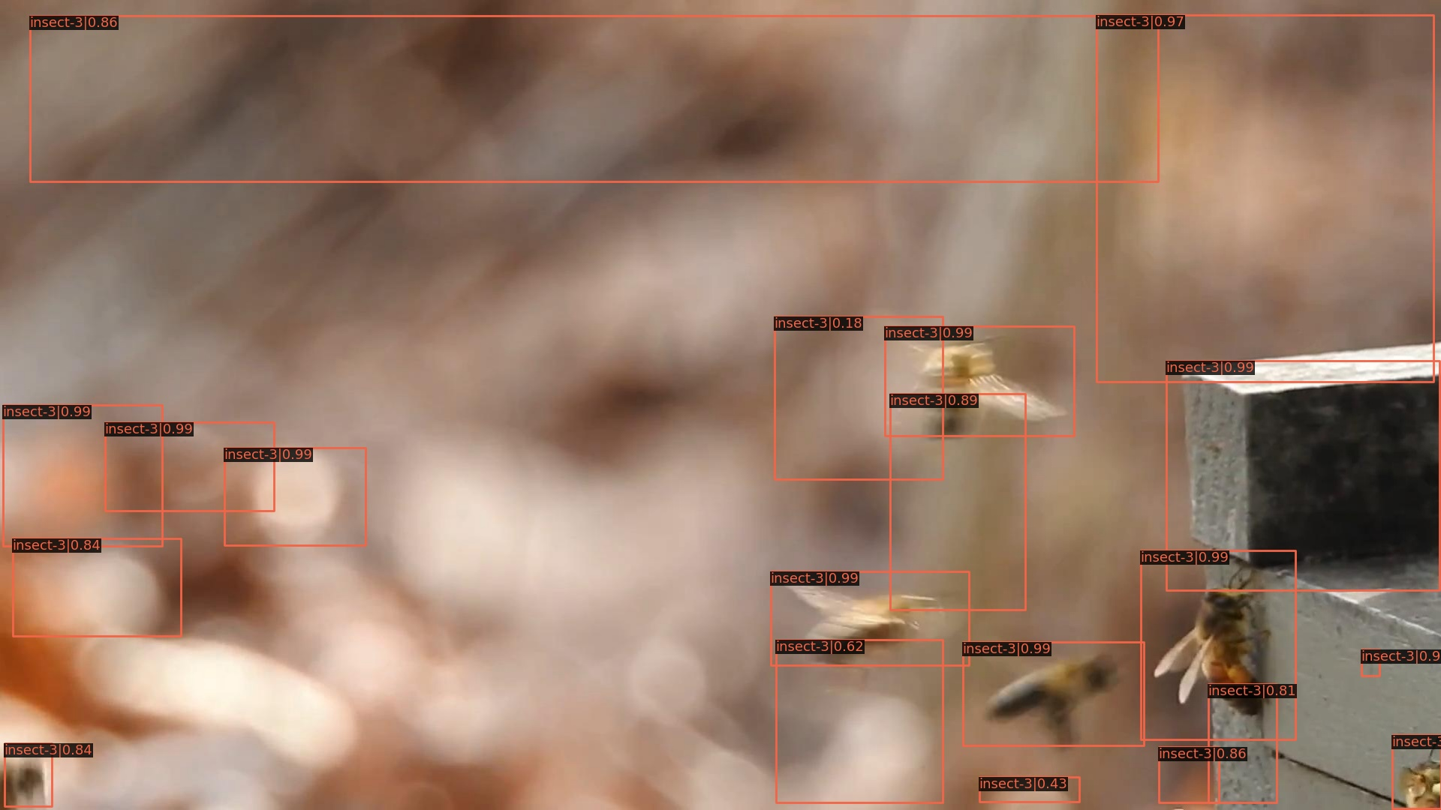
Visual Result Split 2

Slide 6
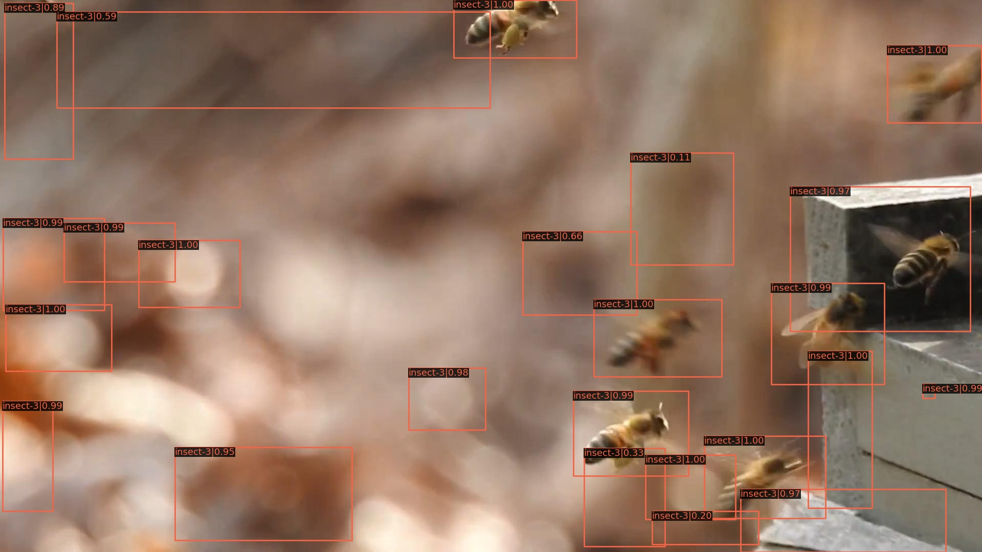
Visual Result Split 3

Slide 7
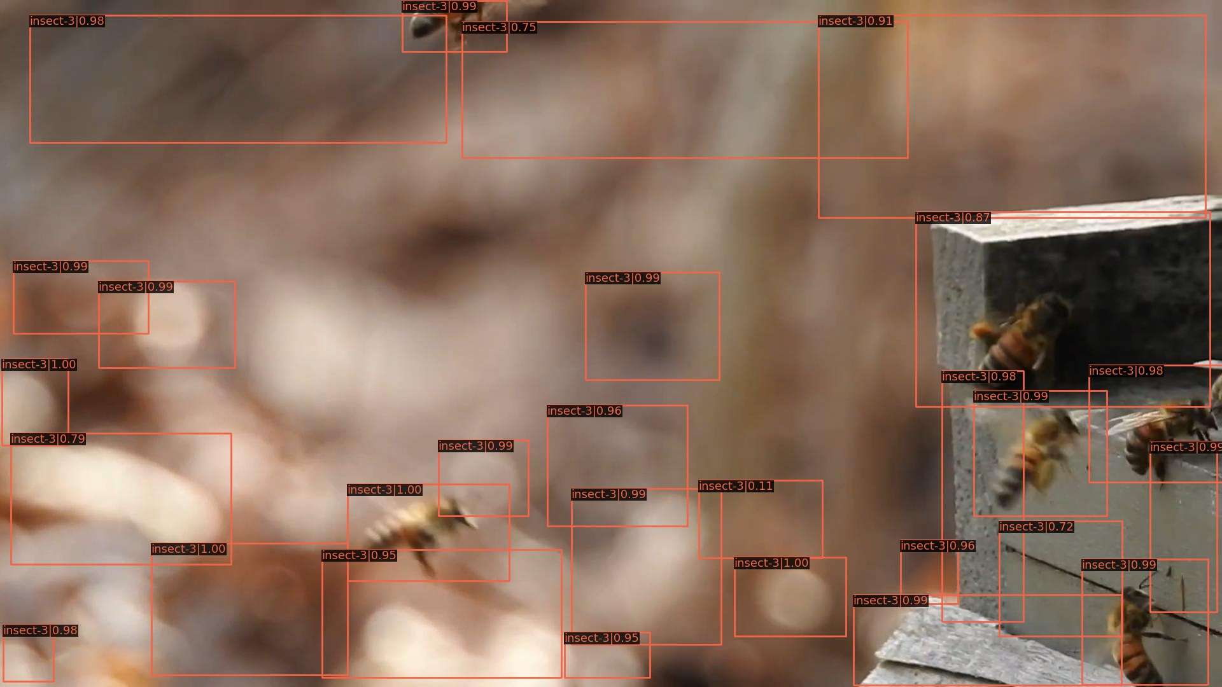
Visual Result Split 4

Slide 8
Report End
程文胜 10.12

