Slide 1
Weekly Report
Wensheng Cheng
2021.10.19-10.28

Slide 2
Last discussion
Iterative updating detector mode with clip length=20 performed badly.
Label noise needs to be removed efficiently.
Related work in weakly/semi supervised learning, noisy label learning.

Slide 3
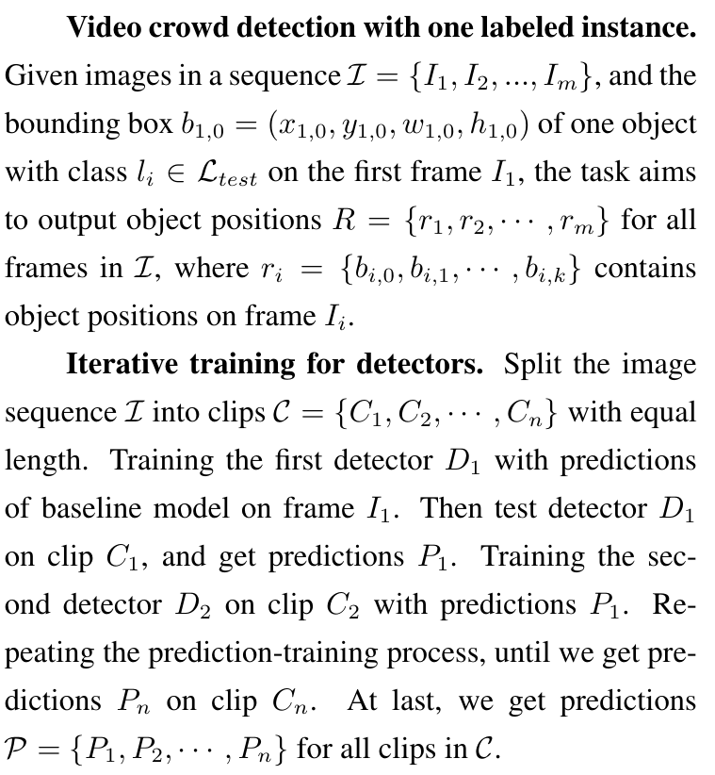
Problem definition

Slide 4
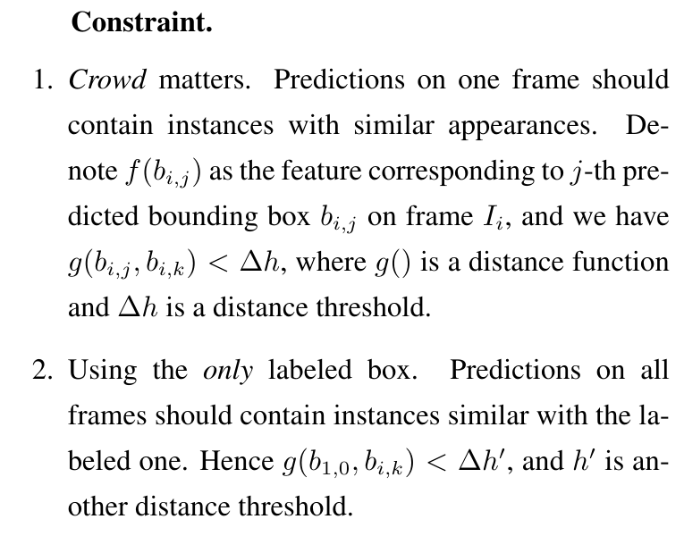
Problem definition

Slide 5
Related work
Semi-supervised object detection
Image classification with noisy label (few work about noisy label in object detection, maybe because the task on image classification is still hard now)
Lottery: one paper very close to our task
Thoughts: keep reformulating problems and try to find existing works mostly related to our task.

Slide 6
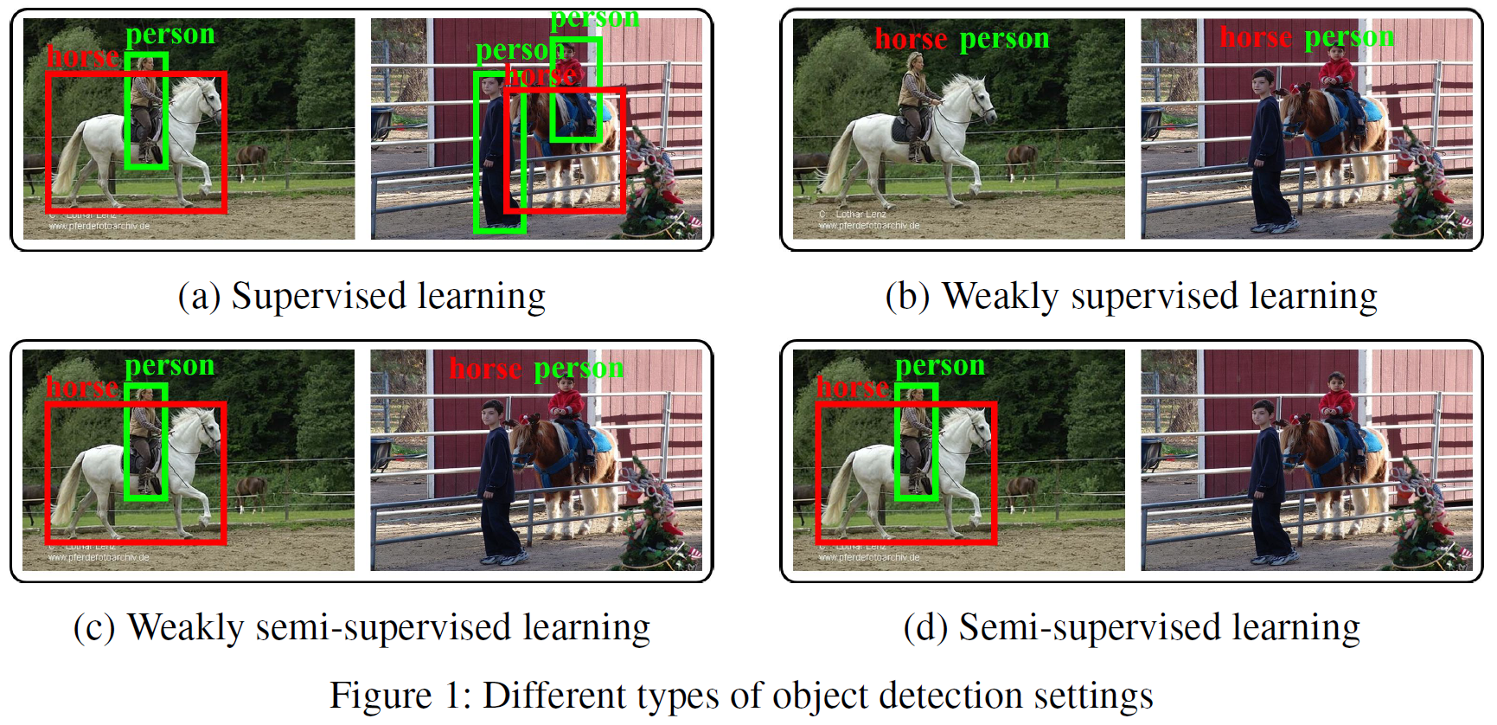
Semi-supervised object detection
There is difference between weakly supervised training and semi-supervised training.
Pic credit: NIPS 2019.Consistency-based Semi-supervised Learning for Object Detection

Slide 7
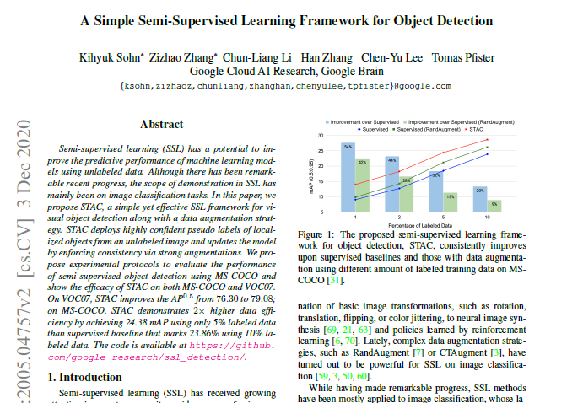
Semi-supervised object detection
A Simple Semi-Supervised Learning Framework for Object Detection
Preprint. https://arxiv.org/pdf/2005.04757.pdf

Slide 8
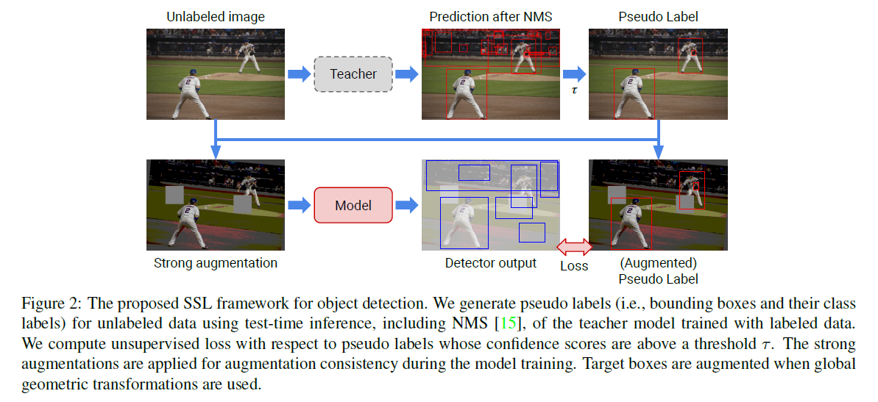
Semi-supervised object detection
The proposed simple framework. Similar with what we did in earlier weeks. But it assumes complete annotation for images containing box labels.
Preprint. https://arxiv.org/pdf/2005.04757.pdf

Slide 9
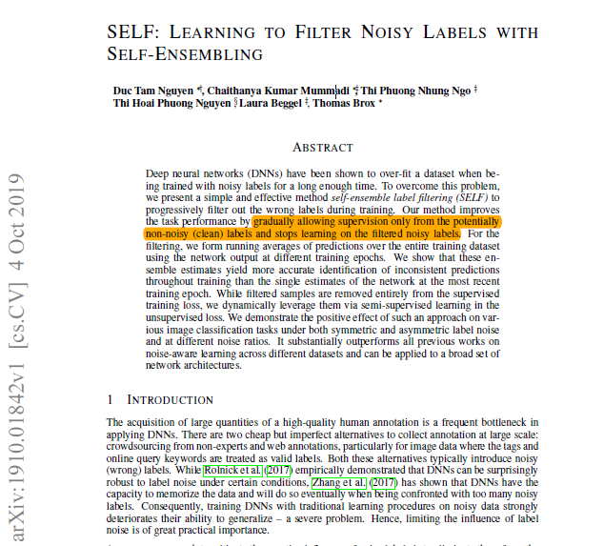
Image classification with noisy labels
SELF: Learning to filter noisy labels with self-ensembling
ICLR 2020. https://arxiv.org/pdf/1910.01842.pdf

Slide 10
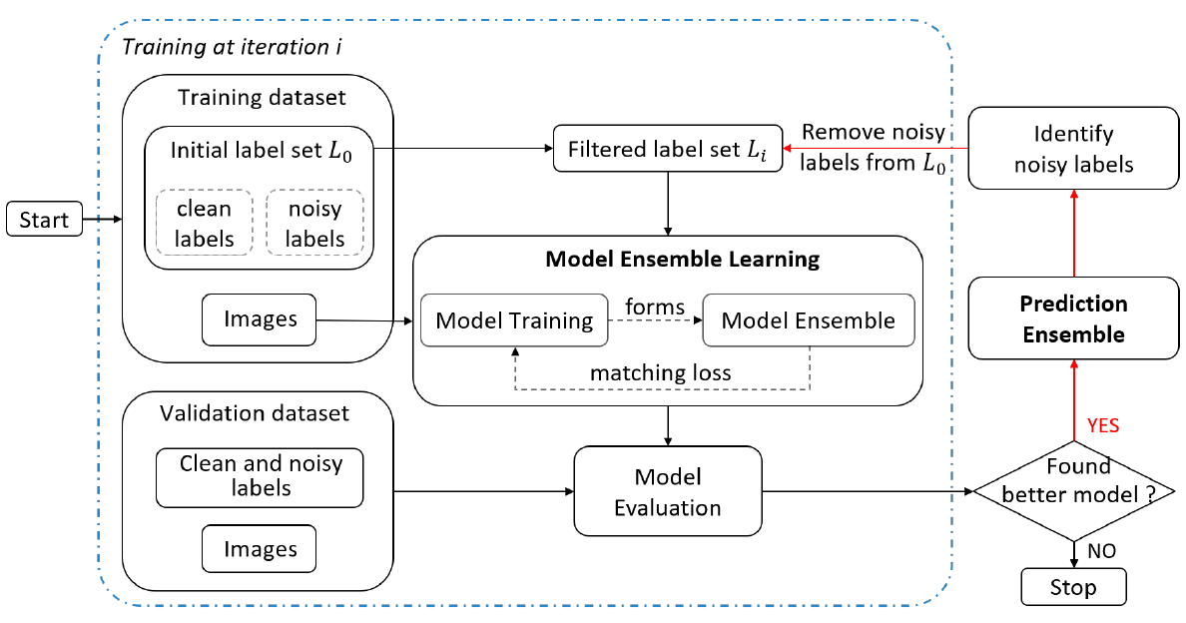
Image classification with noisy labels
It basically transforms the problem of learning from noisy labels into a semi-supervised learning task, by splitting clean labels (labeled data) and noisy labels (unlabeled data).
ICLR 2020. https://arxiv.org/pdf/1910.01842.pdf

Slide 11
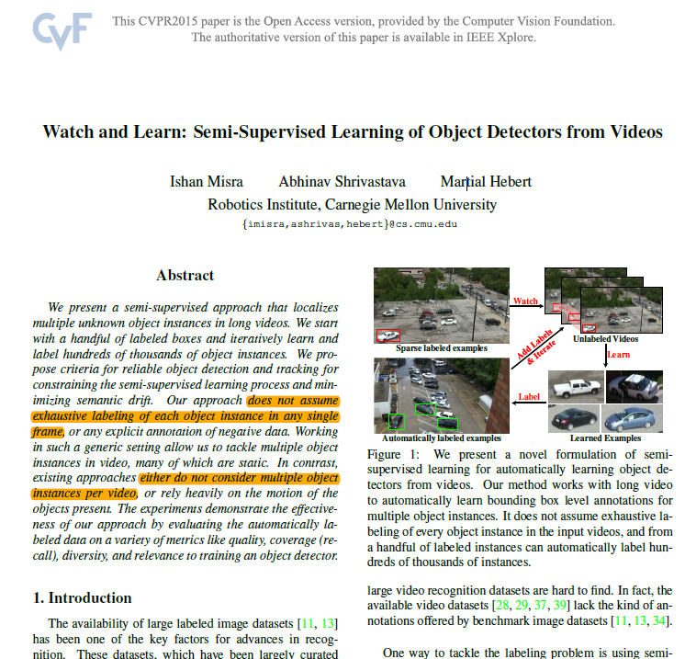
Lottery
Watch and Learn: Semi-Supervised Learning of Object Detectors from Videos
CVPR 2015. https://arxiv.org/pdf/1505.05769.pdf

Slide 12
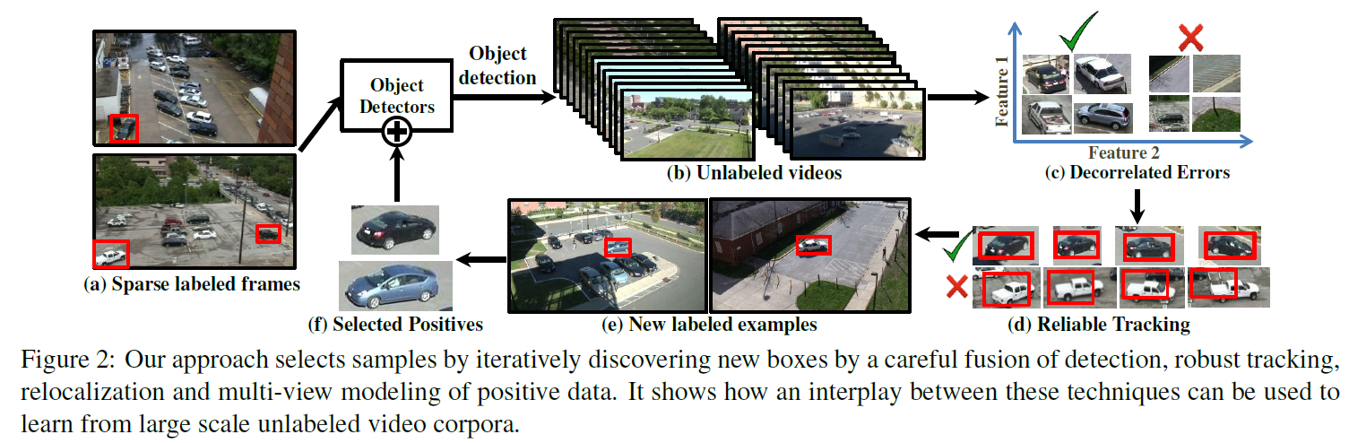
Lottery
Settings in this paper are really close to ours.
Different with semi-supervised object detection, it does not assume exhaustive labeling of every object instance in the input videos.
CVPR 2015. https://arxiv.org/pdf/1505.05769.pdf

Slide 13
End
End and Thanks!

