Slide 1
Weekly Report
程文胜 2020.3.7-3.14

Slide 2
Weekly Report
Abstract
Content
End

Slide 3
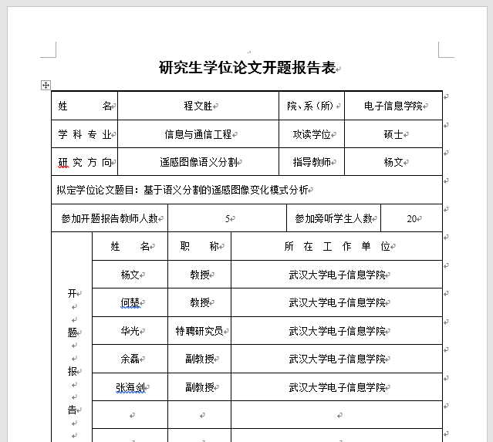
Abstract
This week I mainly put my effort on writing opening report, reviewing a journal paper about building extraction and submitting the supplementary material for Lei Xu’s paper.

Slide 4
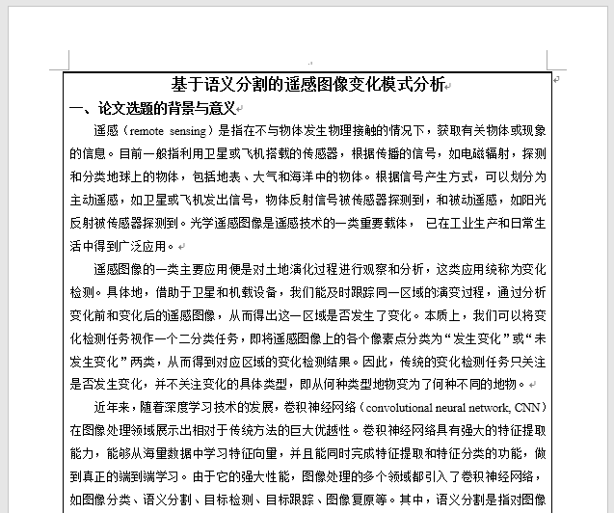
Content
My thesis consists of two parts. One is about semantic segmentation for aerial images, and the other one is a new task about change detection.

Slide 5
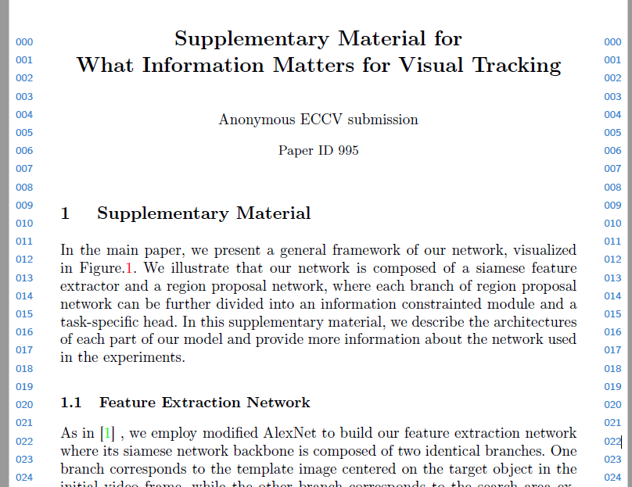
Content
Since Lei Xu’s main paper didn’t explain the network architecture clearly, we wrote the supplementary material to further illustrate that part. But it’s a pity that we didn’t have time to put it into the main paper. Next time we need to be faster.

Slide 6
Report End
程文胜 VIPG

