Slide 1
Weekly Report
程文胜 2020.2.27-3.7

Slide 2
Weekly Report
Abstract
Content
End

Slide 3
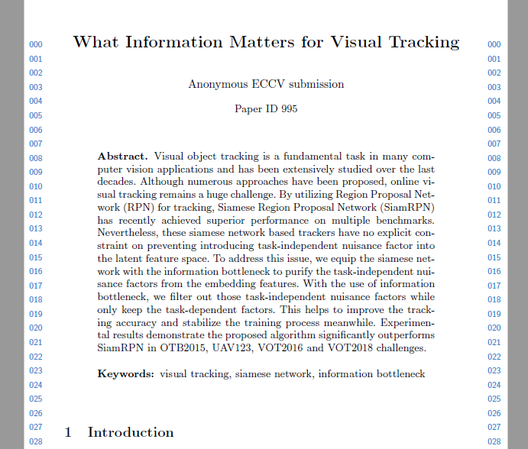
Abstract
This week I mainly put my effort on Lei Xu’s conference paper about visual tracking.

Slide 4
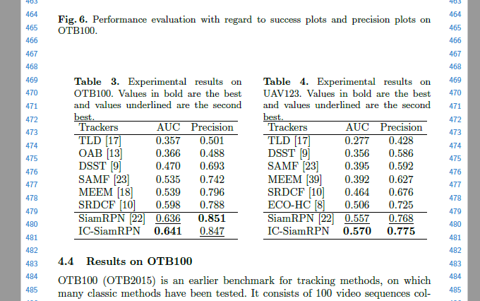
Content
We basically finished writing on the night of Mar, 5th. Lei Xu edited the 3.3 section on the morning of Mar, 6th, which is our final version.

Slide 5
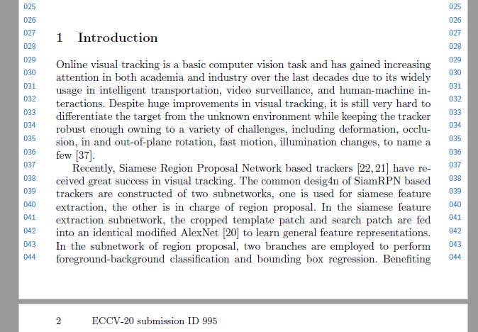
Content
However, there are still some bugs on this paper, since we don’t have enough time to check it carefully. We would learn from it and try to finish the draft as early as possible in the future.

Slide 6
Report End
程文胜 VIPG

