Slide 1
Weekly Report
程文胜 2020.4.17-4.24

Slide 2
Weekly Report
Abstract
Content
End

Slide 3
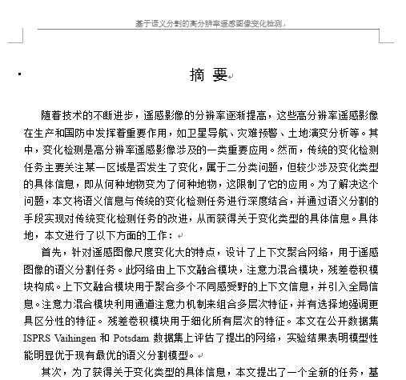
Abstract
This week I continue to correct some mistakes of thesis.

Slide 4
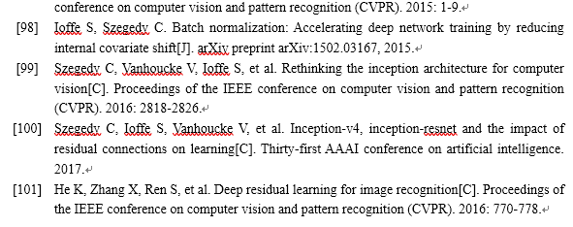
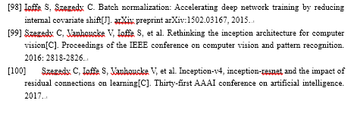
Content
I have modified the number format of reference to make the space consistent. I also added some citations to figures that come from papers, except some figures which come from web blog. I checked the number of reference, figure, table and formulas to make sure they are indexed in correct order.
Before
After

Slide 5
Report End
程文胜 VIPG

