Slide 1
Weekly Report
程文胜 2020.4.3-4.9

Slide 2
Weekly Report
Abstract
Content
End

Slide 3
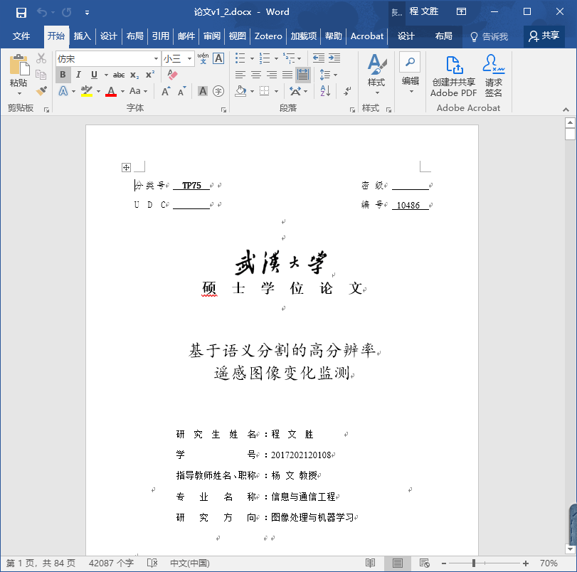
Abstract
This week I mainly put my effort on revising thesis.

Slide 4
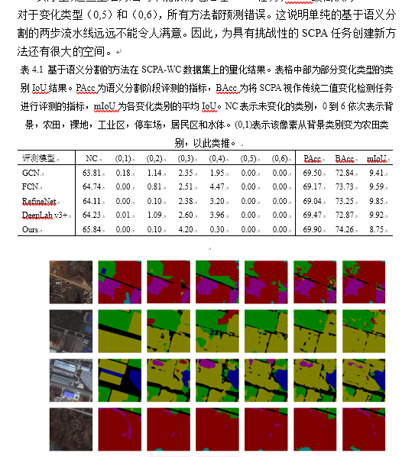
Content
This week I tried to apply my own semantic segmentation model to the change detection task. Its segmentation performance is better than other models after trying many parameters. Its change detection metric is still lower than others, but it is reasonable. Because only when a pair of pixels are predicted right, the change detection task would think it is right. Segmentation doesn’t consider the correspondence relation.

Slide 5
Report End
程文胜 VIPG

