Slide 1
Weekly Report
程文胜 2020.5.7-5.14

Slide 2
Weekly Report
Abstract
Content
End

Slide 3
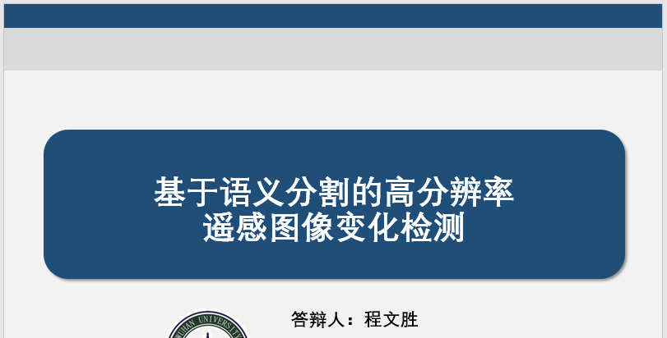
Abstract
This week I mainly put my effort on preparing my master thesis presentation and improving the SCPA work.

Slide 4
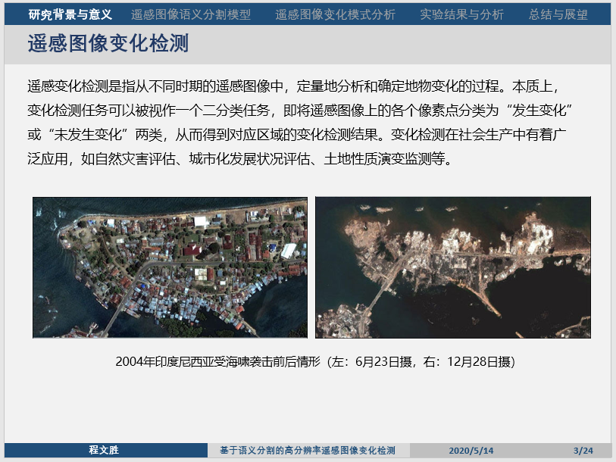
Content
I have spent time on preparing for my master thesis presentation. I have taken part in the official oral defense on Thursday.

Slide 5
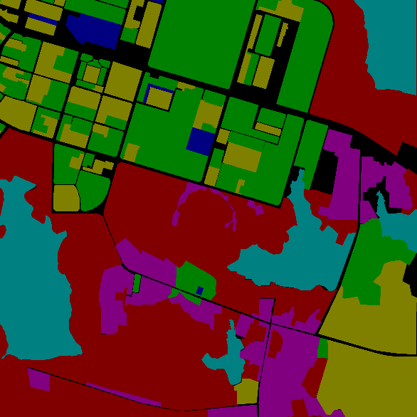
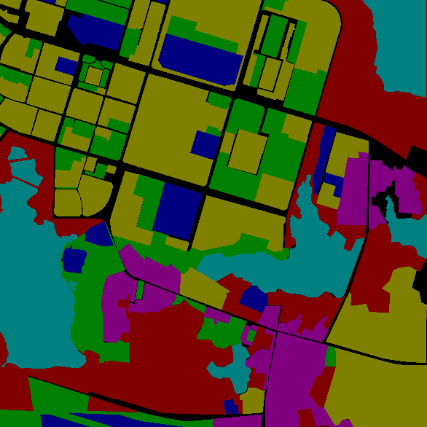
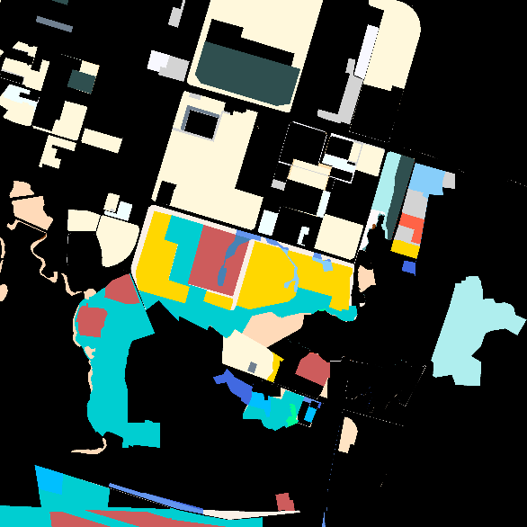
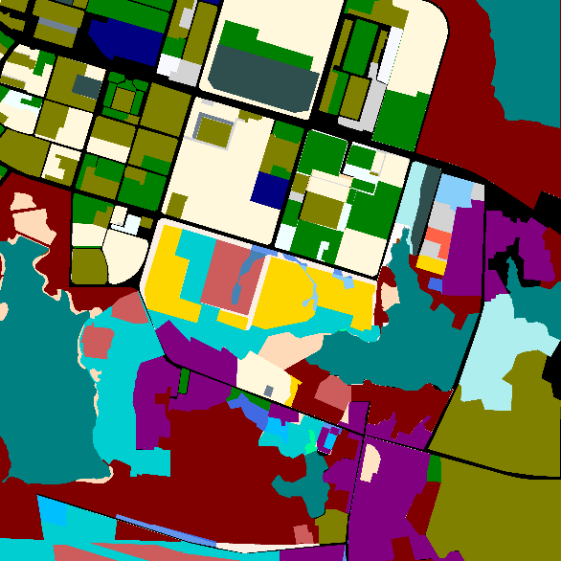
Content
To improve our previous SCPA work, we need to classify the NoChange type into different classes, besides the changed ones. I adjusted the label, and assigned the NoChange area different labels by their semantic category.
Semantic label
before change
(b) Semantic label
after change
(c) SCPA label with
NoChange type as a whole
(d) SCPA label with
different NoChange types

Slide 6
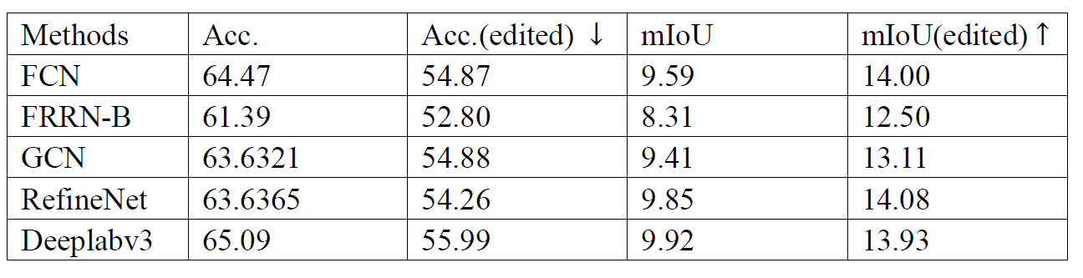
Content
I also tested these semantic segmentation models again to get these metrics. The whole accuracy decreased, while the mean IoU increased.
Next week I plan to deal with those change detection methods, and re-implement them as another baseline.

Slide 7
Report End
程文胜 5.14

