Slide 1
Weekly Report
程文胜 2019.1.6-2019.1.13

Slide 2
Weekly Report
Abstract
Content
Discussion

Slide 3
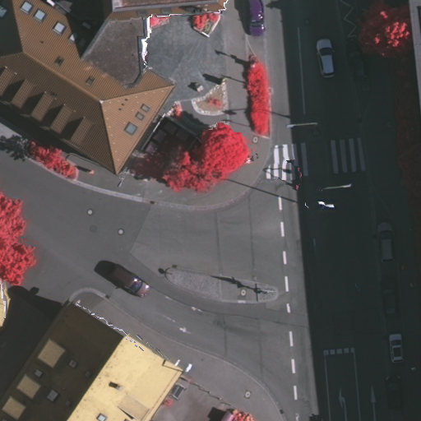
Abstract
This week I mainly put my effort on adding two more baseline models, and testing one customized model.
Vaihingen training sample (512*512)

Slide 4
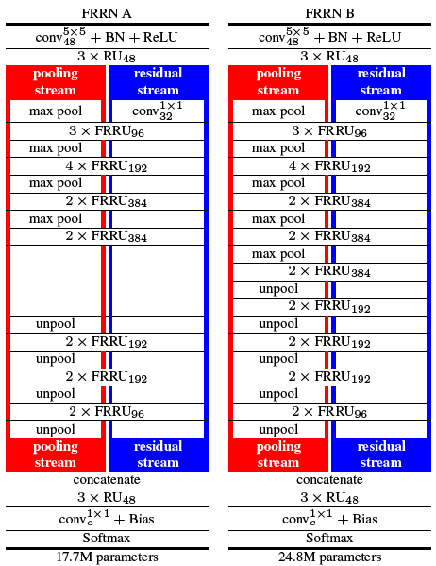
Content
Last week, I tried FCN and RefineNet model with Pytorch framework. To provide more convictive results, I add two more baseline models. Specifically, I add Segnet and Frrn model, then test them with remote sensing dataset, and get reasonable results.
Frrn model

Slide 5
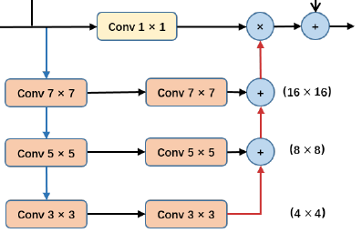
Content
I also tried a preliminary model built by myself. I add a parallel module, consisting of conv 7*7, conv 5*5, conv 3*3 layers, else is similar with U-net. However, this model’s performance resembles to FCN, and didn’t outperform RefineNet.
Module used in my arch

Slide 6

Discussion
My customized model is a preliminary one, and there are many other modules, like pyramid spatial pooling module, refinement block, and channel attention block, to be combined and tested.
Since semantic segmentation task consumes much more resource than other tasks, like detection and classification, the batch size of semantic segmentation module is usually much smaller than other tasks. Hence some training config is important, like synchronized batch normalization, multi-gpu training, so we need to pay extra attention to these engineer config.

Slide 7
Report End
程文胜 VIPG

