Slide 1
Weekly Report
程文胜 2021.6.7-6.14

Slide 2
Weekly Report
Abstract
Content
End

Slide 3
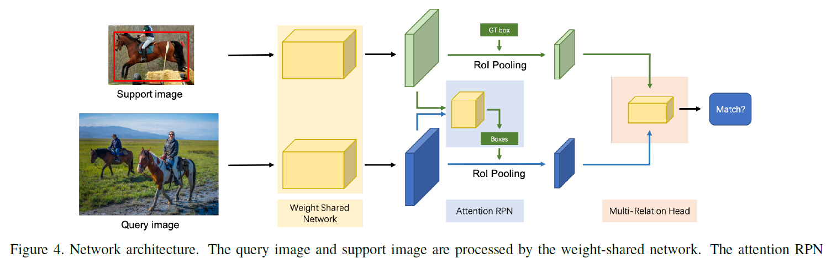
Abstract
Last week I mainly spent time on getting familiar with Detectron2 framework, and running the method of few shot object detection.

Slide 4
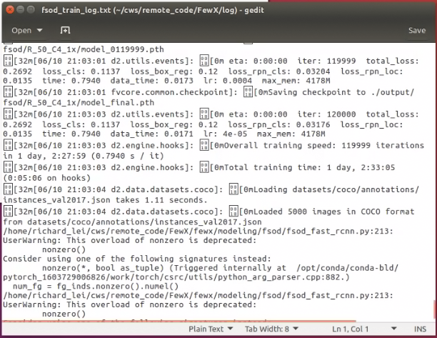
Content
To reimplement the whole process, I trained the whole few shot object detection network from scratch. Training it on 4 GPUs took more than 1 day on COCO dataset.

Slide 5
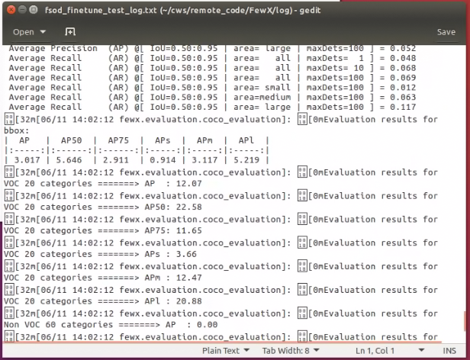
Content
After training, I run the inference on COCO test split dataset. The AP is over 12.0, which achieves the reported accuracy in the original repo.

Slide 6
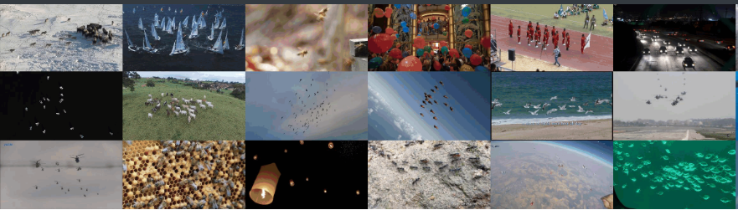
Content
Next week I plan to study the Detectron2 framework more, and then implement the few shot object detection method on our dataset.

Slide 7
Report End
程文胜 6.14

