Slide 1
Weekly Report
程文胜 2021.7.7-7.13

Slide 2
Weekly Report
Abstract
Content
End

Slide 3
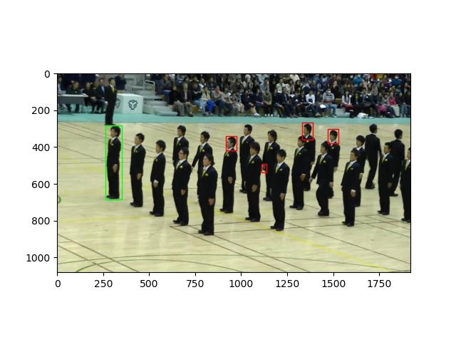
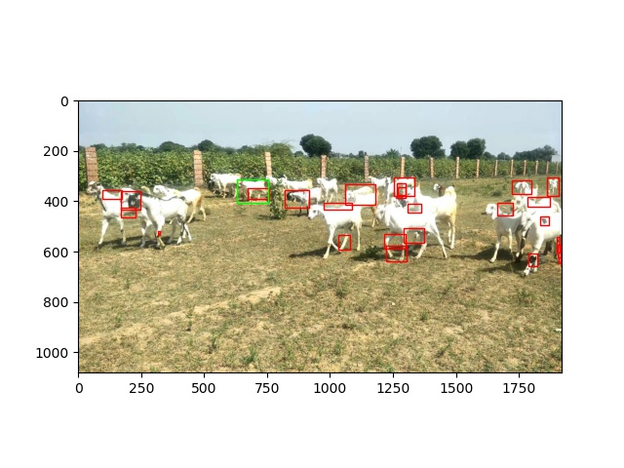
Abstract
Last week I mainly spent time on debugging why the few shot object detection method works bad on person/goat, and training with new settings.

Slide 4
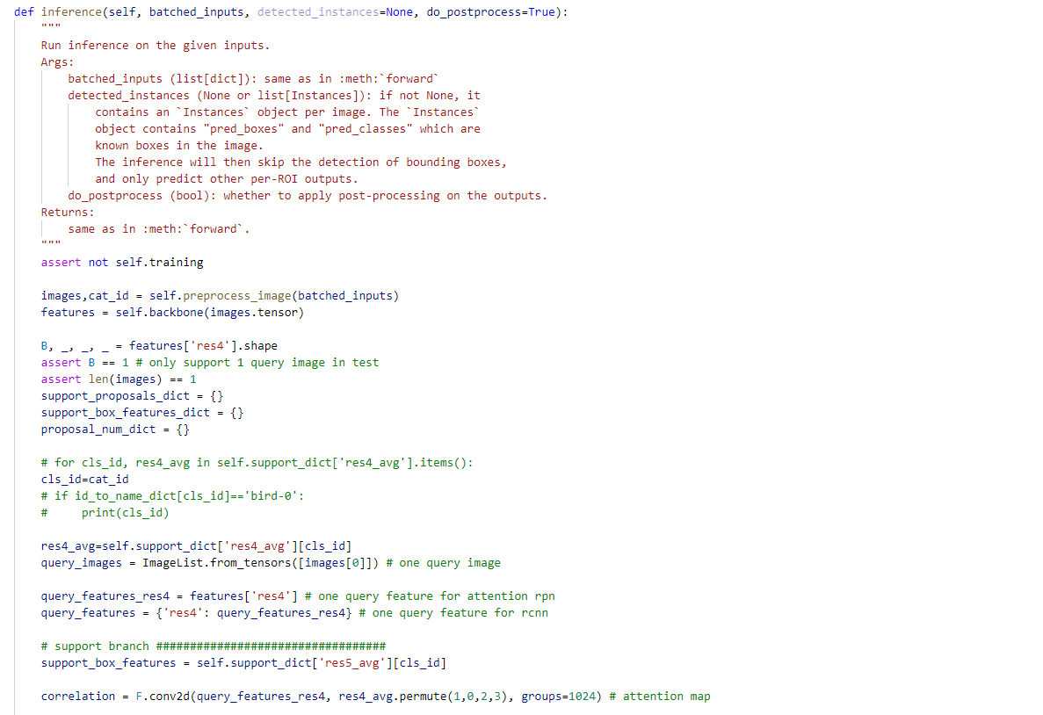
Code Error
I first check the test part code and its output line by line, and there is no error on behavior logic/image display/box position decoding.

Slide 5
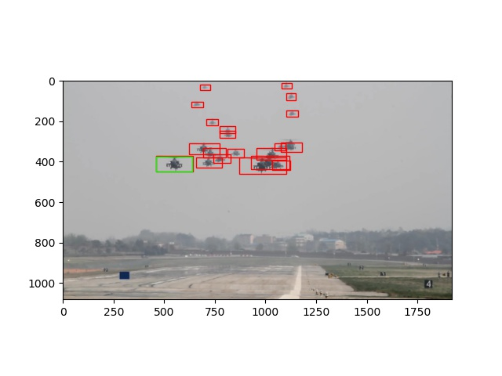
Result on training sequences(folder link below)
Click and go to local file folder

Slide 6
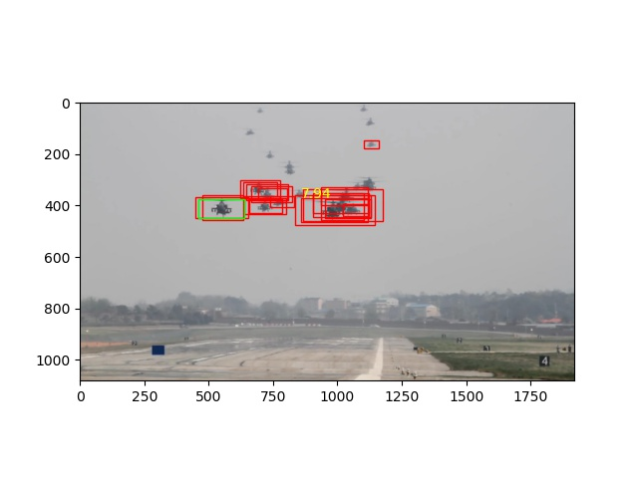
RPN on training sequences
Click and go to local file folder

Slide 7
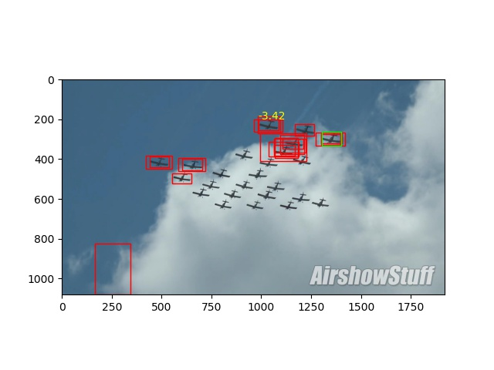
RPN on test sequences
Click and go to local file folder

Slide 8
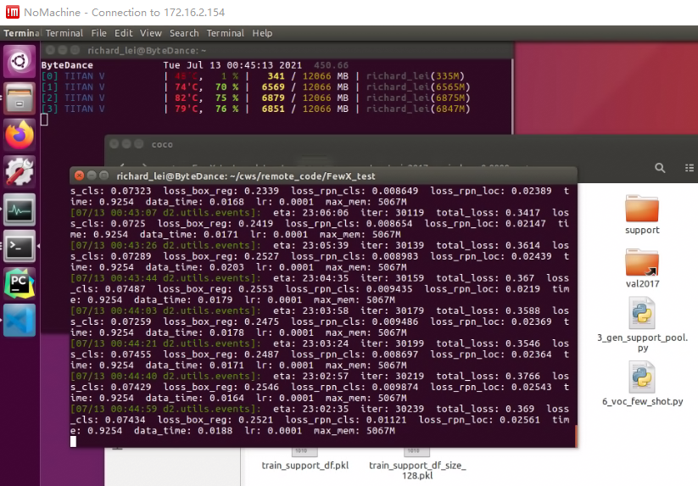
Training with new size/anchor

Slide 9
Report End
程文胜 7.13

