Slide 1
Weekly Report
程文胜 2021.8.23-8.31

Slide 2
Weekly Report
Abstract
Content
End

Slide 3
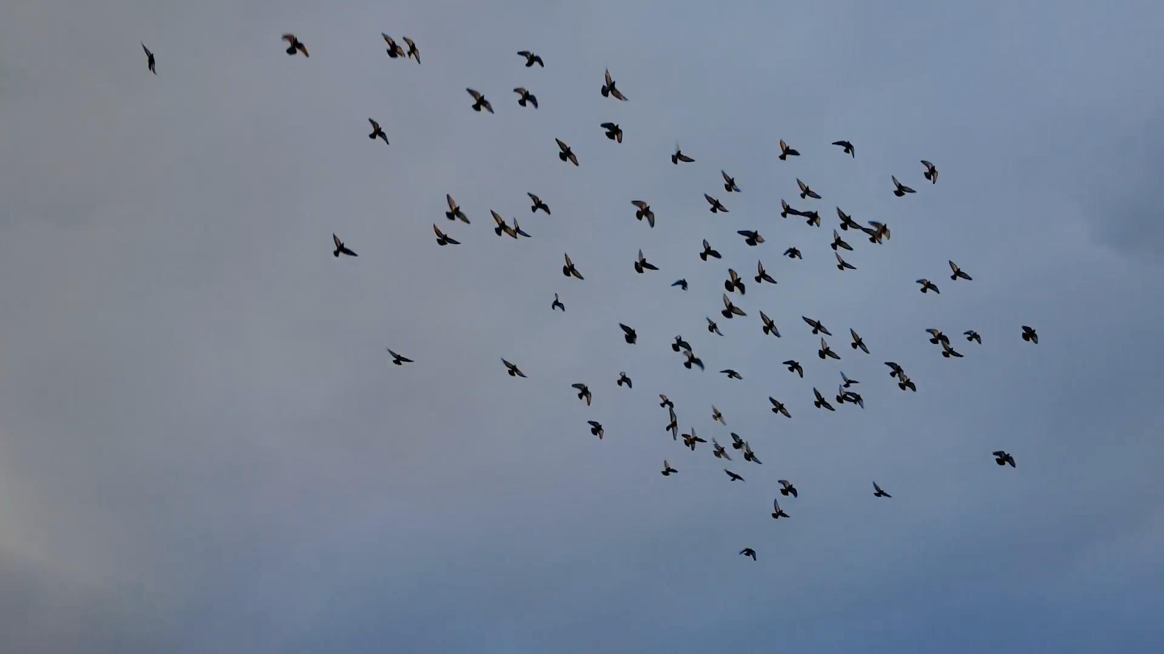
Abstract
Last week I mainly spent time on starting the osteoporosis project and thinking about the way we should go for GMOT problem.

Slide 4
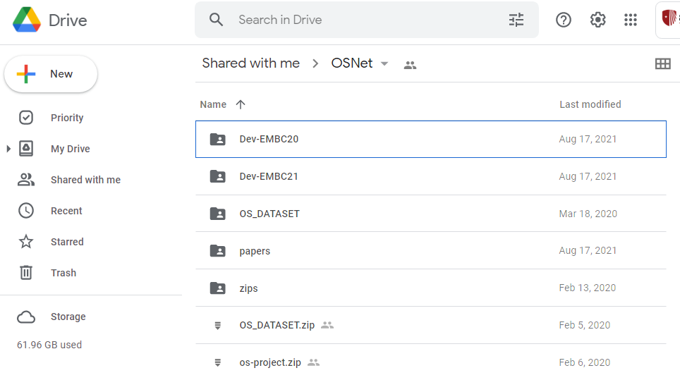
Osteoporosis Project
Jiaxiang shared osteoporosis dataset, codes and papers with me. Then I had the first meeting with Rajput on Monday, and discussing about what he need to do in these days.

Slide 5
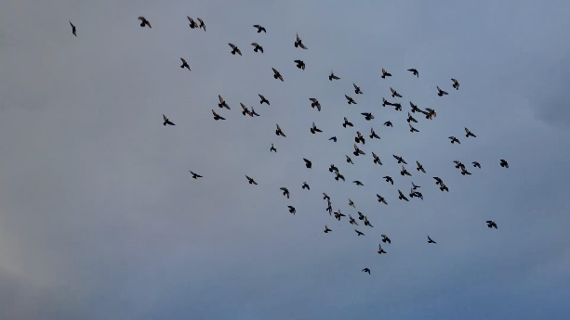
One-shot GMOT Problem
Template
Feature Extraction Module
Template Feature
Add
Filter Generation Module
Conv Kernel
Input Image
Cls
Conv
Box
Input Image
Feature Extraction Module
Image Feature

Slide 6
One-shot GMOT Problem
Template
Feature Extraction Module
Template Feature
Input Image
Cls
Conv
Box
Input Image
Feature Extraction Module
Image Feature

Slide 7
Report End
程文胜 8.31

