Slide 1
Weekly Report
程文胜 2021.9.21-9.27

Slide 2
Weekly Report
Abstract
Content
End

Slide 3
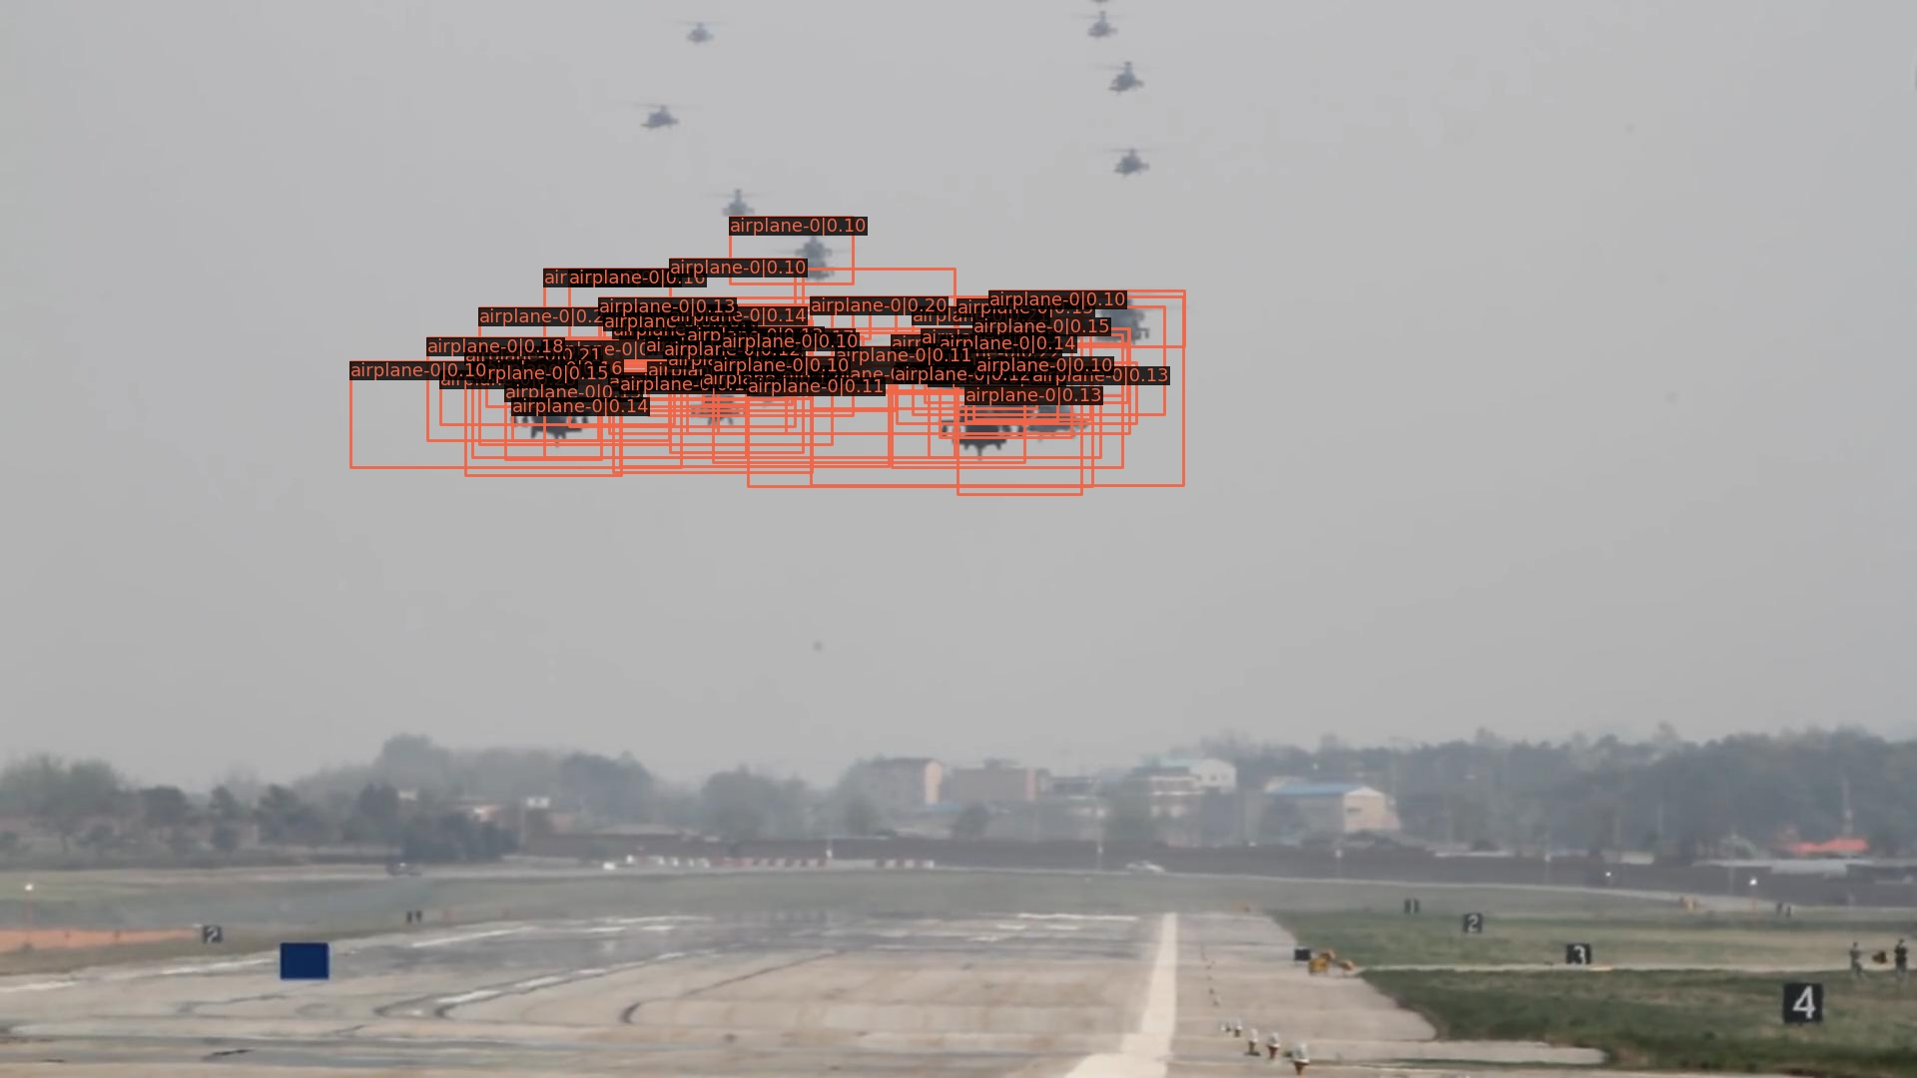
Abstract
Last week I mainly spent time on testing different post processing methods to refine the detection results generated by trained faster-rcnn.

Slide 4
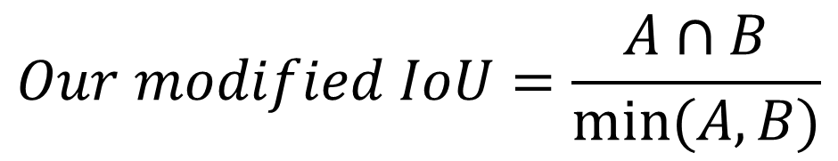
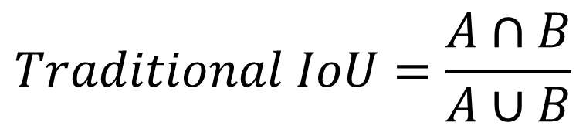
Instance NMS
There are many boxes covering each other. To reduce duplicates, I tried a more strict strategy following Prof.Ling’s advice, which I called Instance NMS.
$$Traditional IoU=\frac{A∩B}{A∪B}$$
$$Our modified IoU=\frac{A∩B}{min⁡(A,B)}$$

Slide 5



Instance NMS
Instance NMS can effectively remove duplicated boxes, especially when a small box with low confidence is totally inside a large box with high confidence(blue is the one we want, which has high conf.).
$$Filter the brown duplicate$$
$$Traditional IoU$$
$$Ours$$

Slide 6

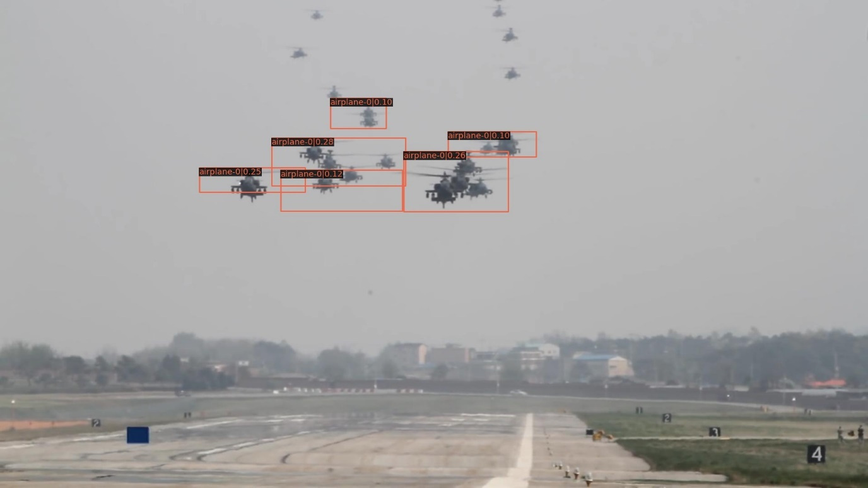
Visual Result
Result of instance NMS on frame-0 of trained faster-rcnn, threshold=0.1.
Traditional NMS
Instance NMS

Slide 7
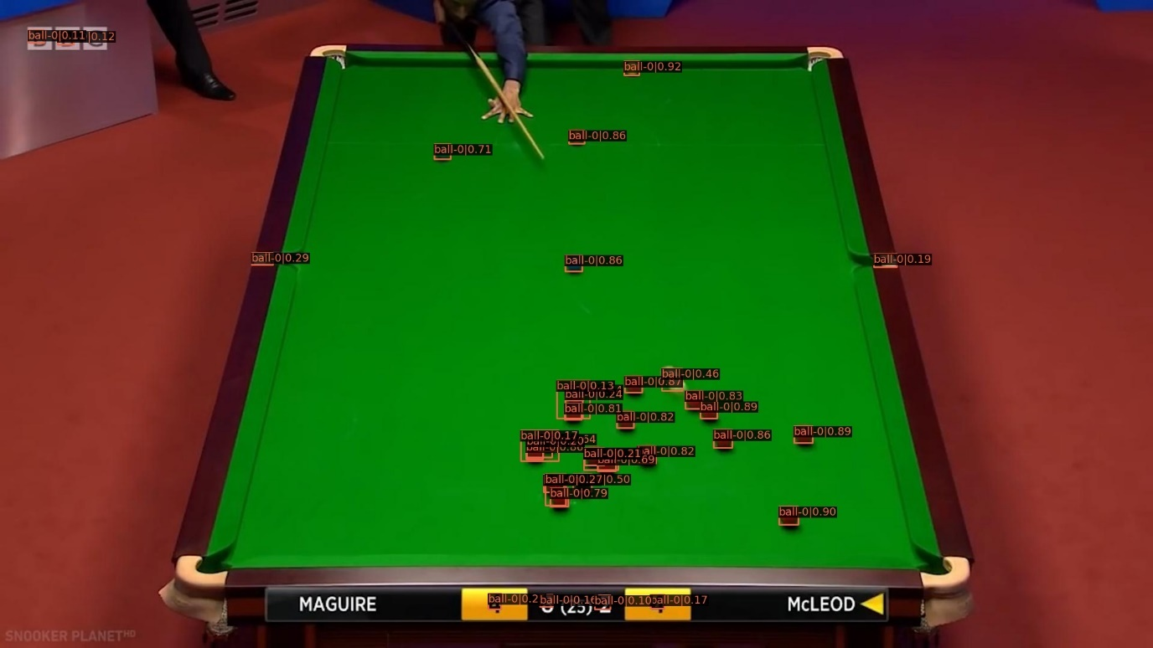
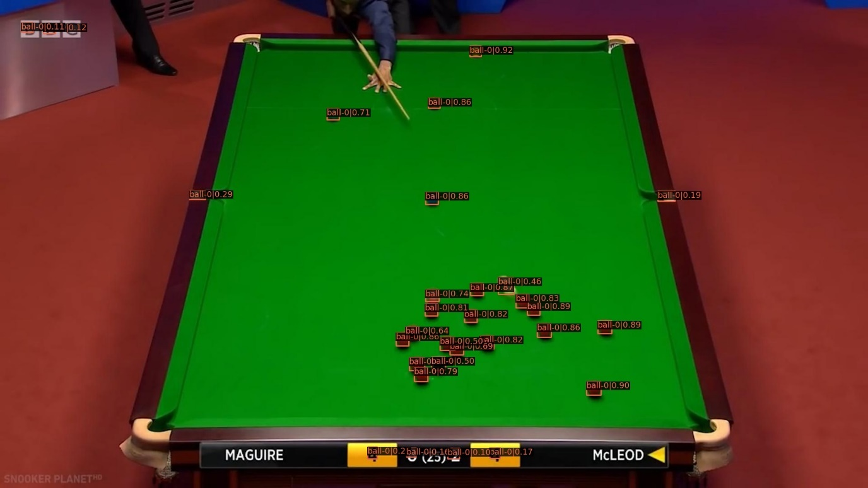
Visual Result
Result of instance NMS on frame-0 of trained faster-rcnn, threshold=0.1.
Traditional NMS
Instance NMS

Slide 8
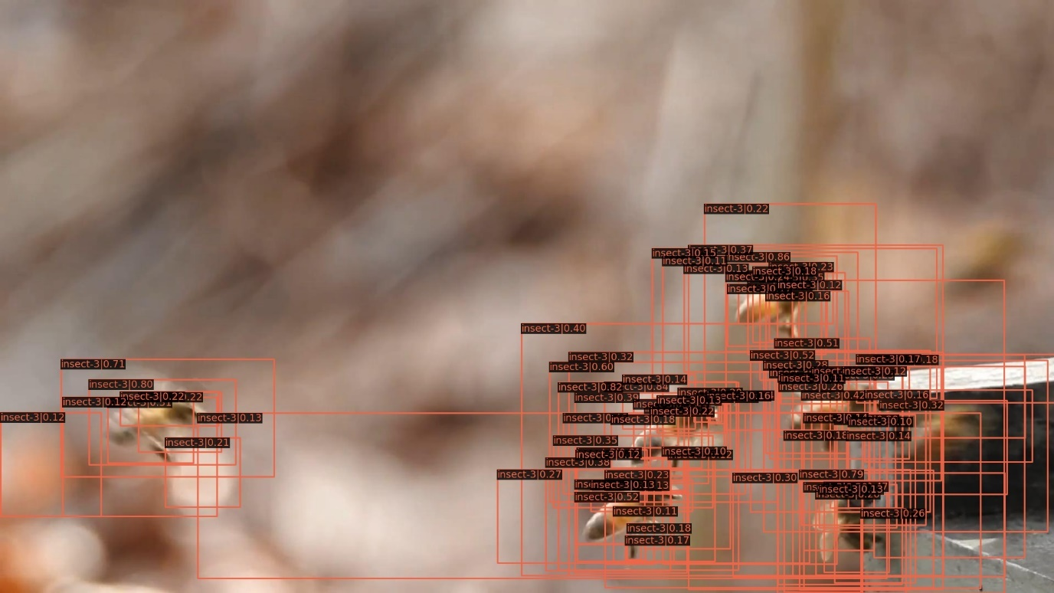
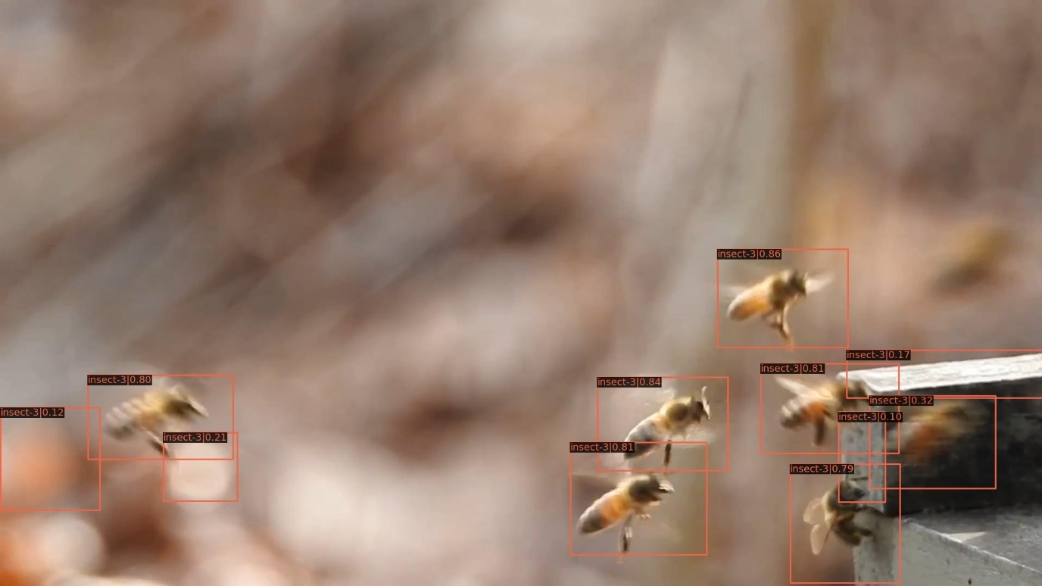
Visual Result
Result of instance NMS on frame-0 of trained faster-rcnn, threshold=0.1.
Traditional NMS
Instance NMS

Slide 9

Top Confidence
For instance NMS, there are also boxes with low confidence left, since they have low overlap with high confidence boxes. Another direct post processing way is to choose boxes with top 20% confidence.
Instance NMS result, where two wrong boxes
Are left(bottom-left corner), since they have low overlap with other boxes.

Slide 10
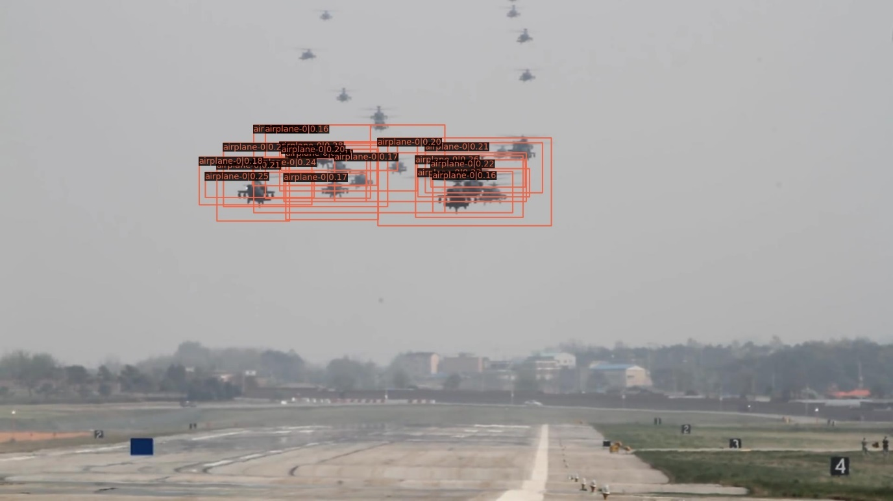
Visual Result
Result of top conf. on frame-0 of trained faster-rcnn, threshold=0.1.
Traditional NMS
Top conf,

Slide 11

Visual Result
Result of top conf. on frame-0 of trained faster-rcnn, threshold=0.1.
Traditional NMS
Top conf,
Note many true balles are removed due to
not high enough conf.

Slide 12
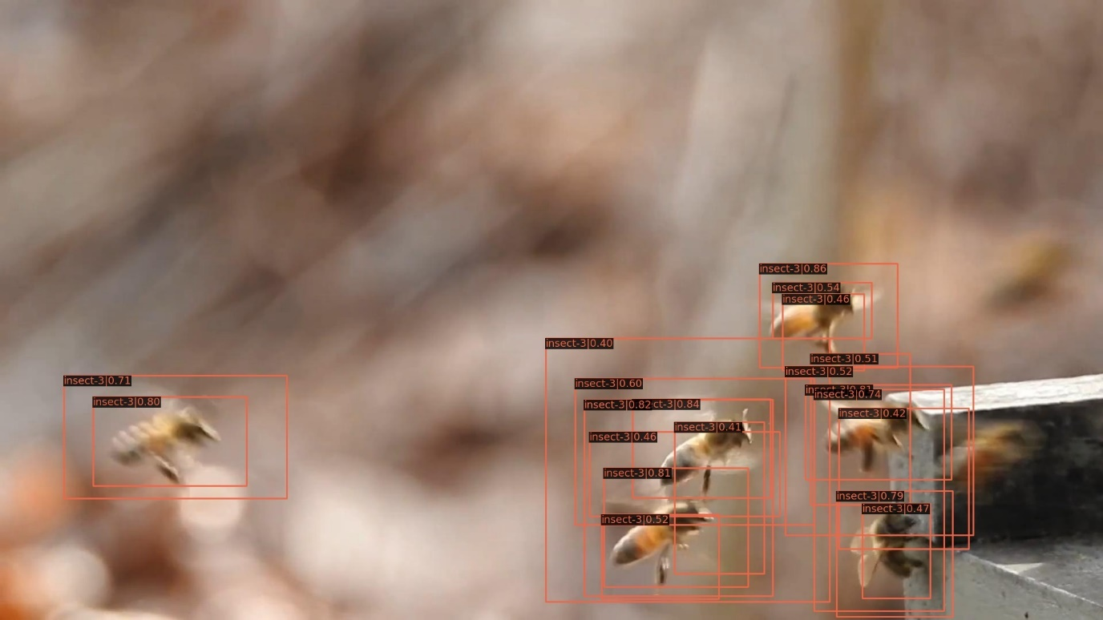
Visual Result
Result of top conf. on frame-0 of trained faster-rcnn, threshold=0.1. We can do instance NMS first, and then use top conf. way to refine more, especially with several frames together.
Traditional NMS
Top conf,
Still many duplicated boxes.

Slide 13
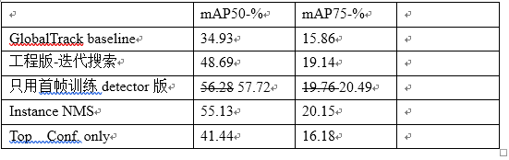
Quantitative Result
The quantitative results drop for both post processing method. But we only apply it on the sample choose stage, not the final stage.

Slide 14
Report End
程文胜 9.27

