Slide 1
Weekly Report
Wensheng Cheng
2021.10.12-10.19

Slide 2
Last discussion
Tried iterative updating detector mode
Tried on insect-3 only
Clip length=50
Always use coco pretrain model as initialization for each training process
Only uses instance nms in postprocess part

Slide 3
This week
Trained on all 40 sequences, training takes 40 RTX 6000 GPU hours and 200 GB disk(saved checkpoint in each clip, max 300GB useable on lab server)
Clip length=20
Use last trained model, instead of coco pretrain model as initialization in the iterative training process
Uses instance nms+rank k(samples with top #k confidence, not top m% tried earlier)+data association(Hungarian alg. with IoU as cost matrix) method together in the post process part.

Slide 4
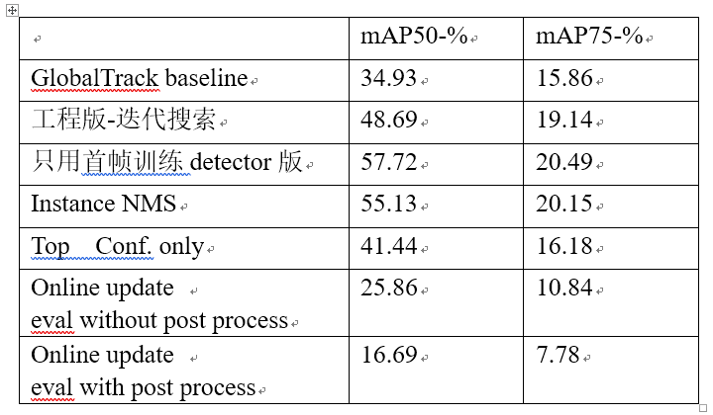
Table result
For online update mode, the performance drops a lot
3 post process methods used to filter training samples

Slide 5
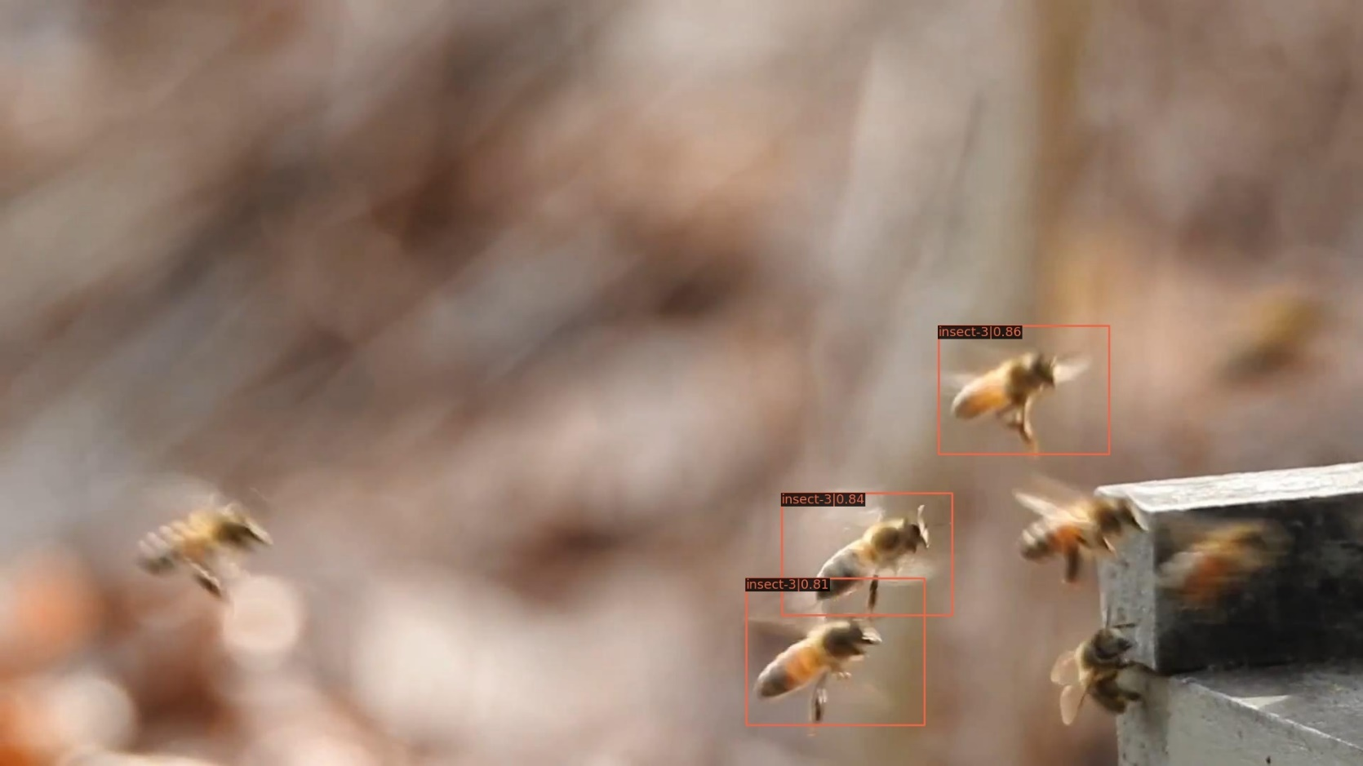
Vis result
Here shows results after post processing, used as training samples.
Insect-3, clip:0-img id in clip:0, filename:insect-3-0000.jpg

Slide 6
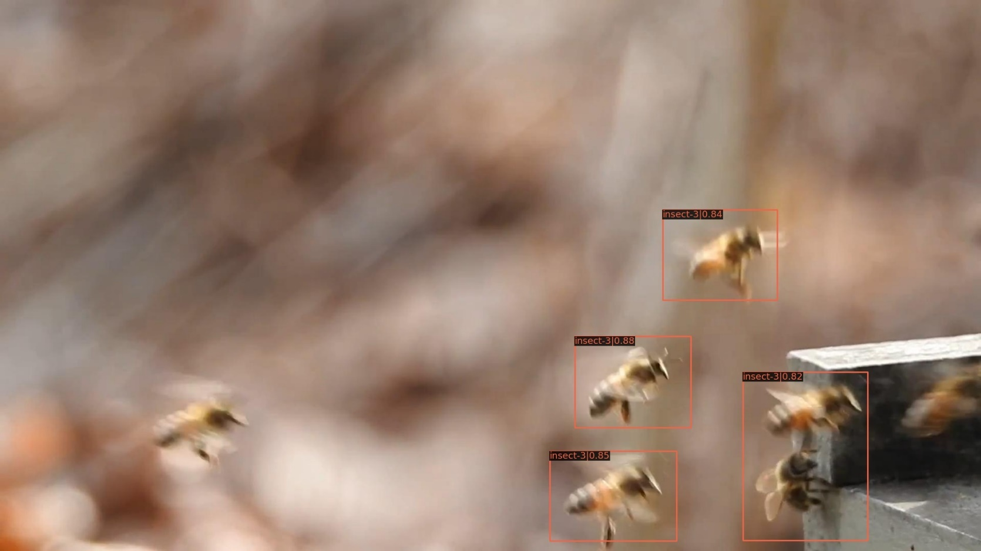
Vis result
Here shows results after post processing, used as training samples.
Insect-3, clip:0-img id in clip:1, filename:insect-3-0001.jpg

Slide 7
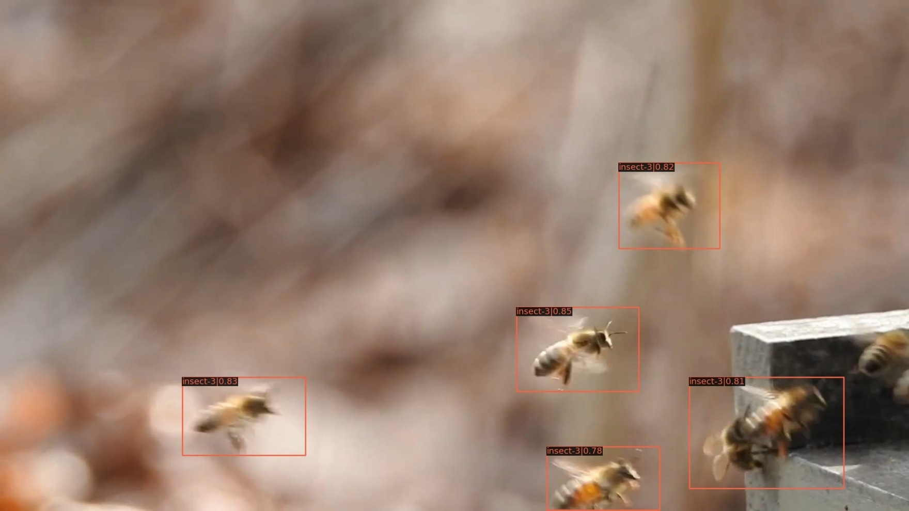
Vis result
Here shows results after post processing, used as training samples.
Insect-3, clip:0-img id in clip:2, filename:insect-3-0002.jpg

Slide 8
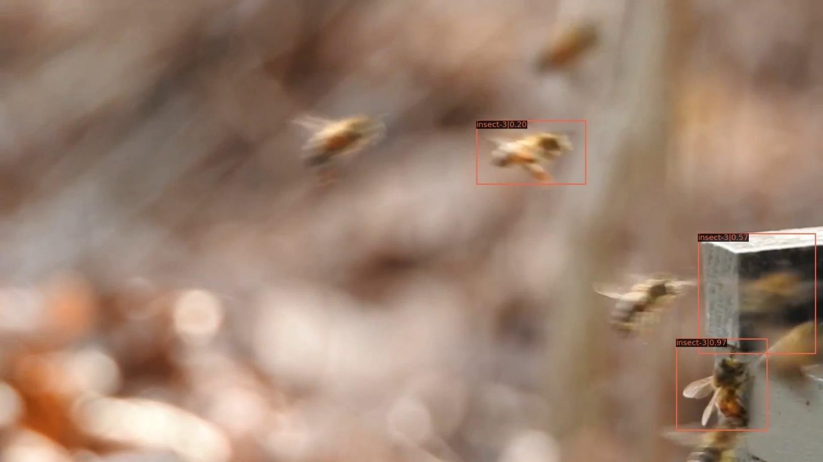
Vis result
Here shows results after post processing, used as training samples.
Insect-3, clip:3-img id in clip:7, filename:insect-3-0067.jpg

Slide 9
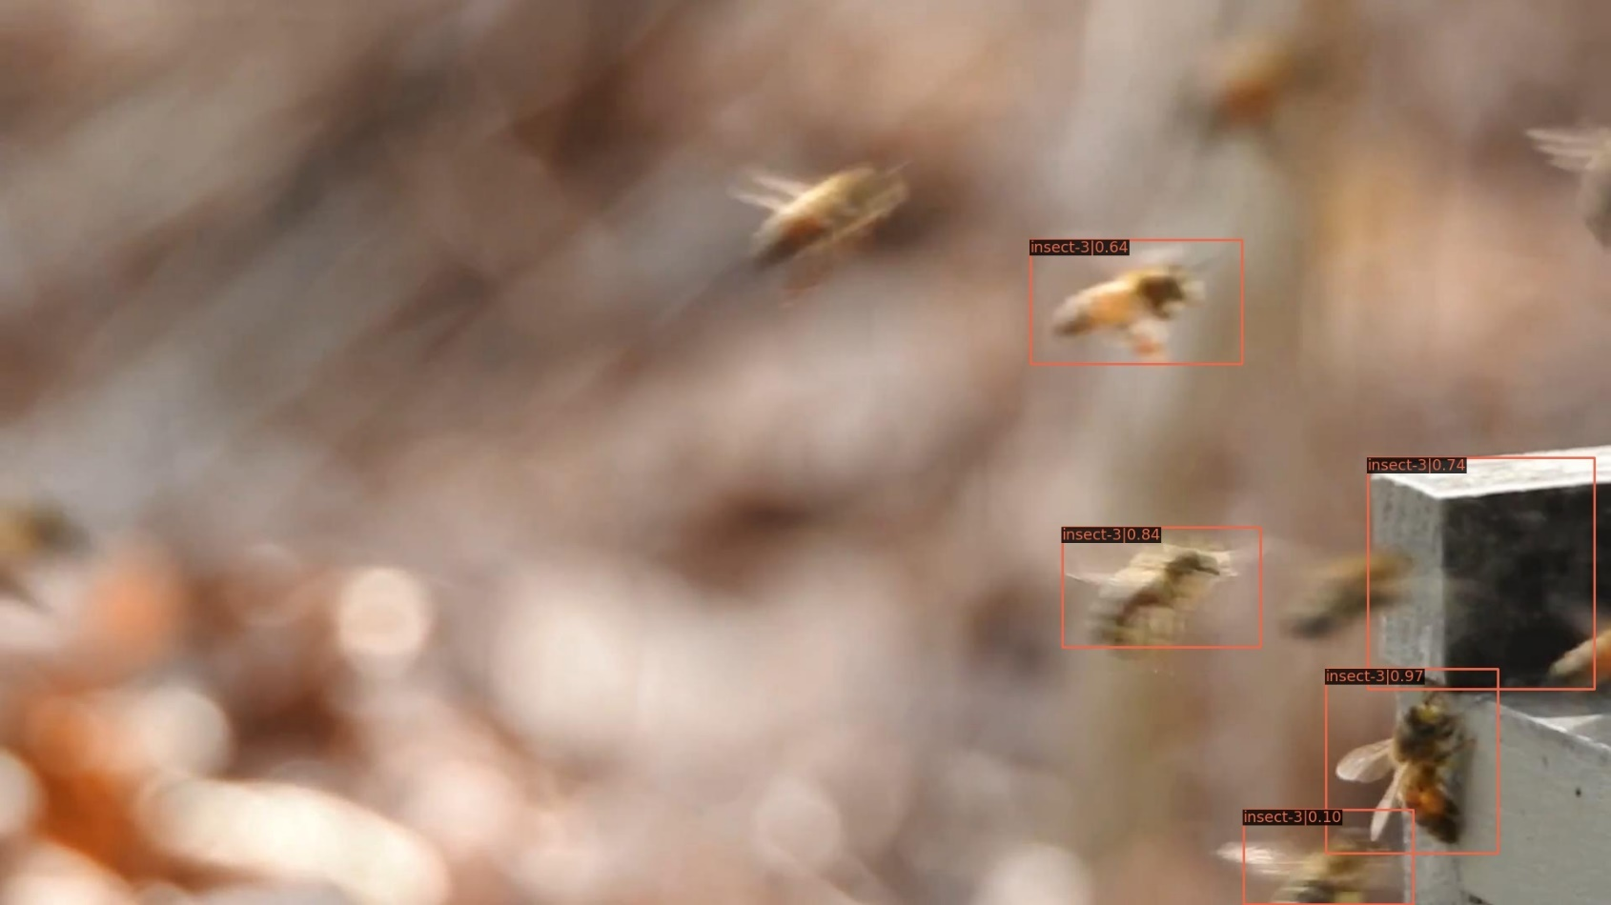
Vis result
Here shows results after post processing, used as training samples.
Insect-3, clip:3-img id in clip:8, filename:insect-3-0068.jpg

Slide 10
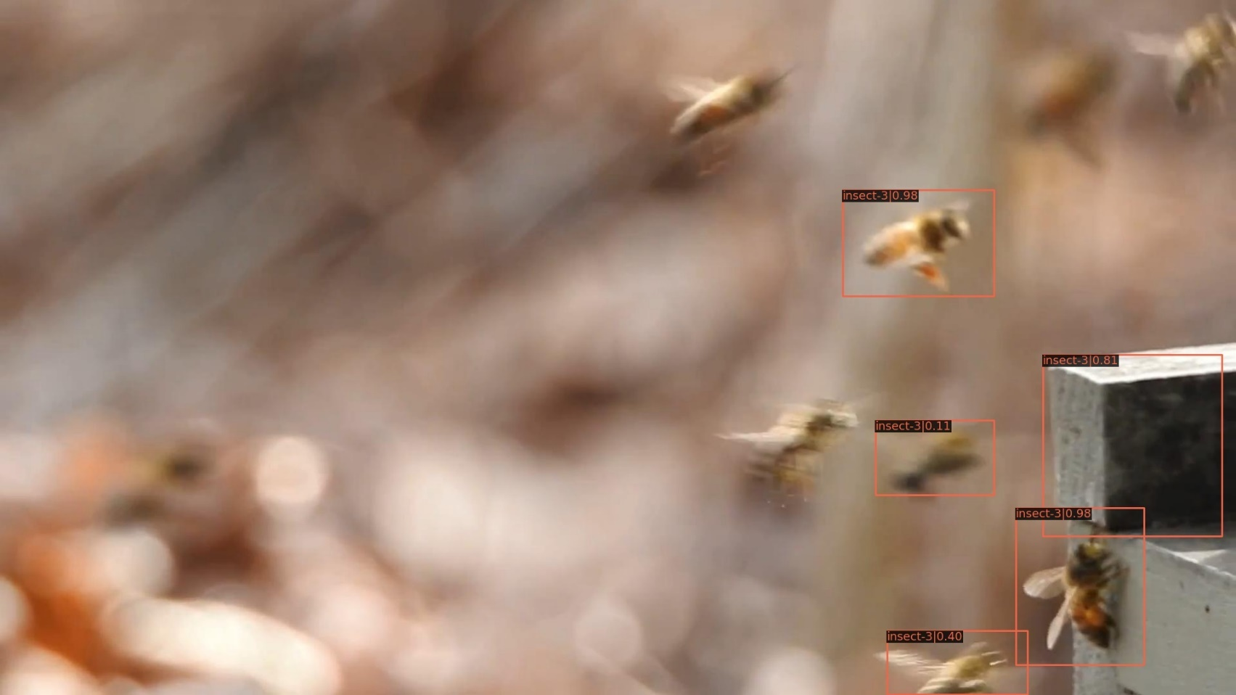
Vis result
Here shows results after post processing, used as training samples.
Insect-3, clip:3-img id in clip:9, filename:insect-3-0069.jpg

Slide 11
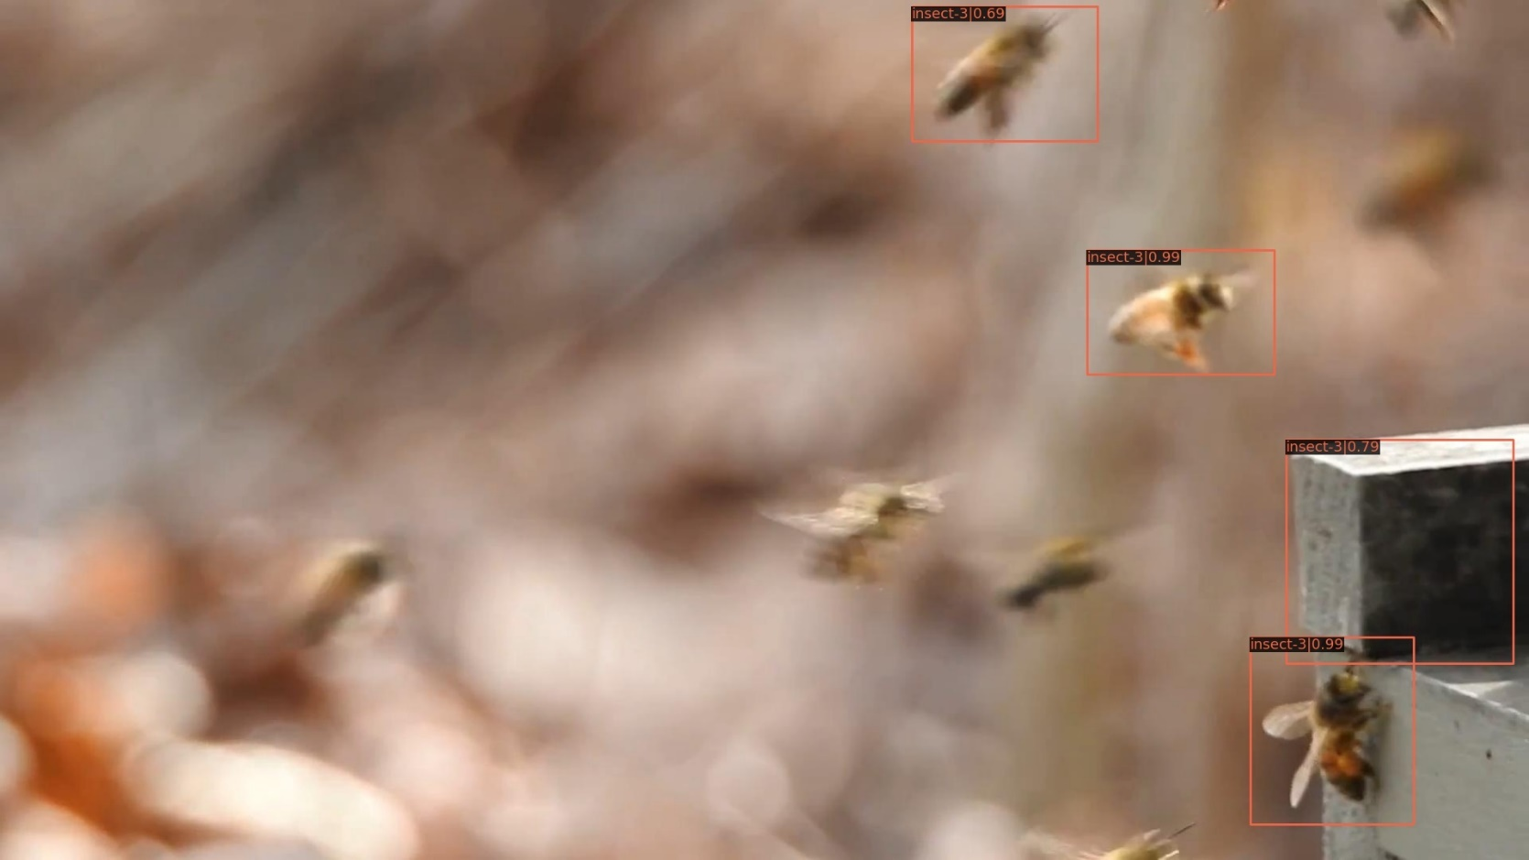
Vis result
Here shows results after post processing, used as training samples.
Insect-3, clip:3-img id in clip:10, filename:insect-3-0070.jpg

Slide 12
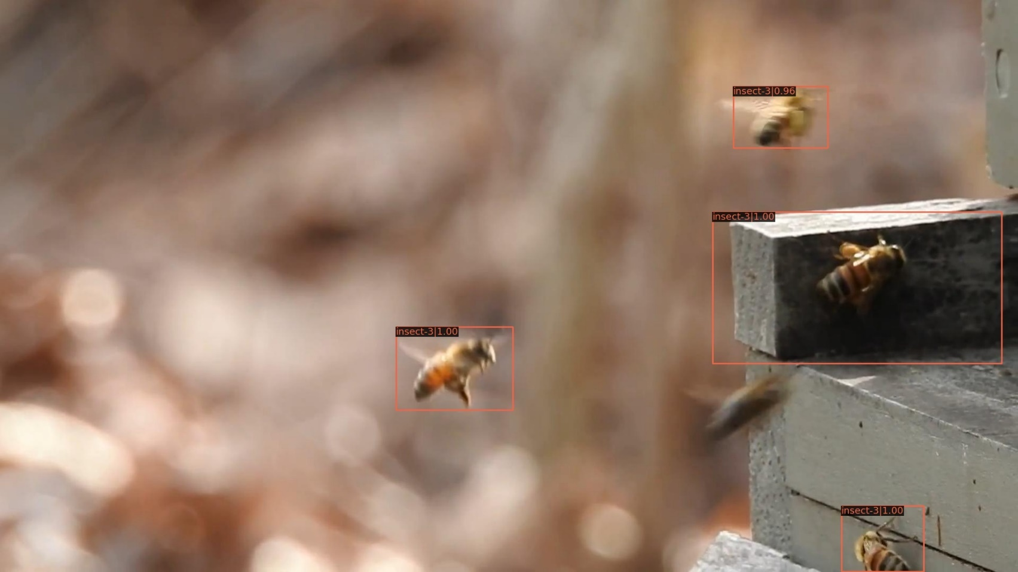
Vis result
Here shows results after post processing, used as training samples.
Insect-3, clip:12-img id in clip:0, filename:insect-3-0240.jpg

Slide 13
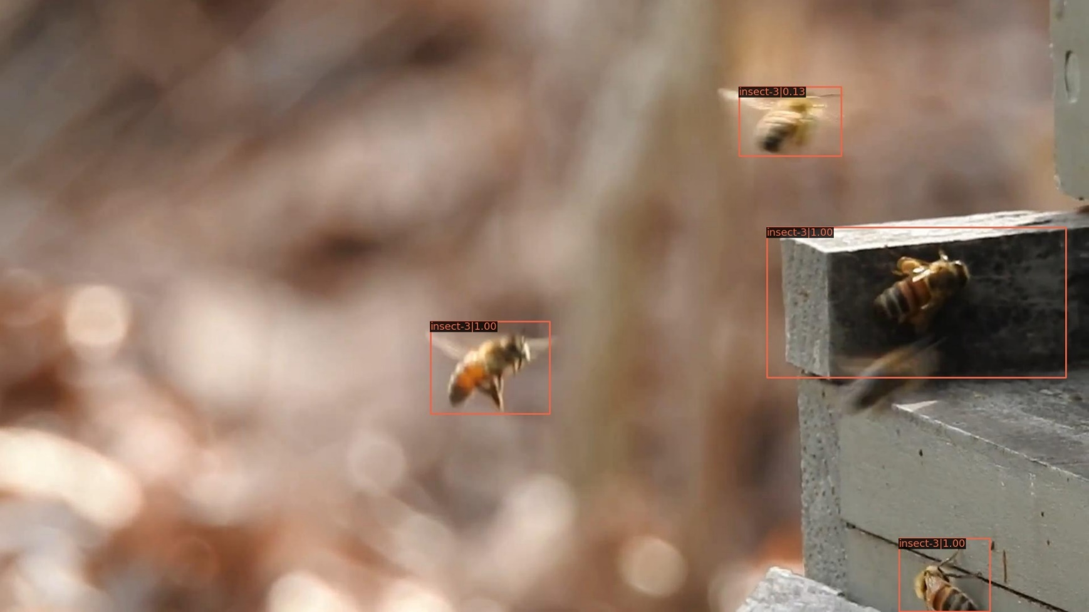
Vis result
Here shows results after post processing, used as training samples.
Insect-3, clip:12-img id in clip:1, filename:insect-3-0241.jpg

Slide 14
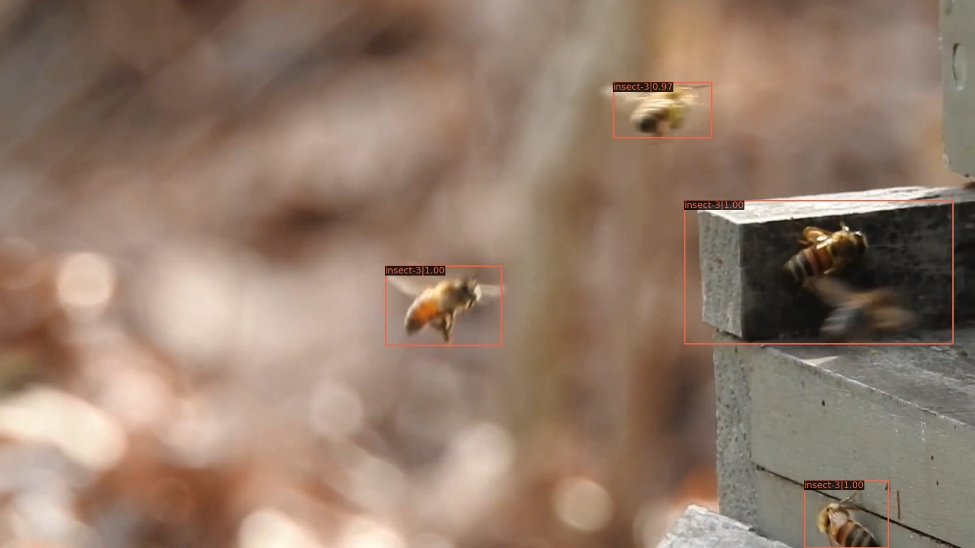
Vis result
Here shows results after post processing, used as training samples.
Insect-3, clip:12-img id in clip:2, filename:insect-3-0242.jpg

Slide 15
Validation during training
The validation AP goes down when training progresses
Insect-3, clip 0 result shown below
Insect-3, clip 1 result shown below
Insect-3, clip 4 result shown below
epoch | 1 | 5 | 10 | 15 | 20 | 24
AP50 | 0.75 | 0.702 | 0.692 | 0.649 | 0.65 | 0.649
epoch | 1 | 5 | 10 | 15 | 20 | 24
AP50 | 0.613 | 0.532 | 0.479 | 0.465 | 0.461 | 0.461
epoch | 1 | 5 | 10 | 15 | 20 | 24
AP50 | 0.666 | 0.615 | 0.577 | 0.582 | 0.582 | 0.583

Slide 16
End
End and Thanks!

