Slide 1
Weekly Report
Wensheng Cheng
2021.10.29-11.2

Slide 2
Last discussion
Semi-supervised object detection
Image classification with noisy label (few work about noisy label in object detection, maybe because the task on image classification is still hard now)
Lottery: one paper very close to our task, CVPR 15

Slide 3
This week
Search papers that cited the CVPR 15 paper
Looked through all papers citing it, and found two close related topics
Learning with sparse annotated dataset
Positive-Unlabeled (PU) learning

Slide 4
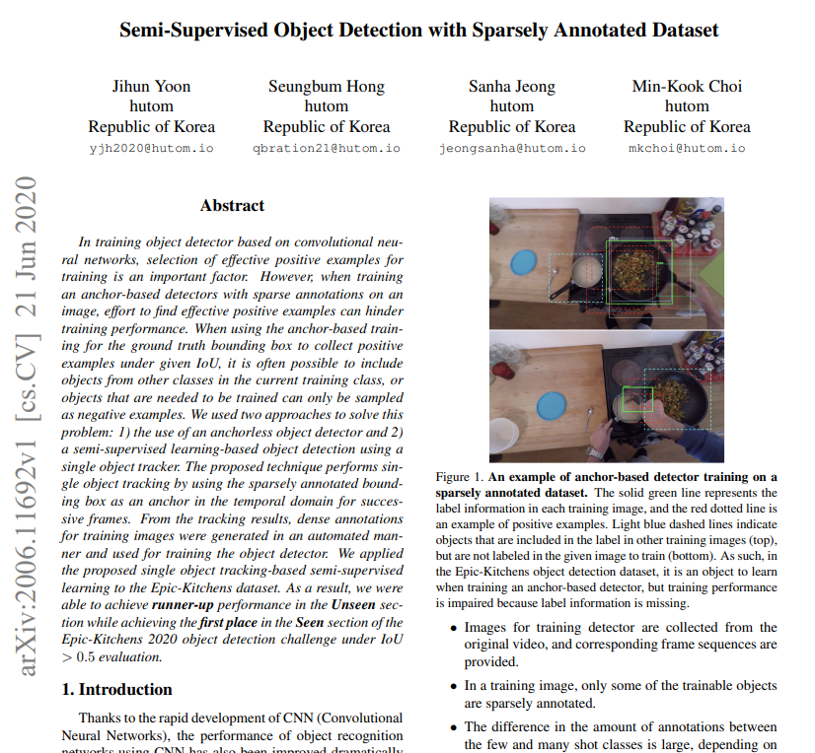
Learning with sparse labeled dataset
Semi-supervised Object Detection With Sparsely Annotated Dataset
ICIP 2021. https://arxiv.org/pdf/2006.11692.pdf

Slide 5
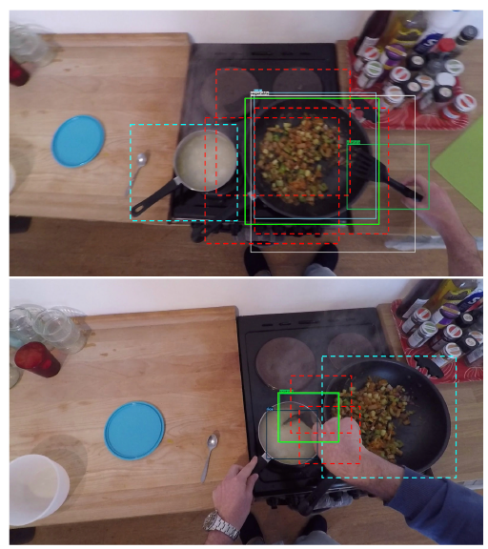
Learning with sparse labeled dataset
Example of anchor-based detector training on a sparsely annotated dataset.
The solid green line boxes: given ground-truth annotations
The red dotted line: positive examples based on IoU between anchors and a ground-truth box.
Light blue dashed line boxes indicate objects to learn but not annotated in all training images.
On the top image, a pot could be assigned as a negative example and also a fan on the bottom image.
ICIP 2021. https://arxiv.org/pdf/2006.11692.pdf

Slide 6
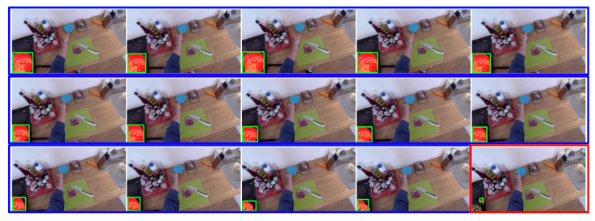
Learning with sparse labeled dataset
Frames marked with blue boxes are frames that have been tracked with the same object since tracking started, and a frame marked with a red box is a frame whose tracking is terminated.
Termination condition: box size difference between previous and current frames.
ICIP 2021. https://arxiv.org/pdf/2006.11692.pdf

Slide 7
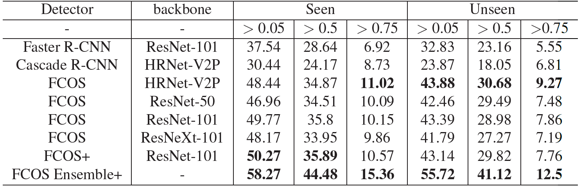
Learning with sparse labeled dataset
Performance comparison of anchor-based and anchor-less detectors. ‘+’ means it is the result of evaluation using tracker-based semi-supervised learning.
ICIP 2021. https://arxiv.org/pdf/2006.11692.pdf

Slide 8
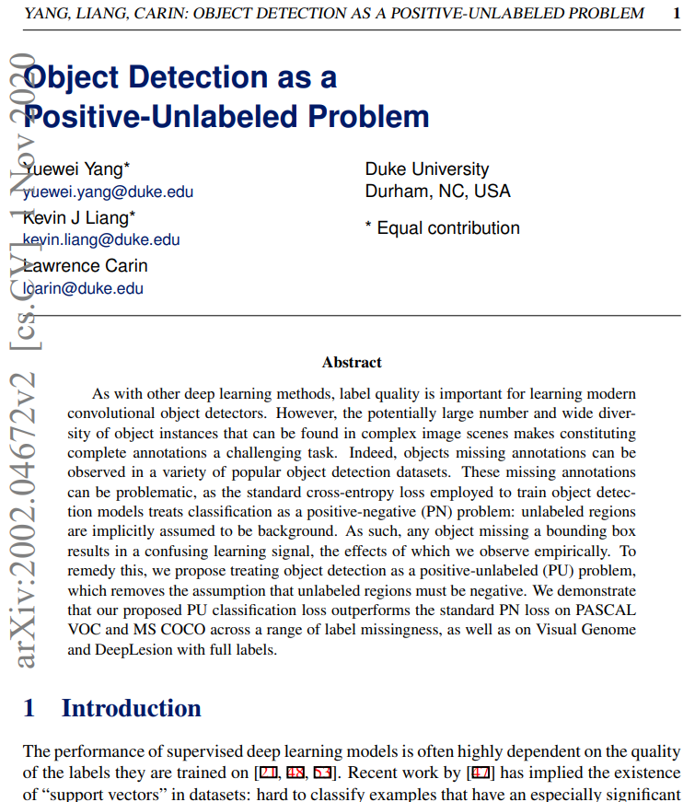
Object detection with PU learning
Object Detection as a Positive-Unlabeled Problem
BMVC 2020. https://arxiv.org/pdf/2002.04672.pdf

Slide 9
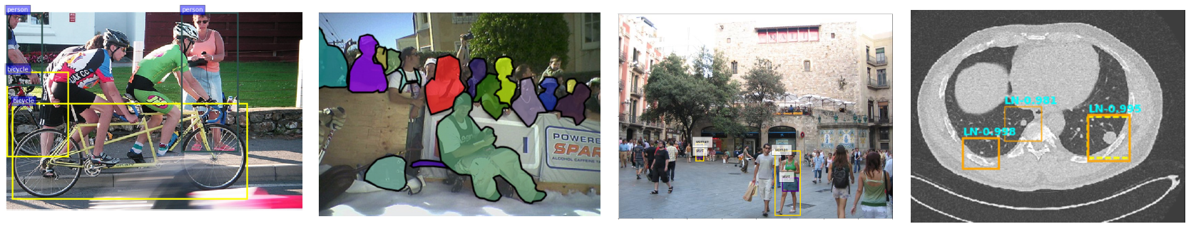
Object detection with PU learning
Incomplete labels: Example images and their ground truth labels shown for (left to right) PASCAL VOC (missing people, bottles), MS COCO (missing people), Visual Genome (missing people, tree, clothing, etc.), and DeepLesion (ground truth is the dotted line; two boxes on the left indicate two unlabeled nodules).
BMVC 2020. https://arxiv.org/pdf/2002.04672.pdf

Slide 10
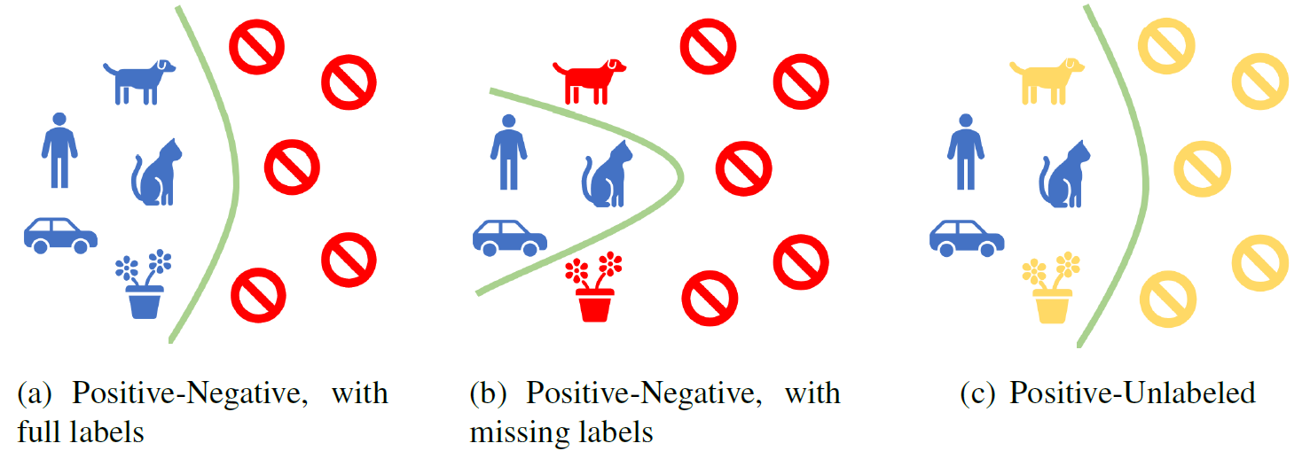
Object detection with PU learning
Positive-unlabeled (PU) approach considers non-labeled regions as unlabeled (yellow) rather than negative, allowing non-positive regions to be classified as positive.
BMVC 2020. https://arxiv.org/pdf/2002.04672.pdf

Slide 11



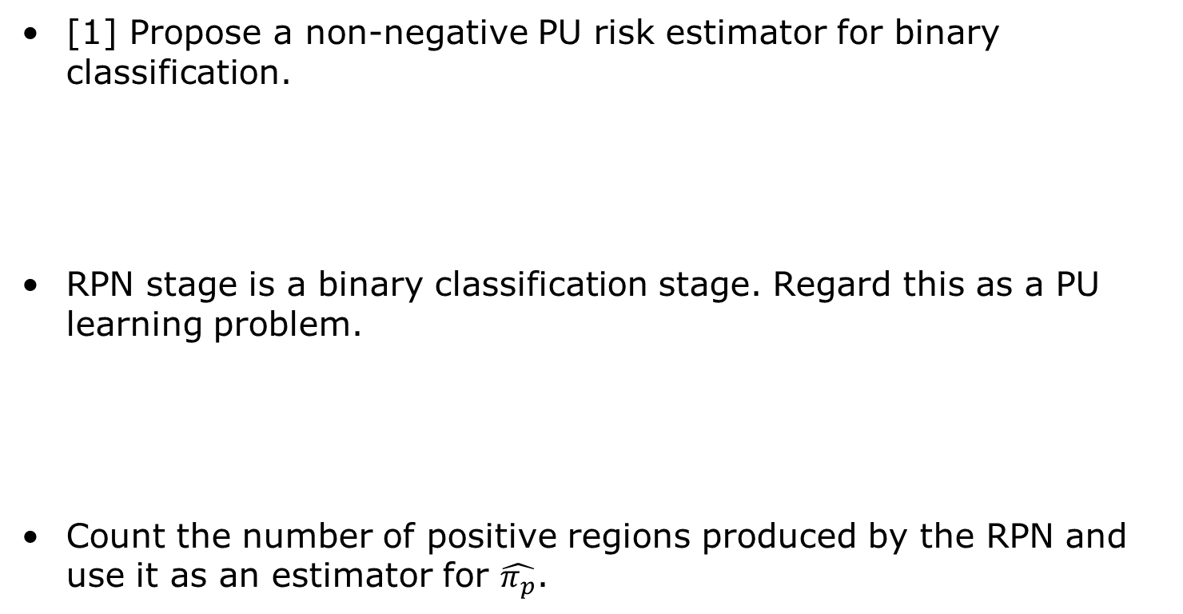
Object detection with PU learning
[1] Propose a non-negative PU risk estimator for binary classification.
RPN stage is a binary classification stage. Regard this as a PU learning problem.
Count the number of positive regions produced by the RPN and use it as an estimator for $\hat{π_{p}}$.
[1] NIPS 2017. Positive-Unlabeled Learning with Non-Negative Risk Estimator.

Slide 12
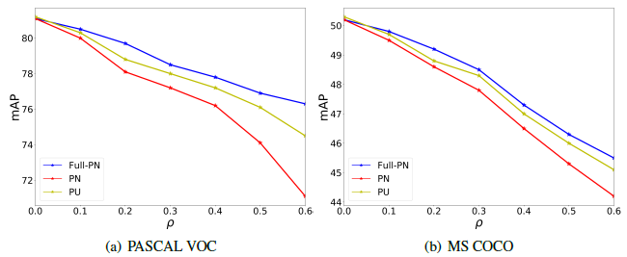
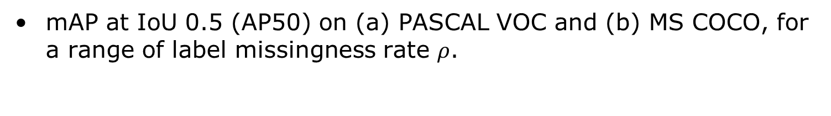
Object detection with PU learning
mAP at IoU 0.5 (AP50) on (a) PASCAL VOC and (b) MS COCO, for a range of label missingness rate $ρ$.
BMVC 2020. https://arxiv.org/pdf/2002.04672.pdf

Slide 13
End
End and Thanks!

