Slide 1
Weekly Report
Wensheng Cheng
2021.11.2-11.18

Slide 2
Last discussion
Talked about papers that cited the CVPR 15 paper
Learning with sparse annotated dataset
Positive-Unlabeled (PU) learning

Slide 3
This week
Adjusted problem definition
(easy?)Thoughts about possible ways to deal with the problem
Iterative search
Sample selection

Slide 4
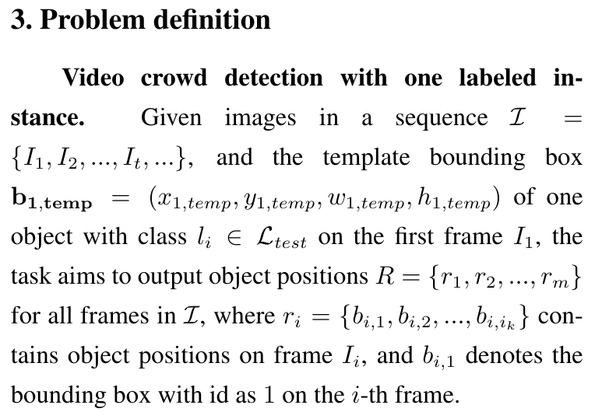
Problem definition

Slide 5
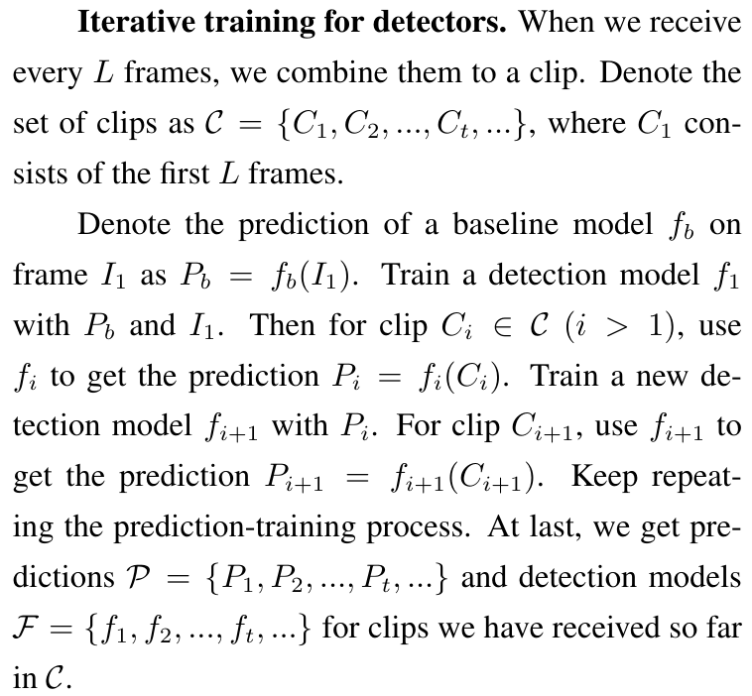
Problem definition

Slide 6
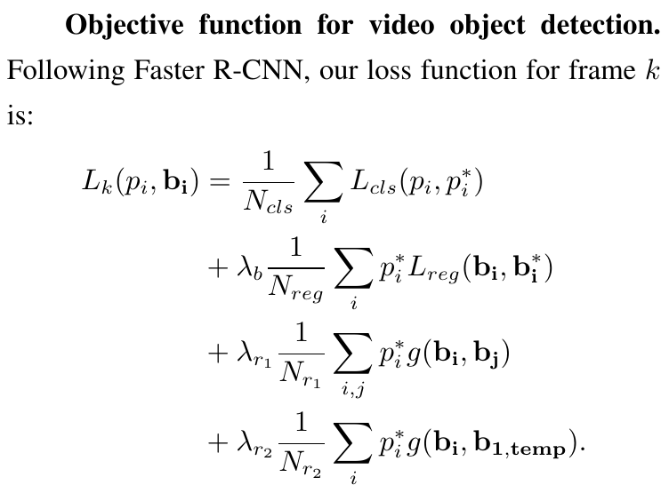
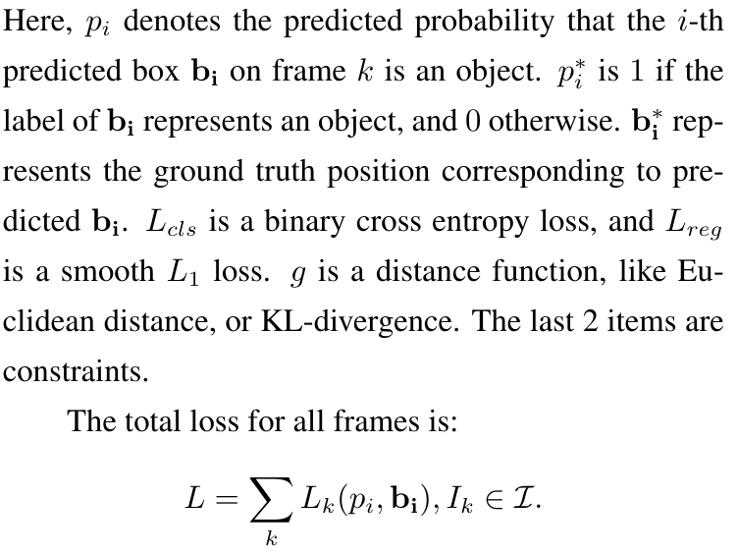
Problem definition

Slide 7
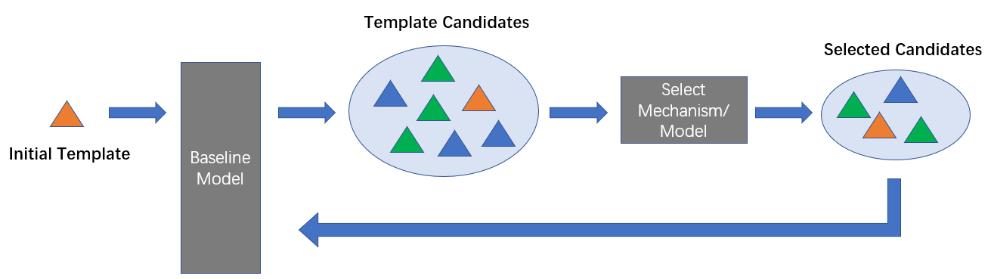
Iterative search with sample selection
First use a baseline model to output candidates on one frame. Then with some select mechanism/model to select a smaller set of candidates as the template bank. When searching on following frames, this template bank is feed to the baseline model. Each sample in the template bank would serve as a template input for the baseline model. Final searching results consist of results we get every time we call the baseline model.

Slide 8
End
End and Thanks!

