Slide 1
Weekly Report
Wensheng Cheng
2021.12.6-12.13

Slide 2
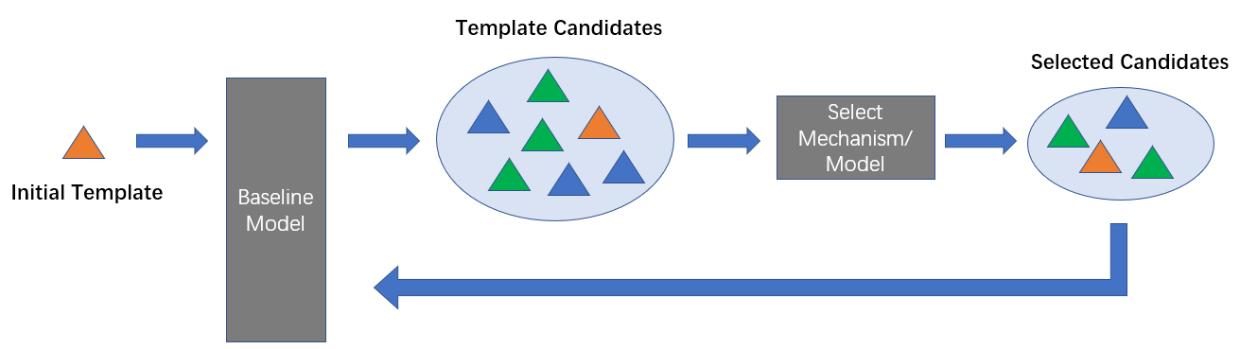
Last discussion
Adjusted problem definition
Thoughts about possible ways to deal with the problem
Iterative search
Sample selection

Slide 3
This week
Possible ways to deal with sample selection
The goal is to get most representative samples
Clustering
Reinforcement learning

Slide 4
Clustering
One natural way to find most representative samples is to do clustering. After clustering, we can take the samples closest to the cluster center as the samples we want.
But classic clustering algorithms are mature and there’s no novelty by directly using them. Neural networks should be incorporated.

Slide 5
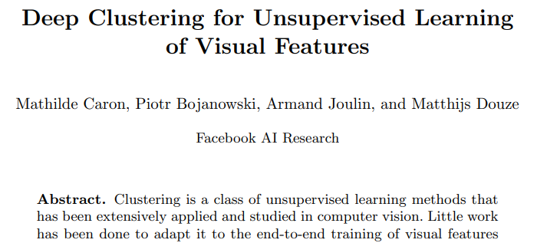
Deep clustering
Some works try to combine neural network with classic clustering methods. They model it as an unsupervised learning problem. Clustering methods are used to get pseudo labels, based on features generated by neural networks.
I think they are not real classic methods. The performance would be limited to the performance of classic clustering methods.
ECCV 2018. https://arxiv.org/pdf/1807.05520v2.pdf

Slide 6
Reinforcement learning
Since this can also be taken as a decision problem, reinforcement learning may apply. It’s based on reward function to generate the loss and update the network parameters.
But most methods are based on existing labels to generate rewards. The point for our task is to design a reward function without existing labels.

Slide 7
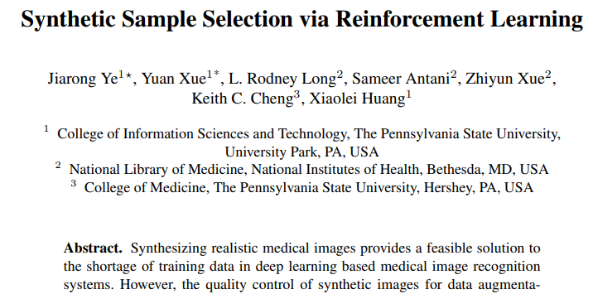
Reinforcement learning
This work proposes a reinforcement learning (RL) based synthetic sample selection method that learns to choose synthetic images containing reliable and informative features. A transformer based controller is trained via proximal policy optimization (PPO) using the validation classification accuracy as the reward. The selected images are mixed with the original training data for improved training of image recognition systems.
MICCAI 2020. https://arxiv.org/pdf/2008.11331.pdf

Slide 8
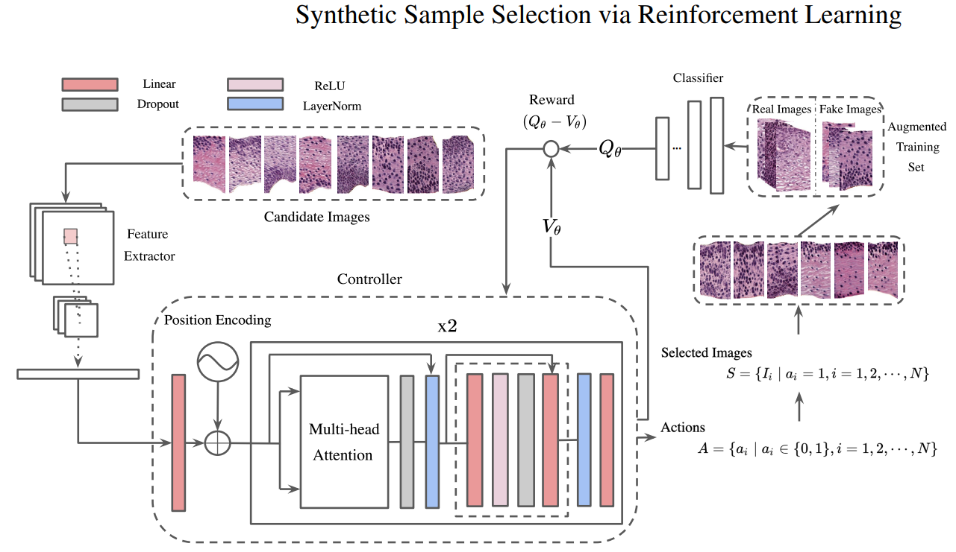
Reinforcement learning
MICCAI 2020. https://arxiv.org/pdf/2008.11331.pdf

Slide 9
End
End and Thanks!

