Slide 1
Weekly Report
Wensheng Cheng
2021.12.12-12.19

Slide 2
Last discussion
Clustering methods
RL methods
Try to use tracklet similarity to remove false positives

Slide 3
This week
Use tracklet similarity to remove false positives
Clip length=20
Trained, tested, evaluated on insect-3 seq

Slide 4
Tracklet similarity
Take Euclidean distance as the metric, each bbox feature is a 1024d vector.
Reference tracklet is the one with highest average confidence score. I didn’t use the template one, since it may disappear in following frames.
Take the max one as the distance between one tracklet and the reference tracklet.
Remove the one that is much larger(1.5x) than the min distance between all tracklets and the reference tracklet.

Slide 5
Table result
The mAP decreases for insect-3 seq. The evaluation results are both based on results without post process.
Insect-3-seq | mAP50-% | mAP75-%
Online update eval without post process | 39.9 | 13.5
With-set semilarity | 24.3 | 7.2

Slide 6
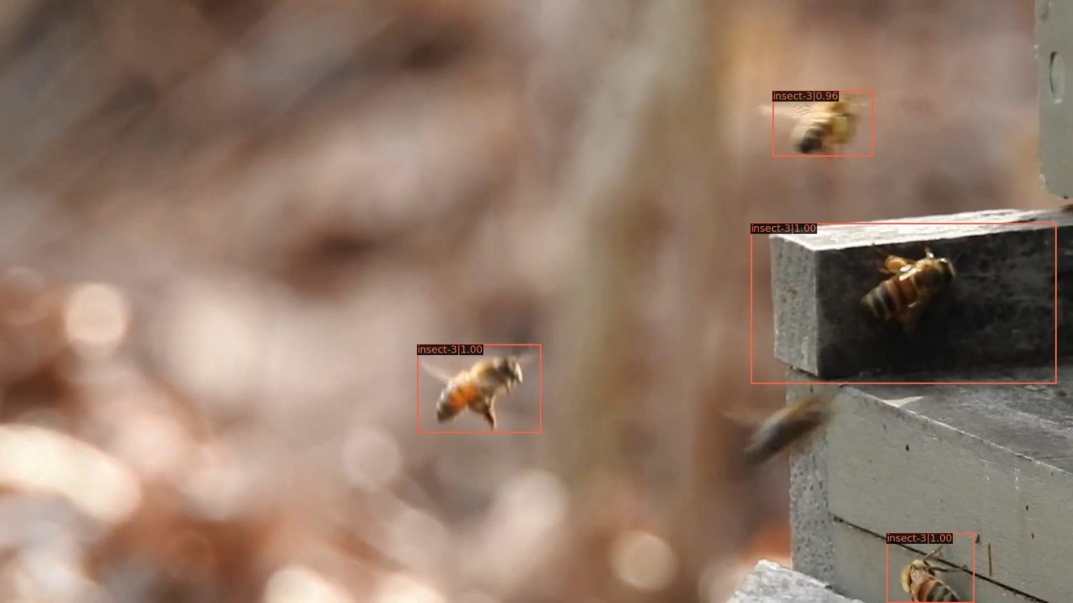
Vis result-without set similarity
Here shows results after post processing, used as training samples.
Insect-3, clip:12-img id in clip:0, filename:insect-3-0240.jpg

Slide 7
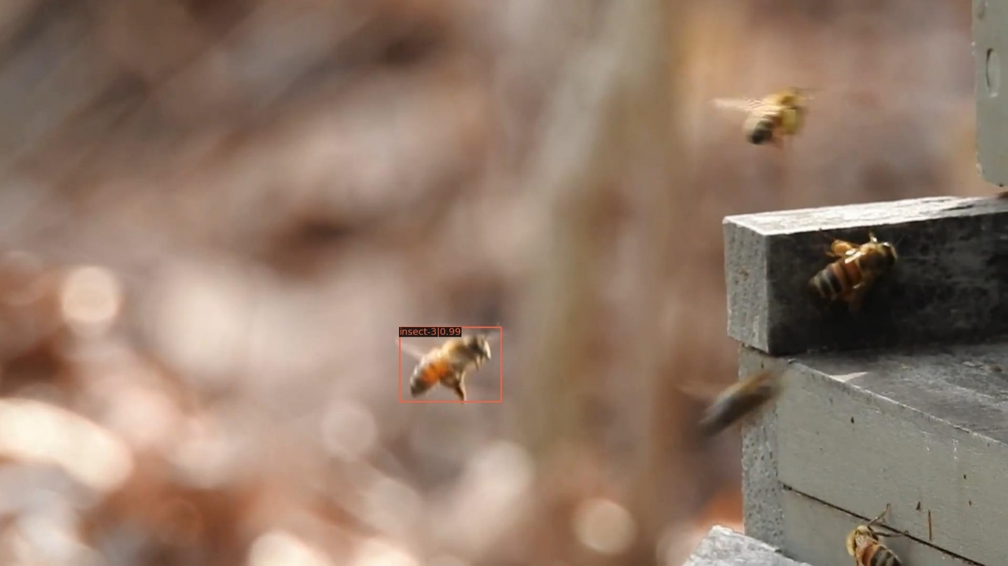
Vis result-with set similarity
Here shows results after post processing, used as training samples.
Insect-3, clip:12-img id in clip:0, filename:insect-3-0240.jpg

Slide 8
End
End and Thanks!

