Slide 1
Weekly Report
Wensheng Cheng
2021.12.19-12.28

Slide 2
Last discussion
Use tracklet similarity to remove false positives
Clip length=20
Base model is the updating detector
Trained, tested, evaluated on insect-3 seq

Slide 3
This week
Use tracklet similarity to remove false positives
No updating detector
Test various parameters on all 40 seqs.

Slide 4
Tracklet similarity
Take Euclidean distance as the metric, each bbox feature is a 1024d vector.
Reference tracklet is the one with highest average confidence score. Could be changed to the tracklet of the template one.
Take the max/min/average one as the distance between one tracklet and the reference tracklet.
Remove the one that is much larger(1.5x, tunable parameter) than the min distance between all tracklets and the reference tracklet.

Slide 5
Table result
I tried several parameters for tracklet similarity method on 40 seqs. No other post processing methods(instance NMS, top conf, rank) performed.
Distance type(distance factor=1.5) | mAP50-% | mAP75-%
No use tracklet similarity | 57.76 | 20.51
Max | 34.24 | 12.56
Min | 13.67 | 7.19
Average | 27.11 | 11.43

Slide 6
Table result
Distance factor(distance type=max) | mAP50-% | mAP75-%
1.3 | 17.97 | 7.00
1.5 | 34.24 | 12.56
1.7 | 42.69 | 15.48
1.9 | 46.73 | 16.90
2.1 | 48.45 | 17.54
2.5 | 50.91 | 18.58
3.0 | 53.40 | 19.48
5.0 | 55.56 | 20.16
7.0 | 55.58 | 20.17
10.0 | 55.58 | 20.17
20.0 | 55.58 | 20.17

Slide 7
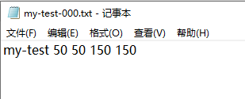
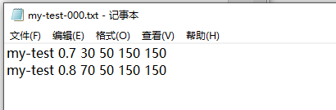
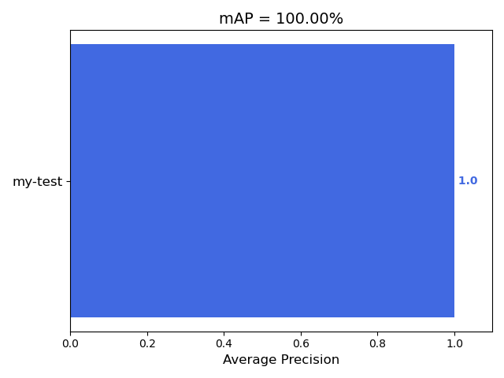
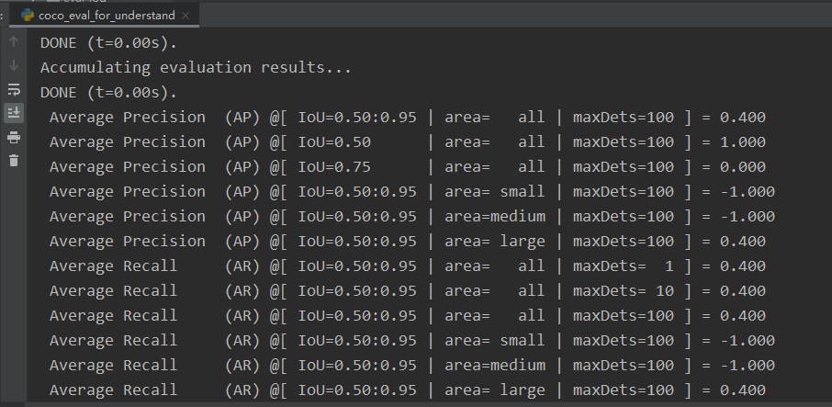
Metric mAP
If 2 boxes have high IoU with a gt box, the mAP is the same with the situation that 1 box has high IoU with the gt box. Tested on both COCO official API and PASCAL VOC API.
Lable
Pred
mAP50 by VOC API
mAP by COCO API

Slide 8
Questions for next week
Why mAP of instance NMS drops?
Would instance NMS play better on MOT metric?

Slide 9
End
End and Thanks!

