Slide 1
Weekly Report
Wensheng Cheng
2021.12.29-2022.1.3

Slide 2
Last discussion
Use tracklet similarity to remove false positives
No updating detector
Test various parameters on all 40 seqs.

Slide 3
This week
Experiment on why instance NMS performs bad on AP
Comparison between MOT metric and AP metric
Check semi-supervised object detection paper

Slide 4
Detection Metric AP
Original AP evaluation toolkit only shows AP50, AP75, and the average of AP over 50 to 95. To know more details, I changed it to show AP80, AP85, AP90, AP95 separately.
Verified Fan Yang’s hypothesis: AP90 could be better with our instance NMS method.
 | No post process | Instance NMS th=0.5
AP50-95 | 26.4896 | 25.1822
AP50 | 57.7740 | 55.1593
AP75 | 20.5172 | 20.1691
AP80 | 11.5138 | 11.4044
AP85 | 3.9782 | 3.9781
AP90 | 0.6153 | 0.6194
AP95 | 0.04023180 | 0.04023103

Slide 5
MOT Metric
I also computed the MOT metrics to see whether it can show the positive effect of our instance NMS method. The result shows it can.
Metrics mainly include MOTA, MOTP(lower is better, opposite with MOT17 website), IDs(switch, low), IDF1, IDP(precision), IDR(recall), Rcll(Recall), Pron(Precision), FP(low), FN(low).

Slide 6
MOT Metric
 | No post process | Instance NMS th=0.5
MOTA | -136.1% | 20.8%
MOTP low | 0.274 | 0.260
IDs low | 18374 | 5789
IDF1 | 15.3% | 37.8%
IDP | 10.6% | 41.0%
IDR | 27.6% | 35.0%
Rcll | 65.6% | 54.2%
Pron | 25.2% | 63.5%
FP low | 498598 | 79951
FN low | 88203 | 117305

Slide 7
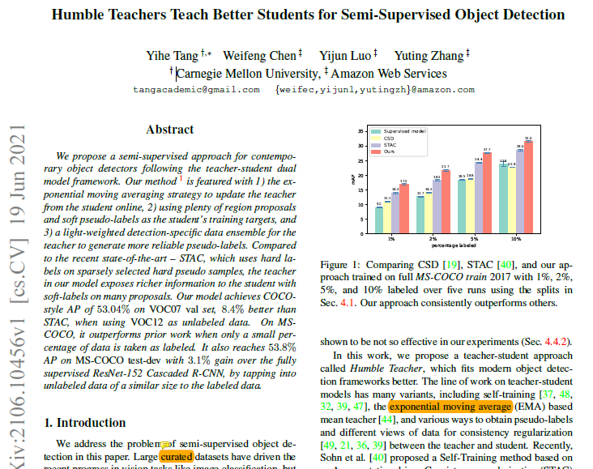
Semi-supervised Object Detection
Humble Teachers Teach Better Students for Semi-Supervised Object Detection
CVPR 2021. https://arxiv.org/abs/2106.10456

Slide 8
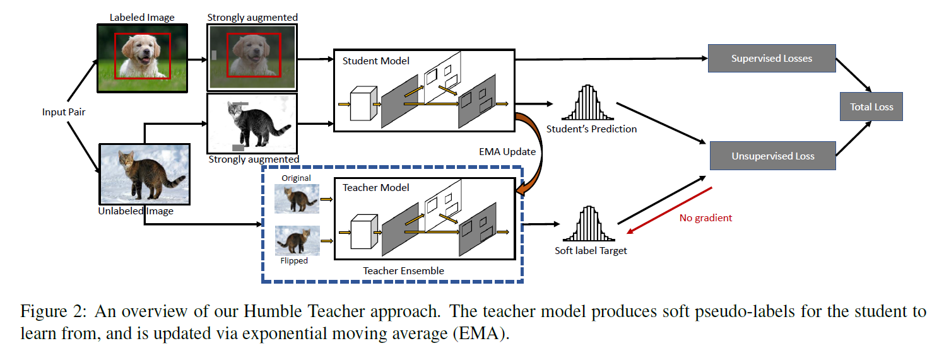
Semi-supervised Object Detection
It gives a framework for the semi-supervised object detection problem. It uses exponential moving average(EMA) and soft pseudo labels techniques. It gets better result than STAC(paper: A Simple Semi-Supervised Learning Framework for Object Detection).
CVPR 2021. https://arxiv.org/abs/2106.10456

Slide 9


Semi-supervised Object Detection
Soft pseudo labels: the unsupervised RPN loss and ROI loss are shown below. It didn’t use thresholding to get definite pseudo ground truth, but used classification probabilities and regression offsets as the training targets.
The teacher model weights are updated from the student model weights by EMA.
CVPR 2021. https://arxiv.org/abs/2106.10456

Slide 10
End
End and Thanks!

