Slide 1
Weekly Report
Wensheng Cheng
2022.1.3-1.11

Slide 2
Last discussion
Experiment on why instance NMS performs bad on AP
Comparison between MOT metric and AP metric
Check semi-supervised object detection paper

Slide 3
This week
Experiment on combination of detector and GlobalTrack search
Test various parameters of the post process method to filter outputs
Task and method formulation

Slide 4
Method: Detect and Search
For the detection results generated by the detector, we first filter the results by many post processing methods, then take the results as the template bank input for the GlobalTrack baseline.
We take the merged outputs of GlobalTrack as the detection results. I tested confidence thresholding method to filter the detector results(already processed by instance NMS), and get the AP and MOT metric.

Slide 5
Method: Detect and Search
 | AP50 | AP75
rank=5 | 46.86 | 16.93
rank=10 | 50.07 | 17.75
rank=20 | 48.76 | 15.91
rank=30 | 47.81 | 15.07
rank=40 | 48.33 | 14.87
rank=50 | 48.64 | 14.81
rank=60 | 48.67 | 14.74
rank=70 | 48.63 | 14.68
rank=80 | 48.61 | 14.67
rank=90 | 48.61 | 14.67
rank=100 | 48.61 | 14.67
no rank | 48.61 | 14.67
Instance NMS th=0.5 | 55.15 | 20.16
Combine rank=10 and Instance NMS th=0.5 | 57.08 | 19.14

Slide 6
Method: Detect and Search
 | No post process | Instance NMS th=0.5-A | no rank | rank=5 | rank=10-B | rank=20 | rank=30 | Combine A and B
MOTA | -136.1% | 20.8% | -19.3% | 20.3% | 13.2% | -7.3% | -18.7% | 12.0%
MOTP low | 0.274 | 0.260 | 0.266 | 0.260 | 0.263 | 0.265 | 0.265 | 0.265
IDs low | 18374 | 5789 | 11426 | 6956 | 8534 | 10358 | 10896 | 9654
IDF1 | 15.3% | 37.8% | 27.9% | 29.5% | 29.3% | 26.8% | 26.1% | 33.2%
IDP | 10.6% | 41.0% | 23.9% | 38.3% | 32.4% | 25.3% | 23.1% | 32.5%
IDR | 27.6% | 35.0% | 33.7% | 23.9% | 26.8% | 28.4% | 30.0% | 33.9%
Rcll | 65.6% | 54.2% | 63.1% | 42.8% | 49.6% | 54.5% | 57.6% | 60.0%
Pron | 25.2% | 63.5% | 44.7% | 68.4% | 60.0% | 48.5% | 44.4% | 57.5%
FP low | 498598 | 79951 | 199783 | 50673 | 84752 | 148282 | 184858 | 113530
FN low | 88203 | 117305 | 94696 | 146574 | 129243 | 116529 | 108648 | 102494

Slide 7
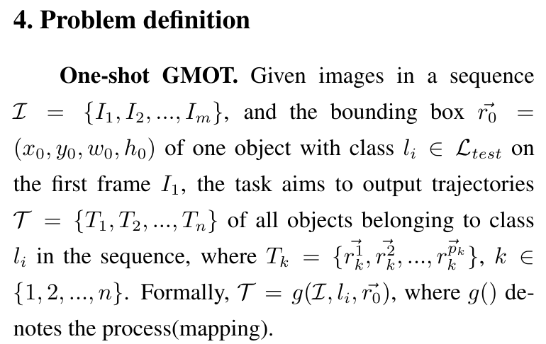
Problem Definition

Slide 8
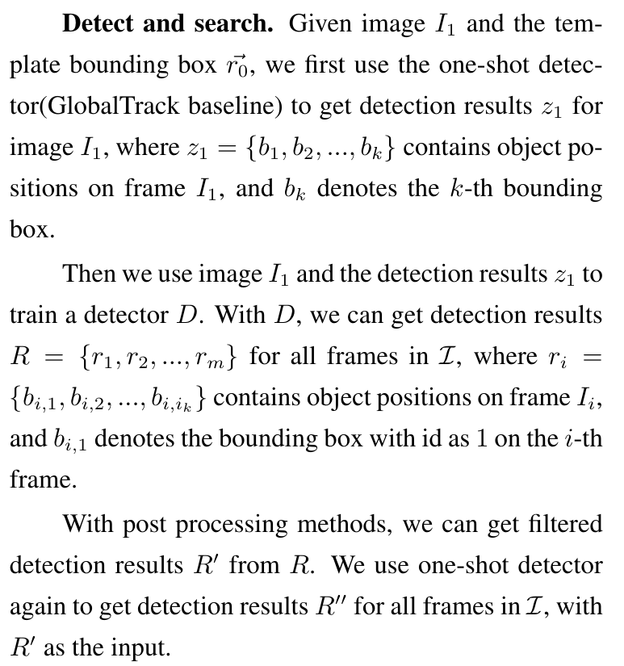
Method Definition

Slide 9
End
End and Thanks!

