Slide 1
Weekly Report
Wensheng Cheng
2022.1.11-1.18

Slide 2
Last discussion
Experiment on combination of detector and GlobalTrack search
Test various parameters of the post process method to filter outputs
Task and method formulation

Slide 3
This week
Train an oracle detector with the ground truth label on the 1st image of each sequence
Run SOTA data association methods on our task
Concerns

Slide 4
Ground Truth Detector
Instead of using baseline detection results, we directly use the ground truth labels on the 1st image of each sequence to train a detector for each sequence.
Use GT | AP | AP50 | AP75
No post process | 38.28 | 77.50 | 32.57
inst_th_05_op_2 | 36.28 | 73.52 | 31.70
Use baseline | AP | AP50 | AP75
No post process | 26.4896 | 57.7740 | 20.5172
inst_th_05_op_2 | 25.1822 | 55.1593 | 20.1691

Slide 5
Ground Truth Detector
We then combine the detection results of the ground truth detector and a simple IoU based data association method to get tracklets.
 | No post process | Instance NMS th=0.5 | No post process-gt | Instance NMS th=0.5-gt
MOTA | -136.1% | 20.8% | -152.3% | 37.7%
MOTP low | 0.274 | 0.260 | 0.255 | 0.242
IDs low | 18374 | 5789 | 21173 | 6298
IDF1 | 15.3% | 37.8% | 17.8% | 49.2%
IDP | 10.6% | 41.0% | 11.7% | 47.3%
IDR | 27.6% | 35.0% | 36.9% | 51.1%
Rcll | 65.6% | 54.2% | 85.5% | 74.1%
Pron | 25.2% | 63.5% | 27.1% | 68.6%
FP low | 498598 | 79951 | 588367 | 87128
FN low | 88203 | 117305 | 37279 | 66353

Slide 6
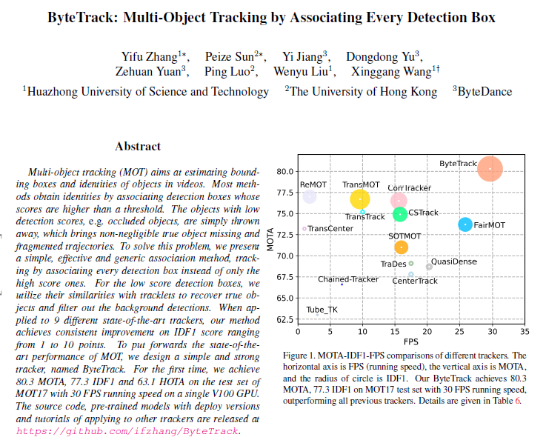
SOTA Data Association Method
I tested a new SOTA data association method, BYTETracker, on our dataset, with parameters changed.
https://arxiv.org/abs/2106.10456

Slide 7
SOTA Data Association Method
 | Instance NMS th=0.5+byte | Instance NMS th=0.5 | Instance NMS th=0.5-gt+byte | Instance NMS th=0.5-gt
MOTA | 34.8% | 20.8% | 51.5% | 37.7%
MOTP low | 0.266 (have NaN seq) | 0.260 | 0.253 | 0.242
IDs low | 1745 | 5789 | 21173(change to 2797) | 6298
IDF1 | 49.3% | 37.8% | 63.3% | 49.2%
IDP | 67.0% | 41.0% | 64.9% | 47.3%
IDR | 39.0% | 35.0% | 61.7% | 51.1%
Rcll | 46.8% | 54.2% | 73.8% | 74.1%
Pron | 80.6% | 63.5% | 77.7% | 68.6%
FP low | 28895 | 79951 | 54347 | 87128
FN low | 136304 | 117305 | 67101 | 66353

Slide 8
Concerns
The one-shot GMOT task would be vague when there two groups, which belong to same class, but have large appearance differences.
How to get method novel since we don’t have training data, and many improvements on supervised training are not applicable.

Slide 9
End
End and Thanks!

