Slide 1
Weekly Report
Wensheng Cheng
2022.1.23-1.31

Slide 2
Last discussion
Experiments on why oracle detector performs worse than the detector trained with baseline result on the first image, without instance NMS post processing
Experiments on the effectiveness of instance NMS with different detection thresholds used in the data association stage
More experimental results on few shot counting
Directions, matching based or semi supervised

Slide 3
This week-add conclusion
Test whether iterative search on the 1st frame can improve the training of detector
Test the effectiveness of post process on the search result, which serves as the input of training the detector
Visual results of experiments above

Slide 4
Effect of iterative search
We use iterative search to get more search results. These results are used to train a faster-rcnn detector. Only the 1st image is used to train. No post process used on the iterative search result.
 | AP | AP50 | AP75
gt | 38.28 | 77.50 | 32.57
baseline(iter_1) | 26.48 | 57.77 | 20.51
iter_2 | 27.55 | 62.07 | 20.40
iter_3 | 24.48 | 58.45 | 16.31
iter_4 | 21.30 | 53.23 | 13.26
iter_5 | 20.22 | 51.92 | 11.70

Slide 5
Effect of iterative search
We use iterative search to get more search results. These results are used to train a faster-rcnn detector. Only the 1st image is used to train. Post process method-inst_th_05 is used on the iterative search result.
 | AP | AP50 | AP75
gt | 38.28 | 77.50 | 32.57
baseline(iter_1) | 26.48 | 57.77 | 20.51
iter_2 | 29.10 | 64.34 | 22.70
iter_3 | 27.88 | 63.43 | 20.64
iter_4 | 27.57 | 63.49 | 19.81
iter_5 | 26.96 | 62.72 | 19.08

Slide 6
Effect of iterative search
 | AP | AP50 | AP75
gt | 38.28 | 77.50 | 32.57
baseline(iter_1) | 26.48 | 57.77 | 20.51
iter_2 | 27.55 | 62.07 | 20.40
iter_2_inst_th_05 | 29.10 | 64.34 | 22.70
iter_3 | 24.48 | 58.45 | 16.31
iter_3_inst_th_05 | 27.88 | 63.43 | 20.64
iter_4 | 21.30 | 53.23 | 13.26
iter_4_inst_th_05 | 27.57 | 63.49 | 19.81
iter_5 | 20.22 | 51.92 | 11.70
iter_5_inst_th_05 | 26.96 | 62.72 | 19.08

Slide 7
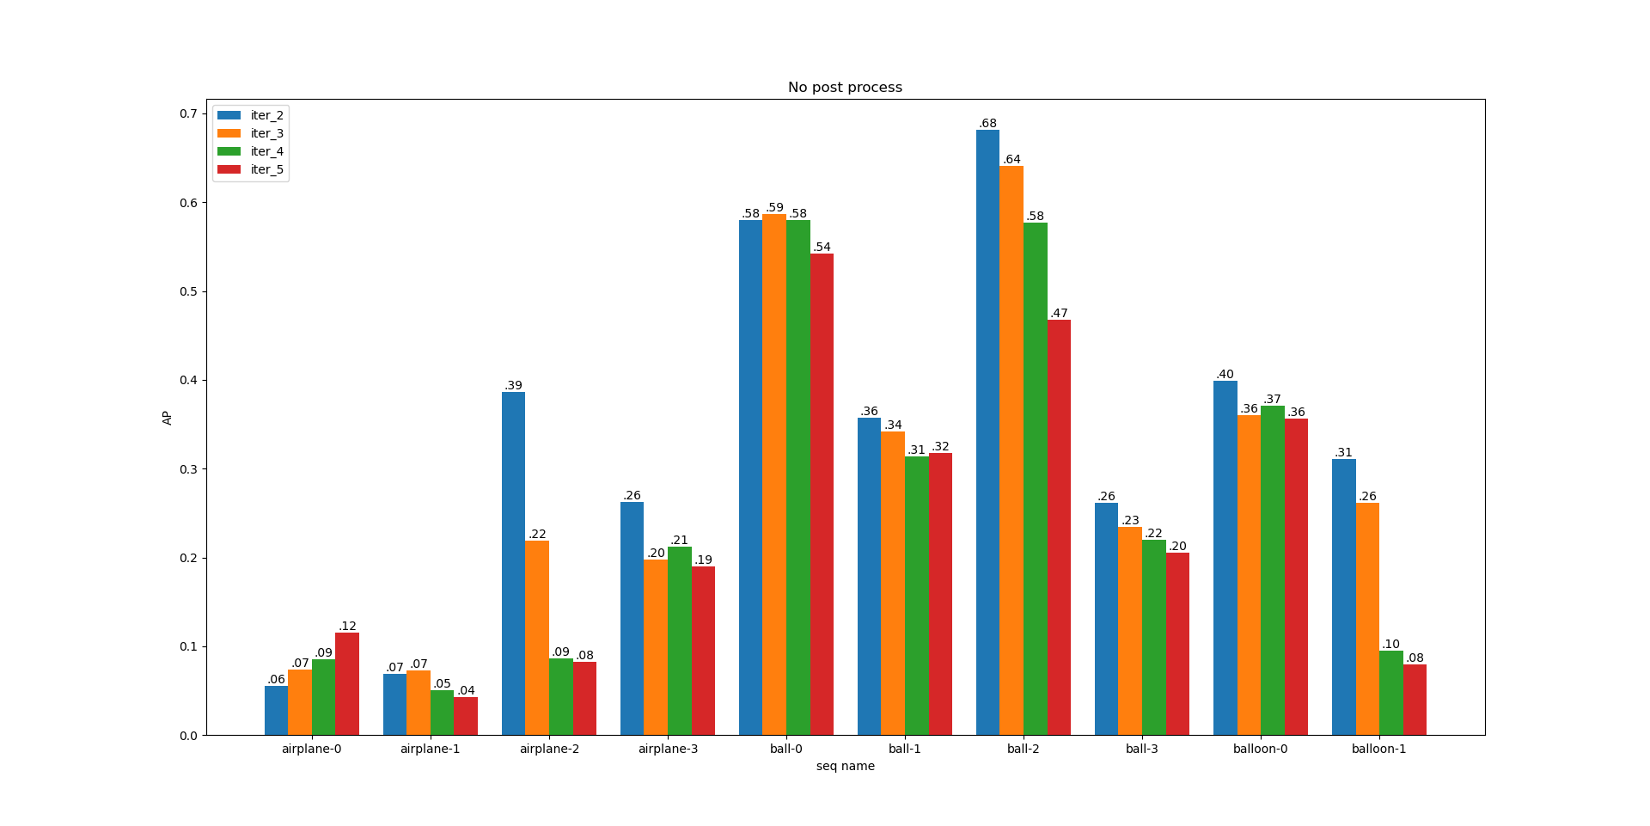
Seq AP Result-No Post Process

Slide 8
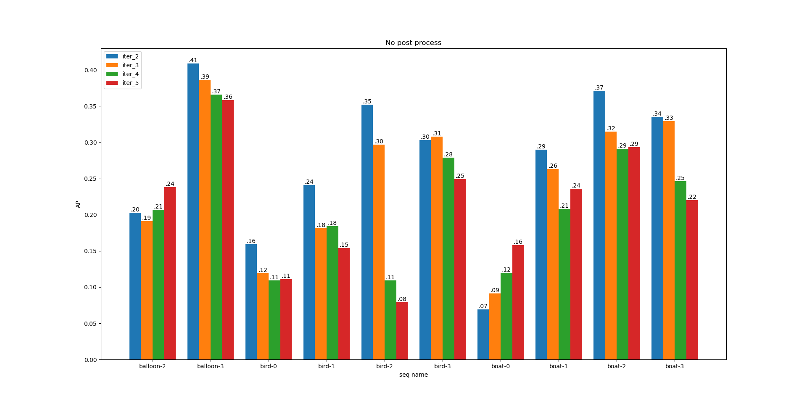
Seq AP Result-No Post Process

Slide 9
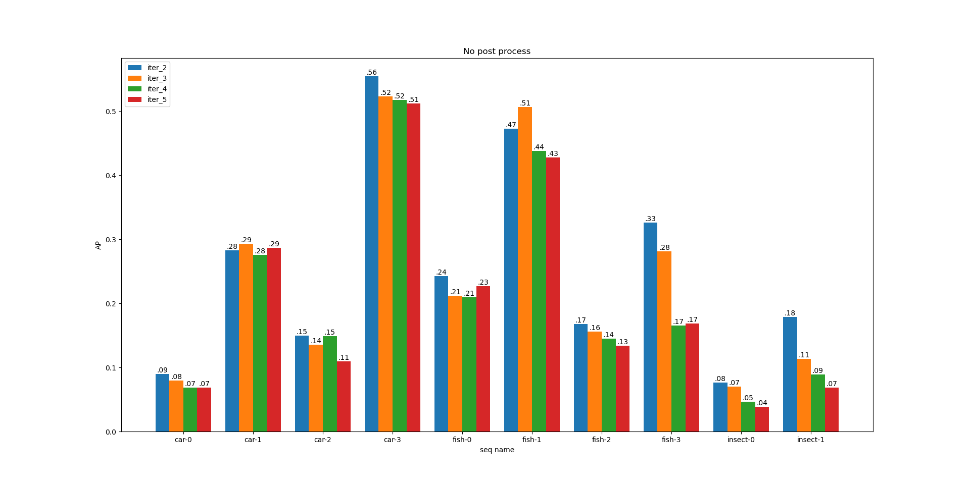
Seq AP Result-No Post Process

Slide 10
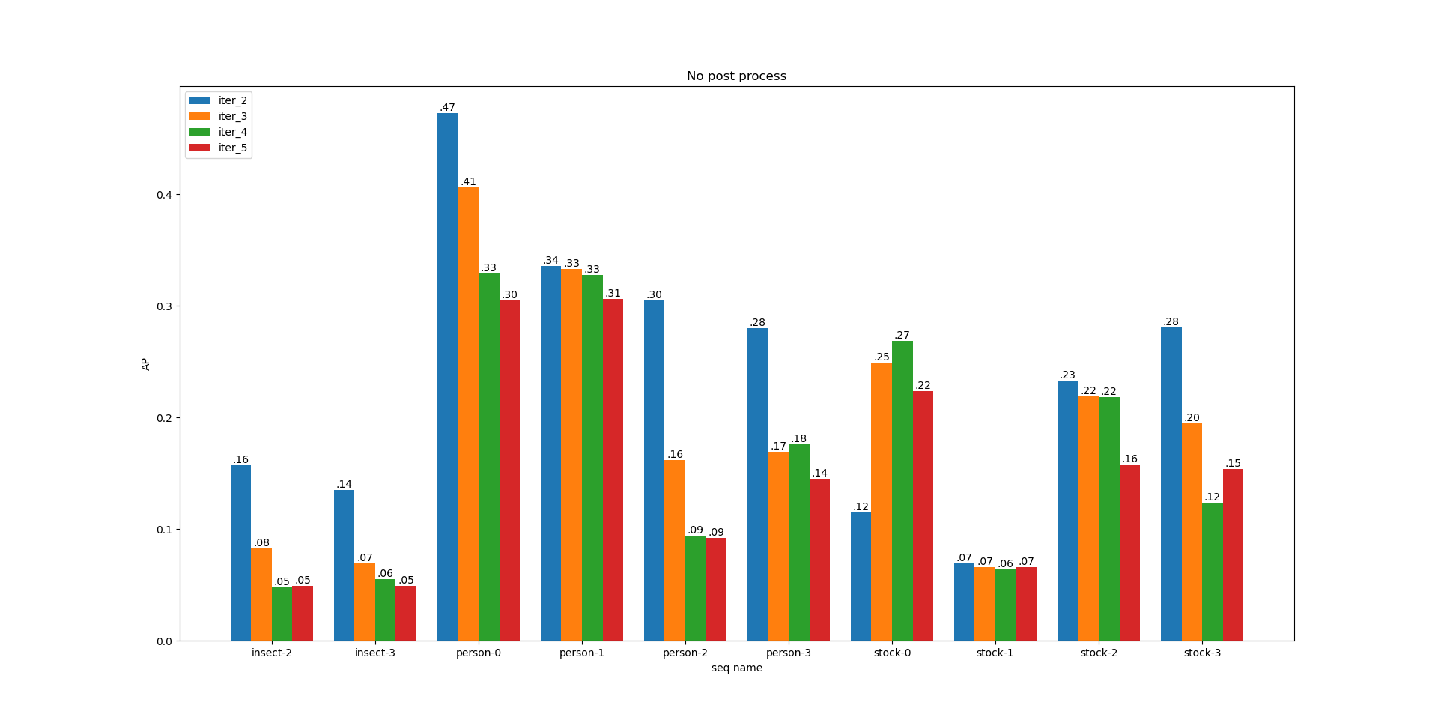
Seq AP Result-No Post Process

Slide 11
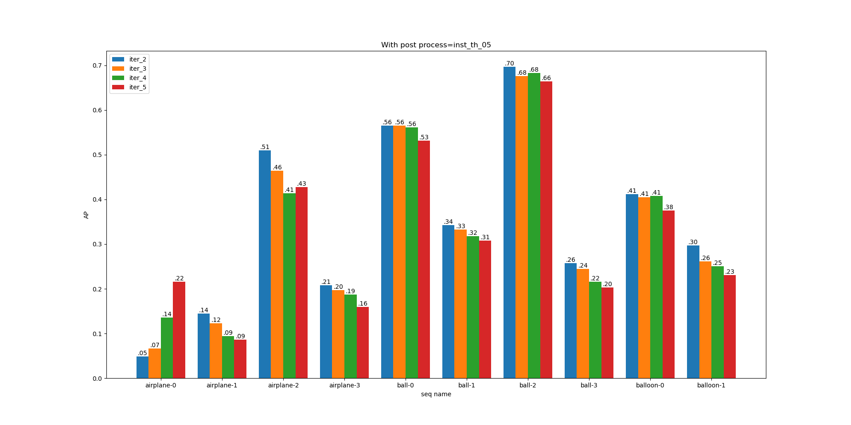
Seq AP Result-Inst_th_05

Slide 12
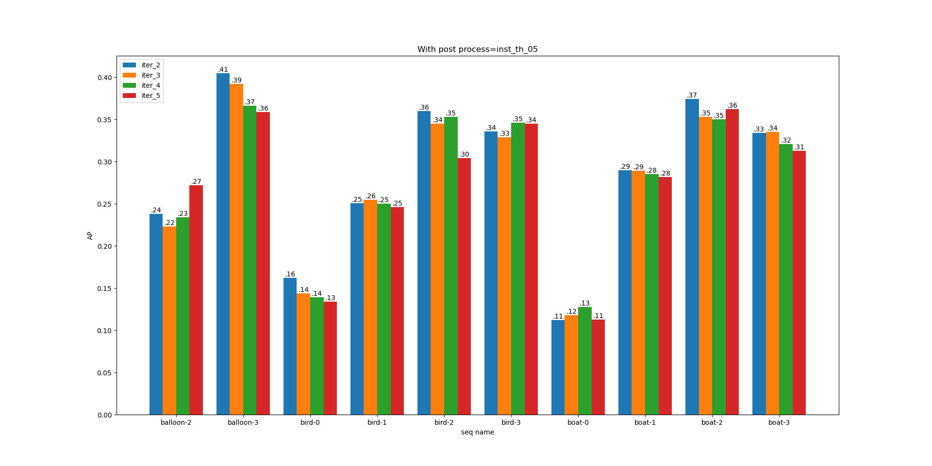
Seq AP Result-Inst_th_05

Slide 13
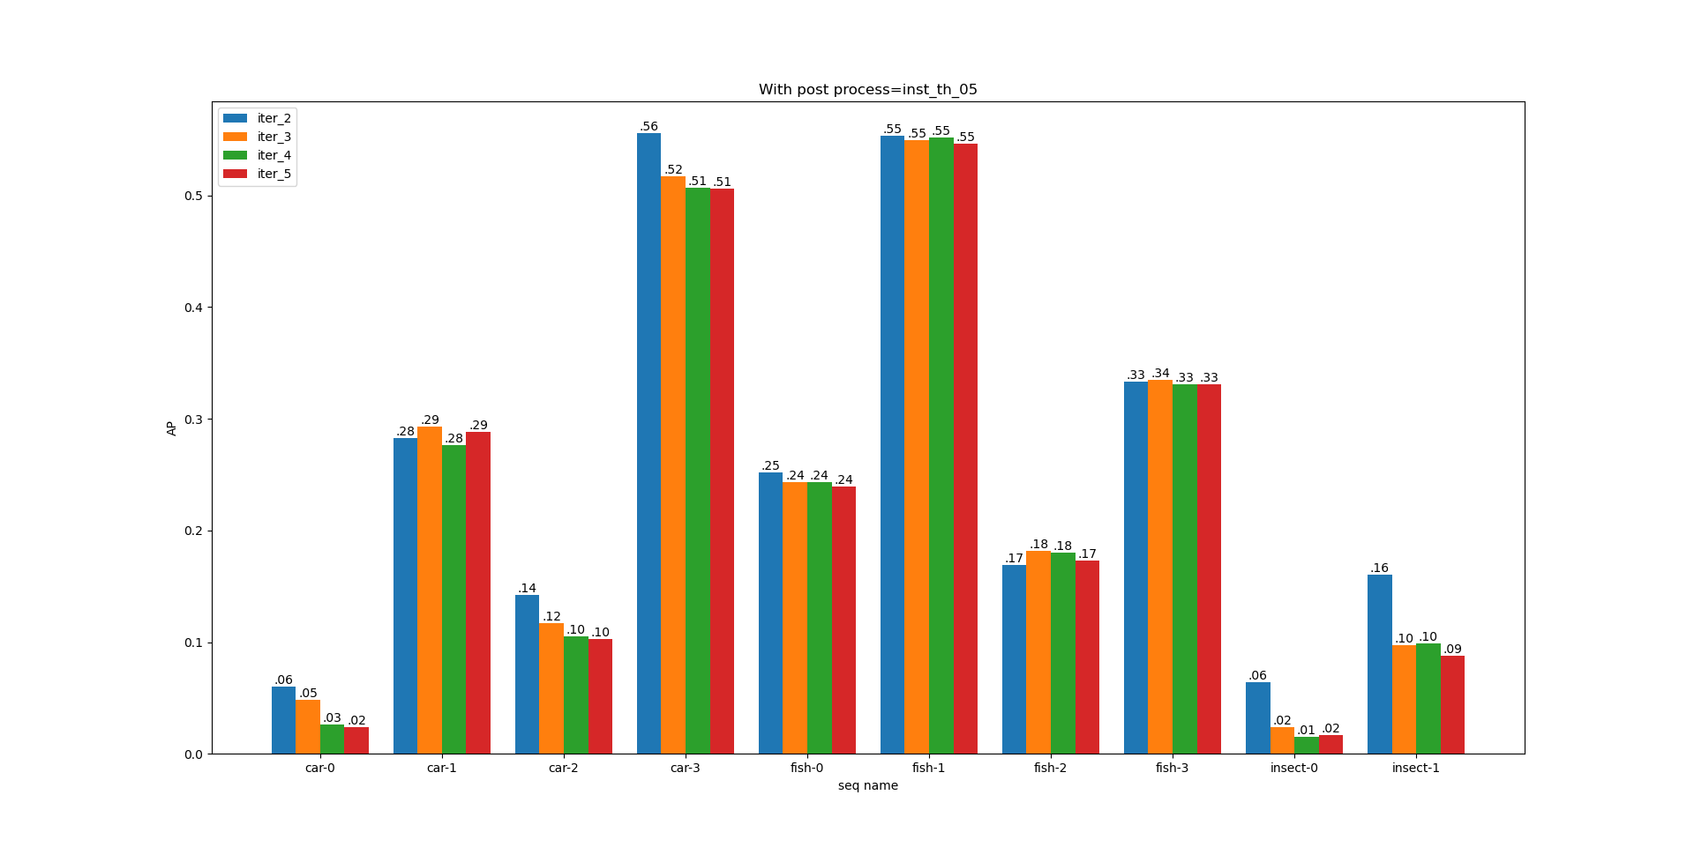
Seq AP Result-Inst_th_05

Slide 14
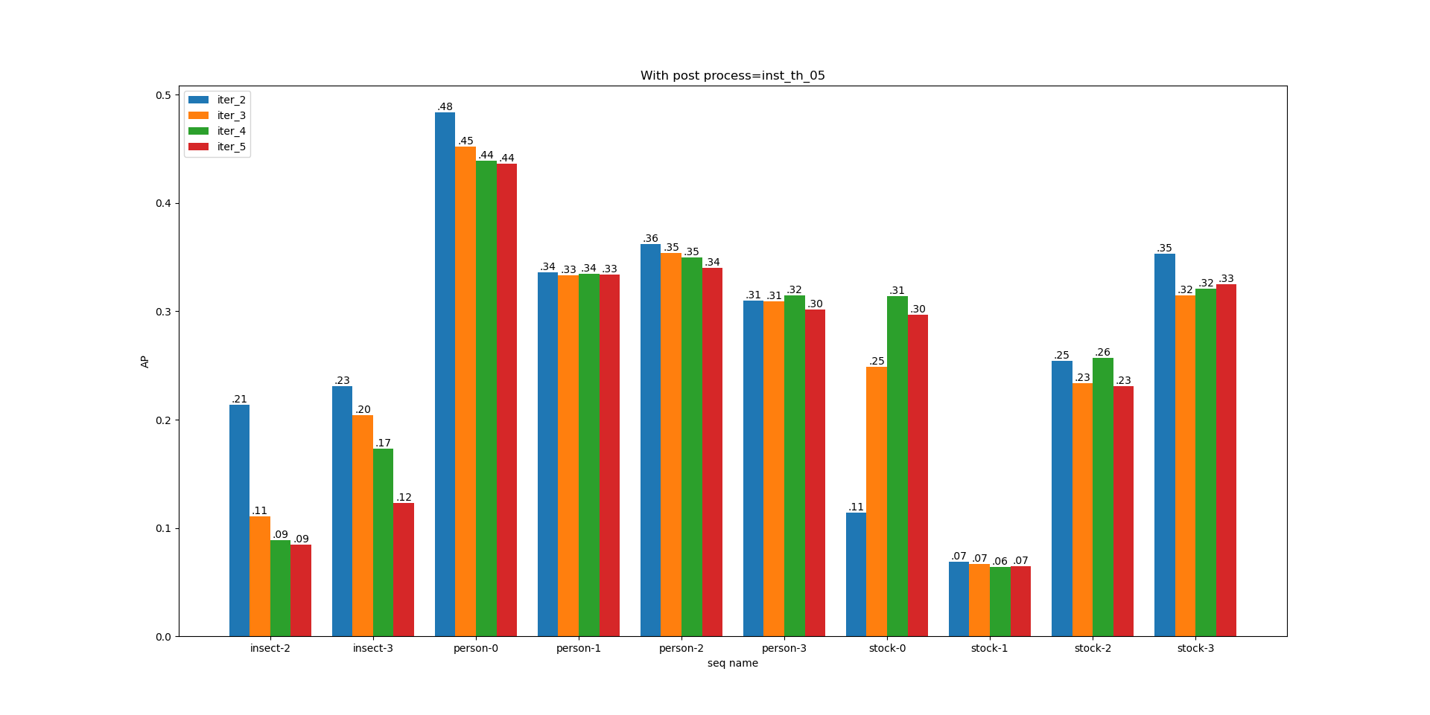
Seq AP Result-Inst_th_05

Slide 15
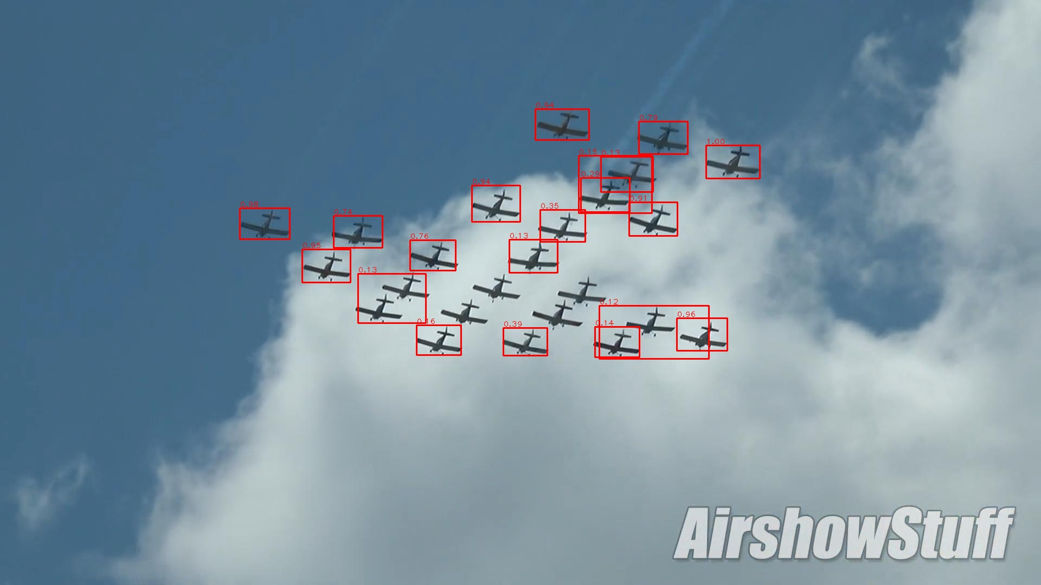
Vis Results-No Post Process-Iter 1
Airplane-2-Iter 1

Slide 16
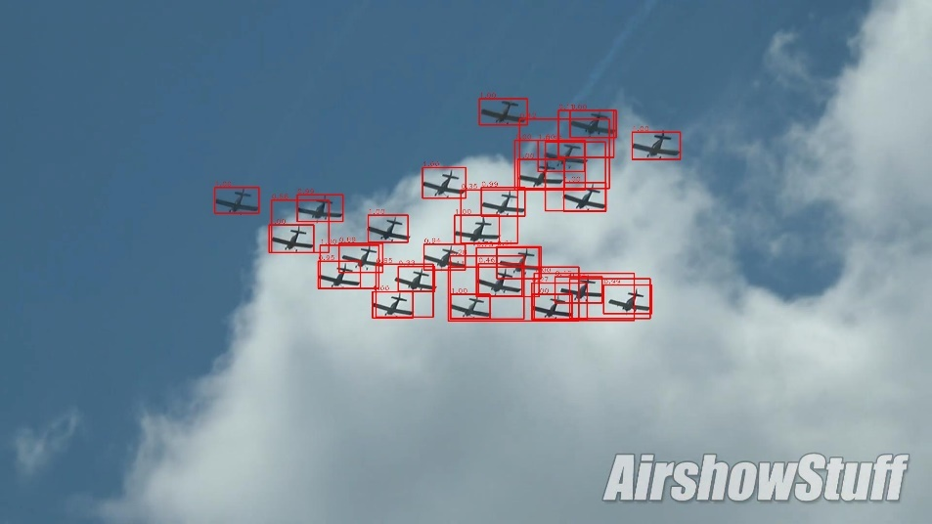
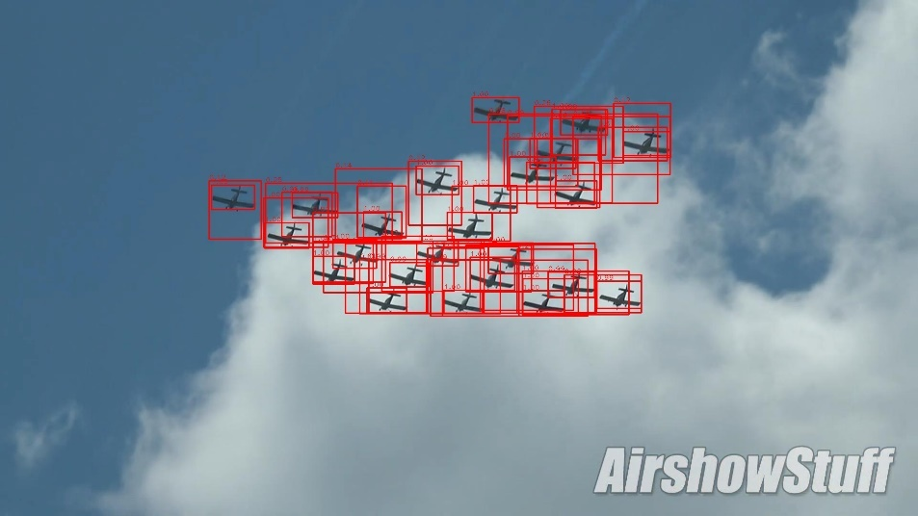
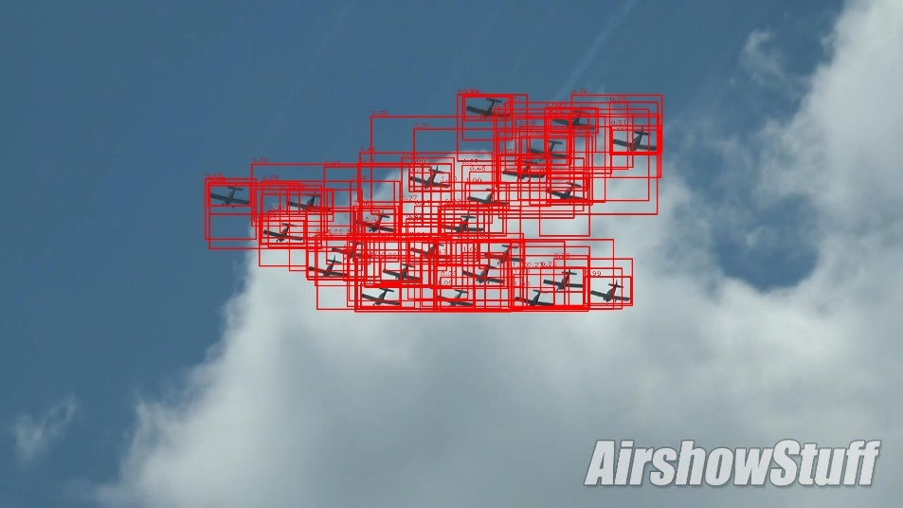
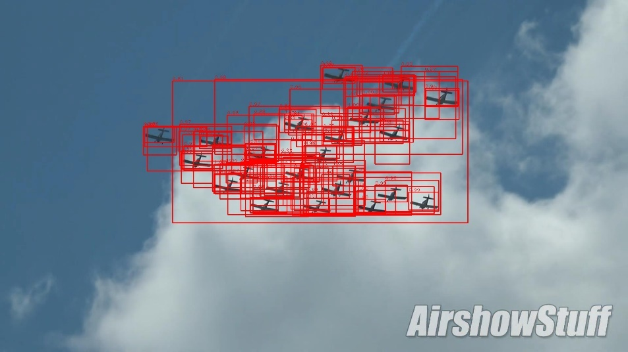
Vis Results-No Post Process-Iter 2-5
Iter 2
Iter 3
Iter 4
Iter 5

Slide 17

Vis Results-Inst NMS-Iter 1

Slide 18
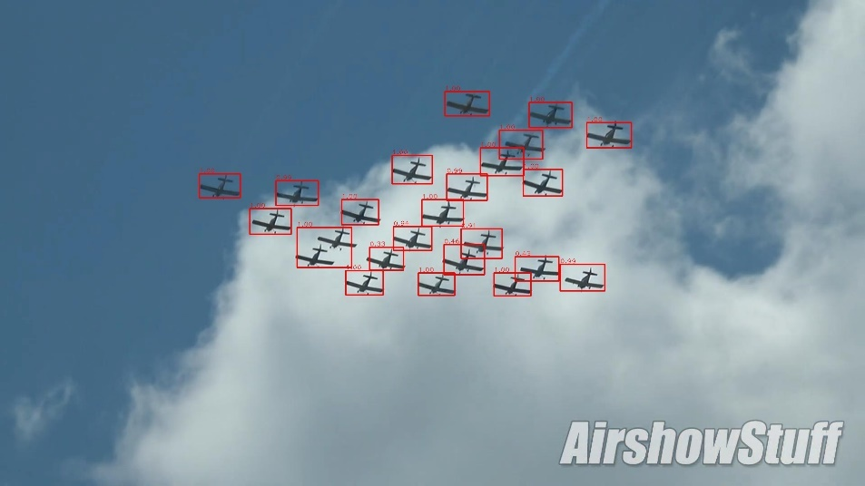



Vis Results-Inst NMS-Iter 2-5
Iter 2
Iter 3
Iter 4
Iter 5

Slide 19
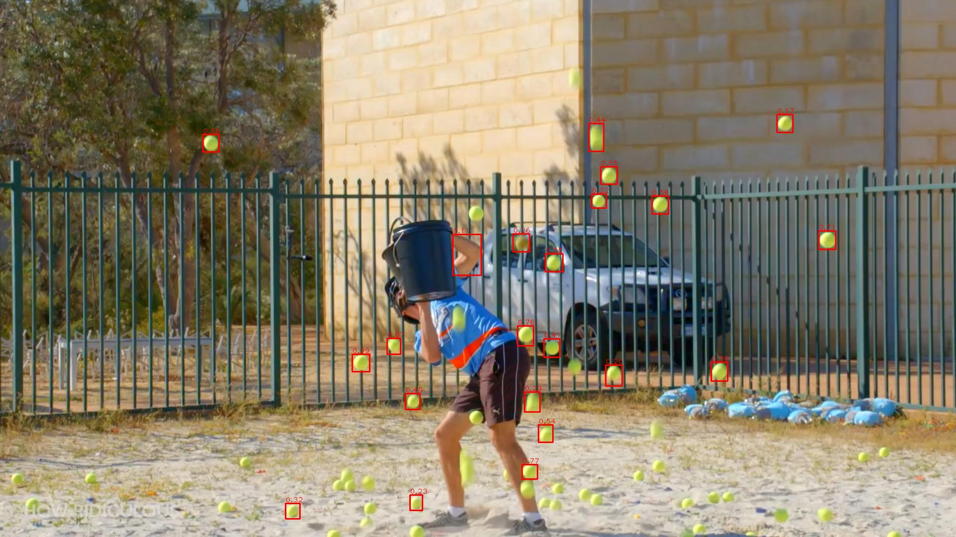
Vis Results-Inst NMS-Iter 1-Problem

Slide 20
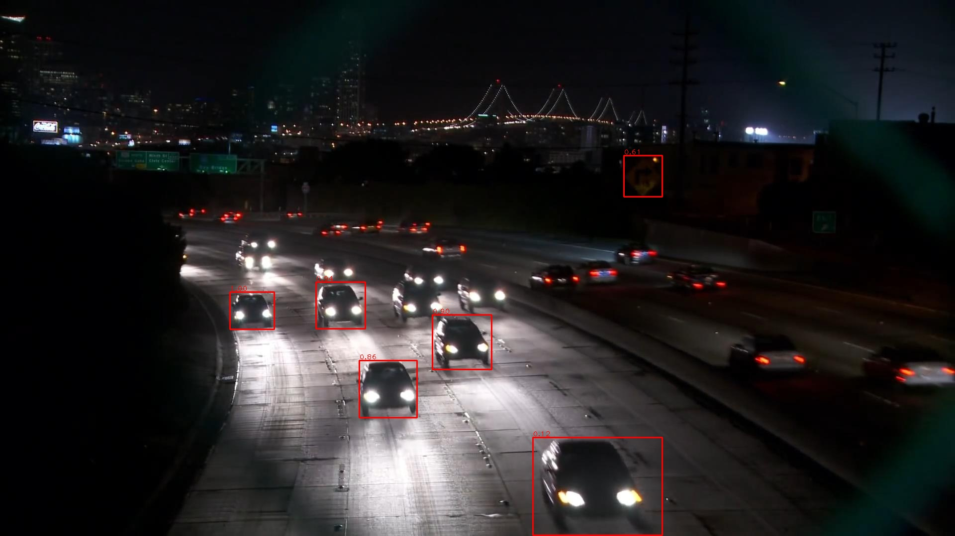
Vis Results-Inst NMS-Iter 1-Problem

Slide 21
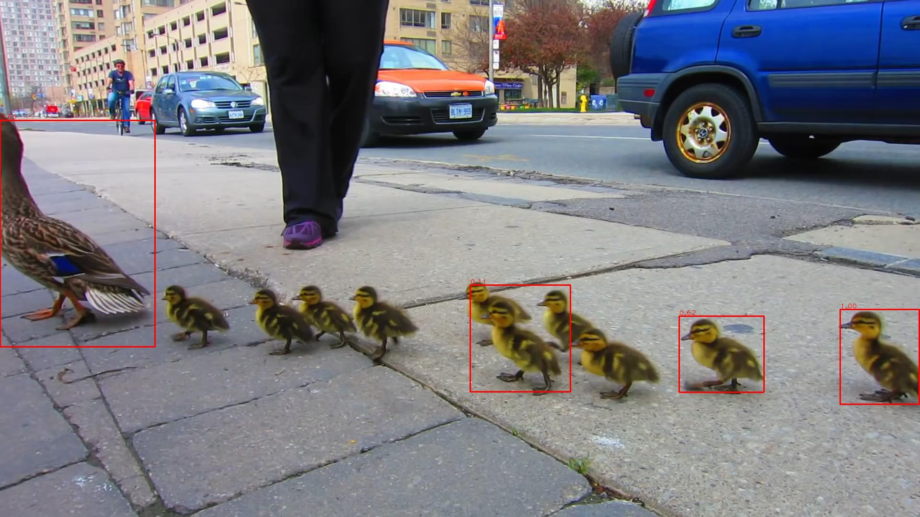
Vis Results-Inst NMS-Iter 1-Problem

Slide 22
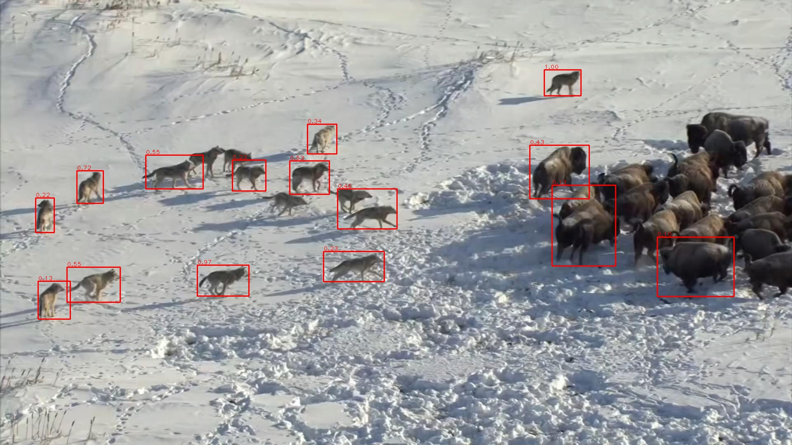
Vis Results-Inst NMS-Iter 1-Problem

Slide 23
End
End and Thanks!

