Slide 1
Weekly Report
Wensheng Cheng
2022.2.1-2.7

Slide 2
Last discussion
Test whether iterative search on the 1st frame can improve the training of detector
Test the effectiveness of post process on the search result, which serves as the input of training the detector
Visual results of experiments above

Slide 3
This week
Regard the false positive filtering problem as outlier detection, which is a specific study field in data science
Try feature similarity to find FP
Conclusion: yes, even some high score FP could be removed, but also some TPs are removed wrongly.
Try spatial/position relation to find FP
Conclusion: yes, this could remove some FP which has similar feature with others, but this need to be used carefully, since some high score TP could be removed wrongly.

Slide 4
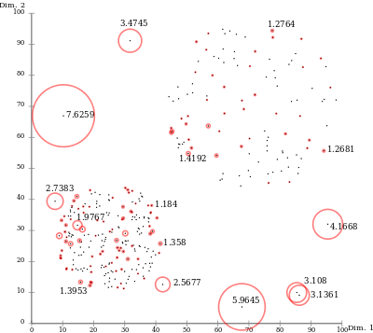
Tool: Local Outlier Factor
LOF finds anomalous data points by measuring the local deviation of a given data point with respect to its neighbours. Larger circle in the picture below means higher probability to be outliers.
SIGMOD 2000. LOF: Identifying Density-based Local Outliers.

Slide 5
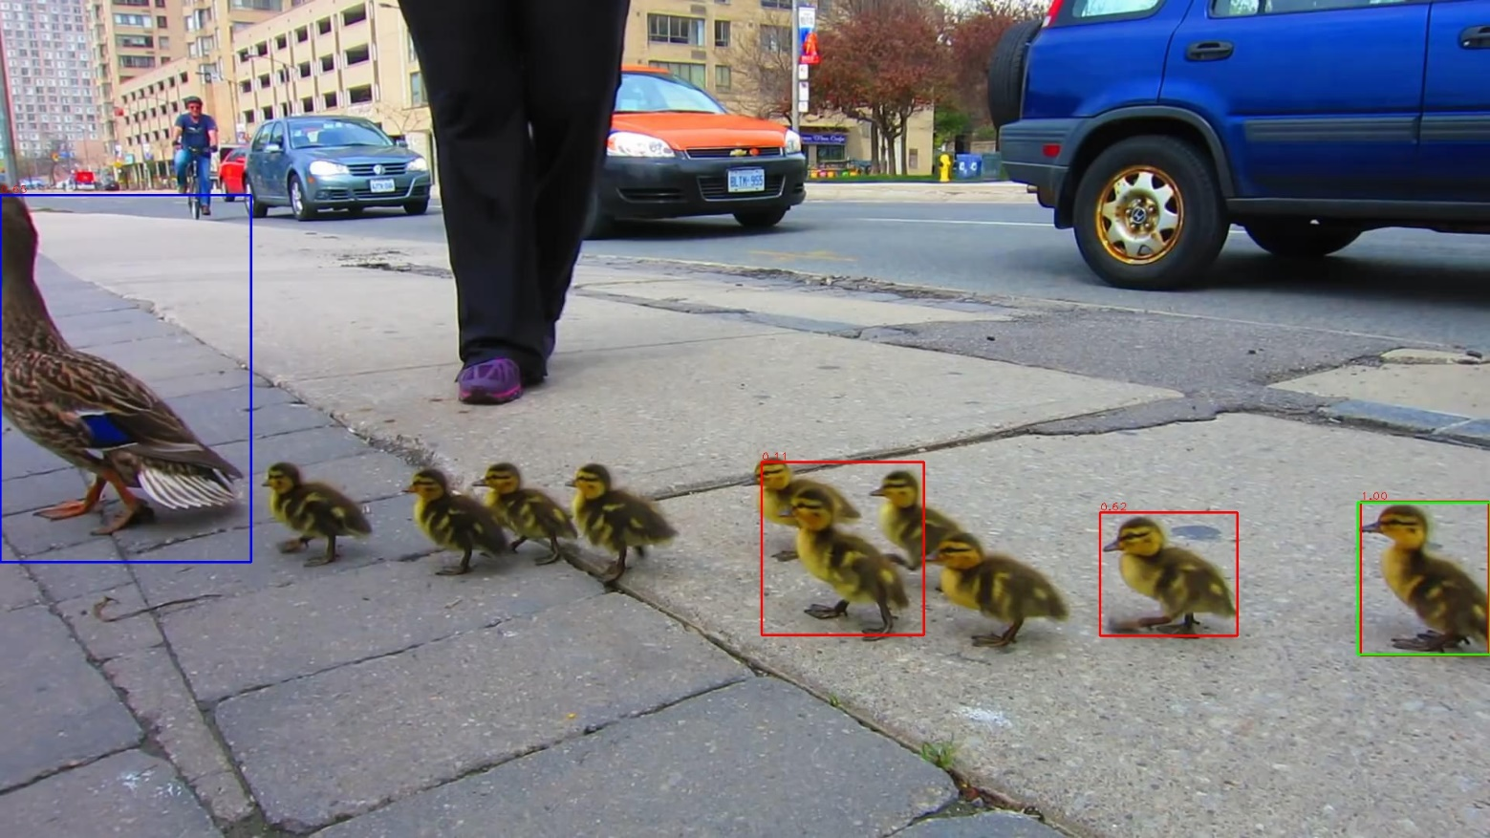
Feature Similarity Result-Find FP
Motivation: FP may be similar with the template, especially with high score, but it could be different from other TP results(param: no_temp_n_1_c_005). Green-temp, Red-original results, Blue-detected FP.

Slide 6
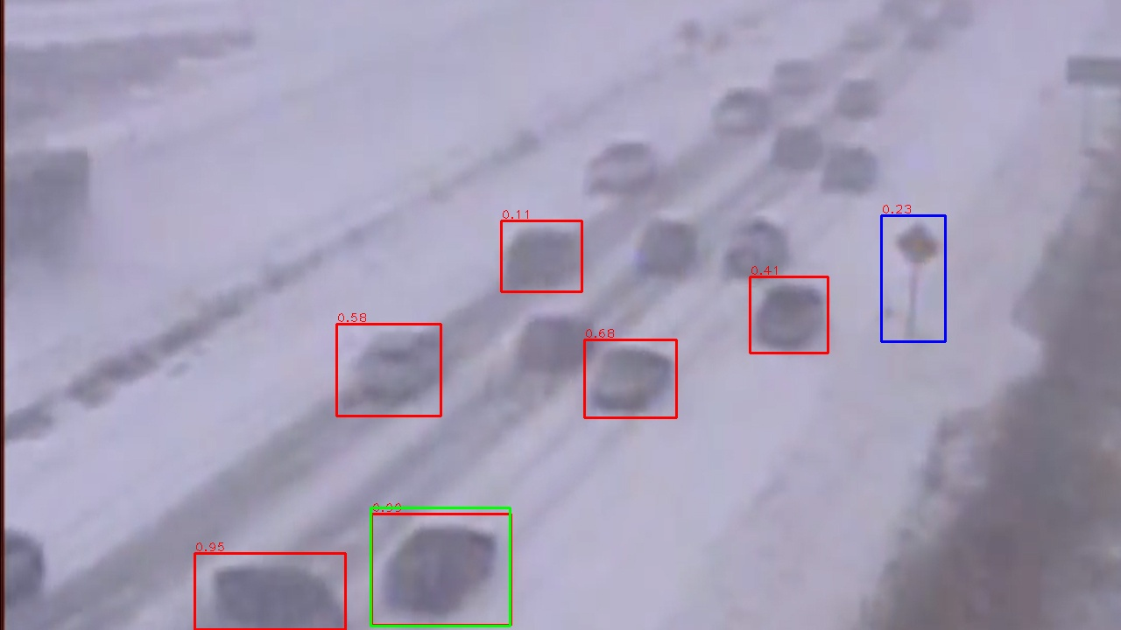
Feature Similarity Result-Find FP

Slide 7
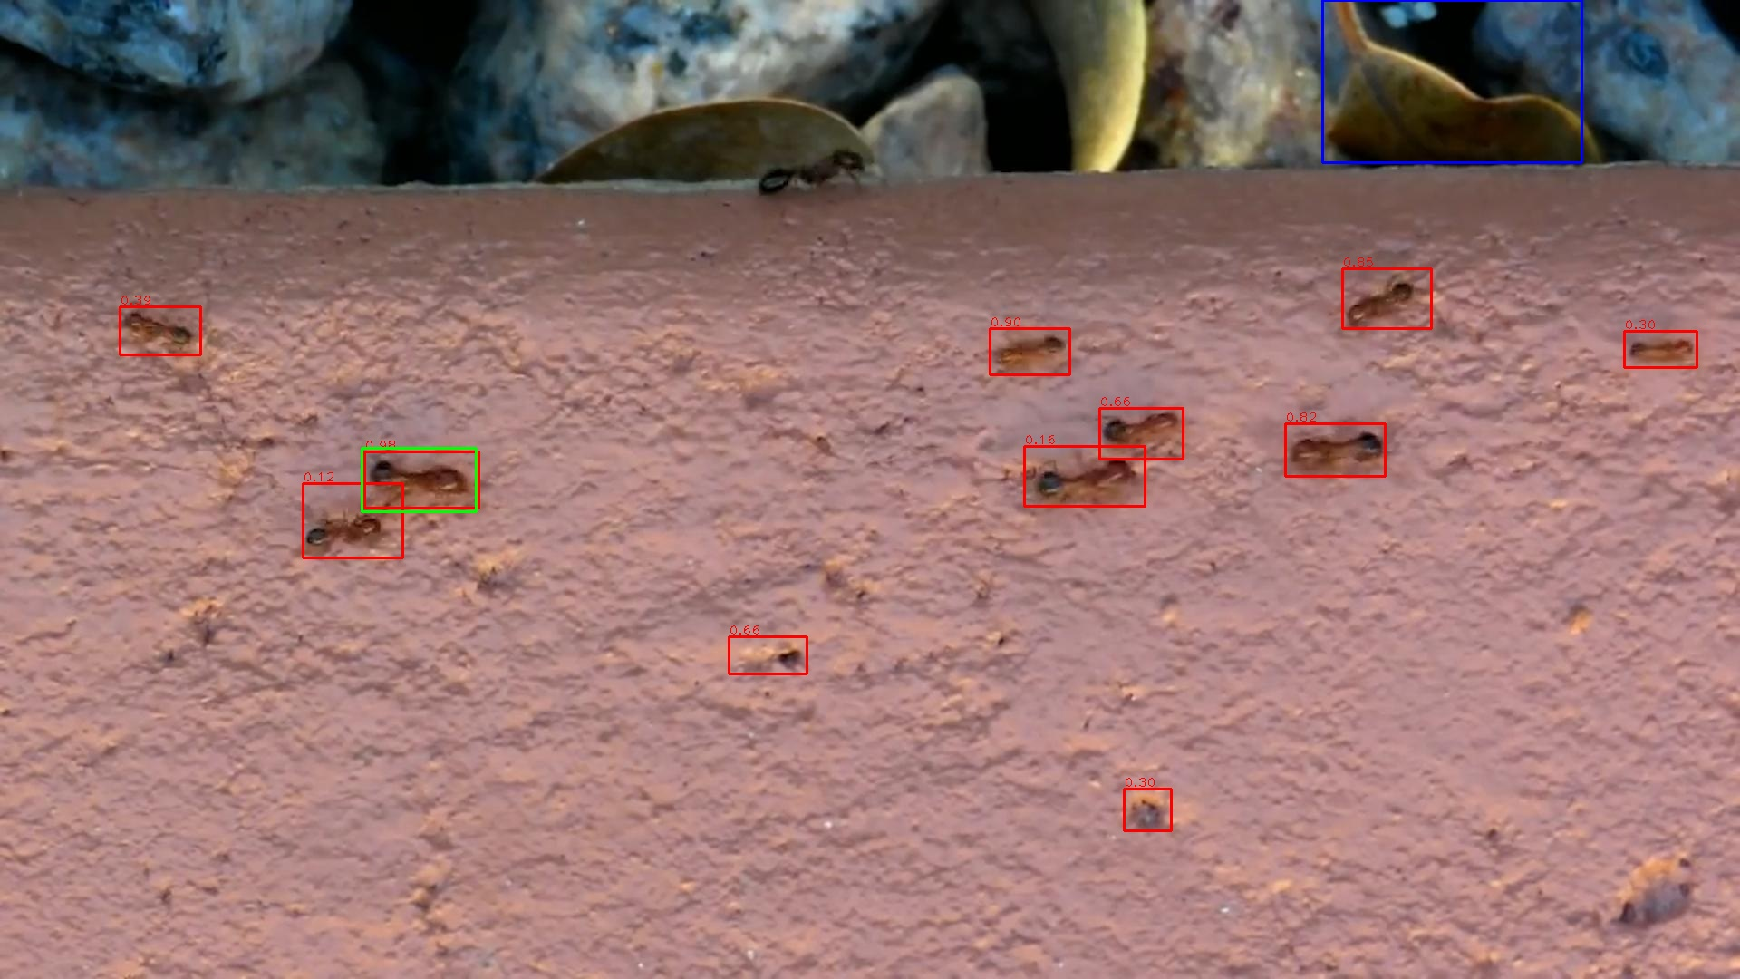
Feature Similarity Result-Find FP

Slide 8
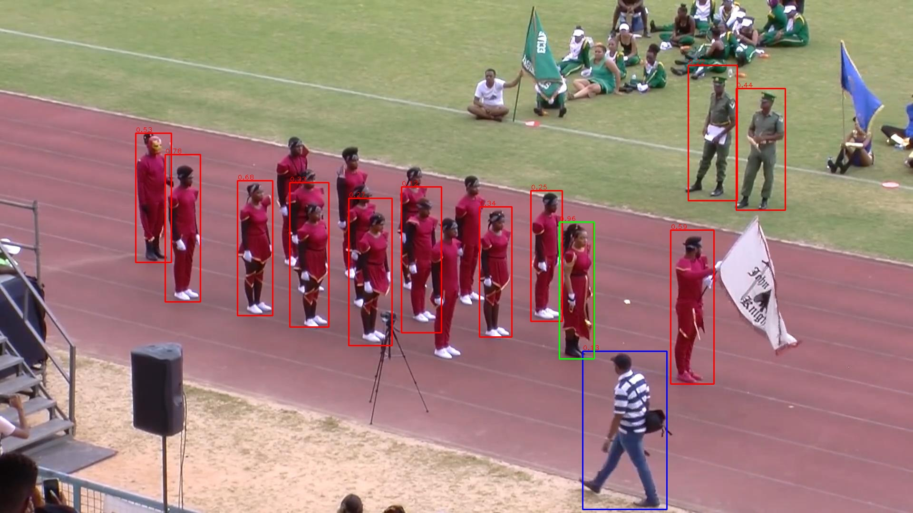
Feature Similarity Result-Find FP

Slide 9
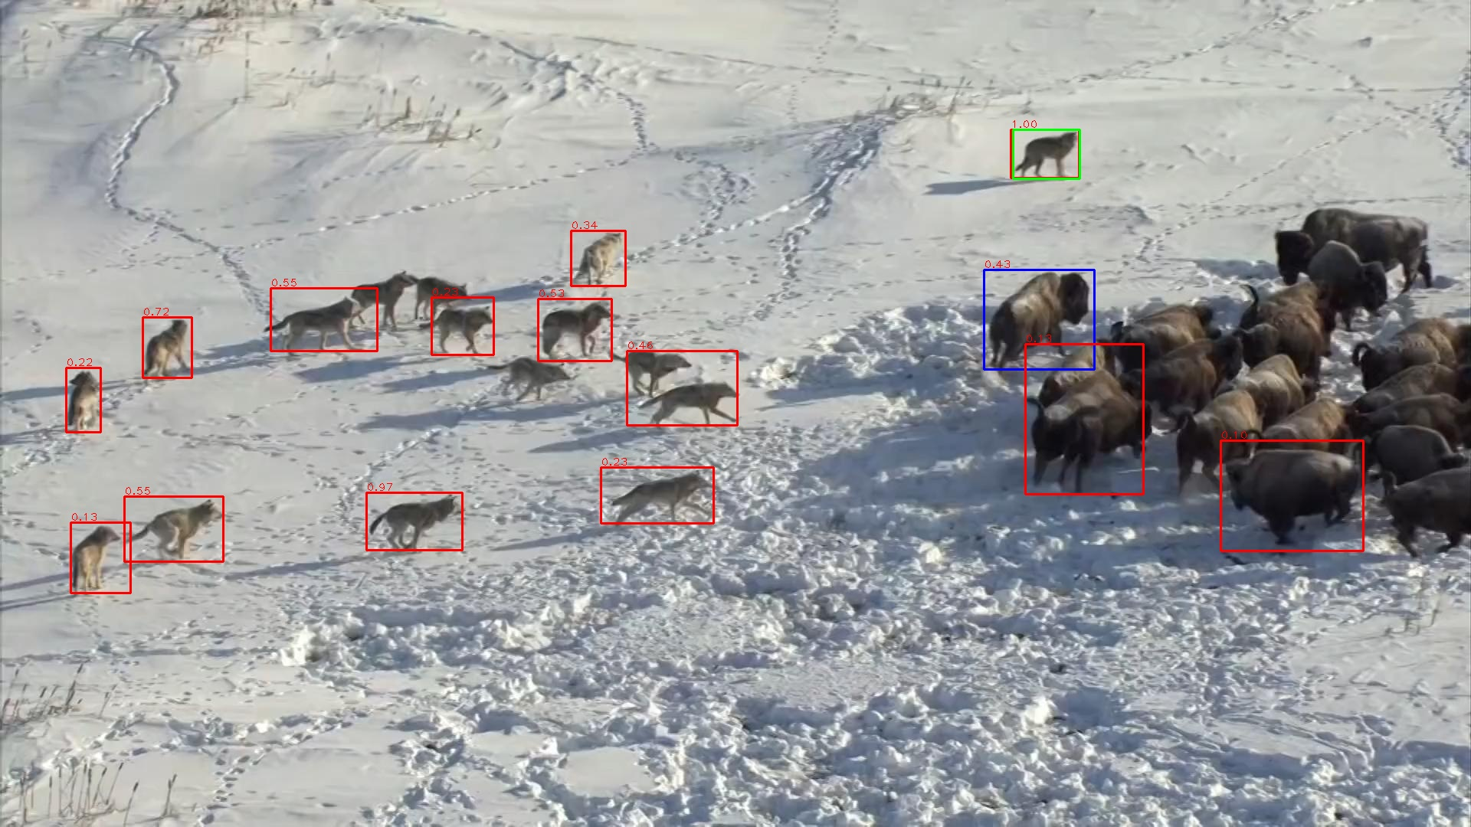
Feature Similarity Result-Find FP

Slide 10
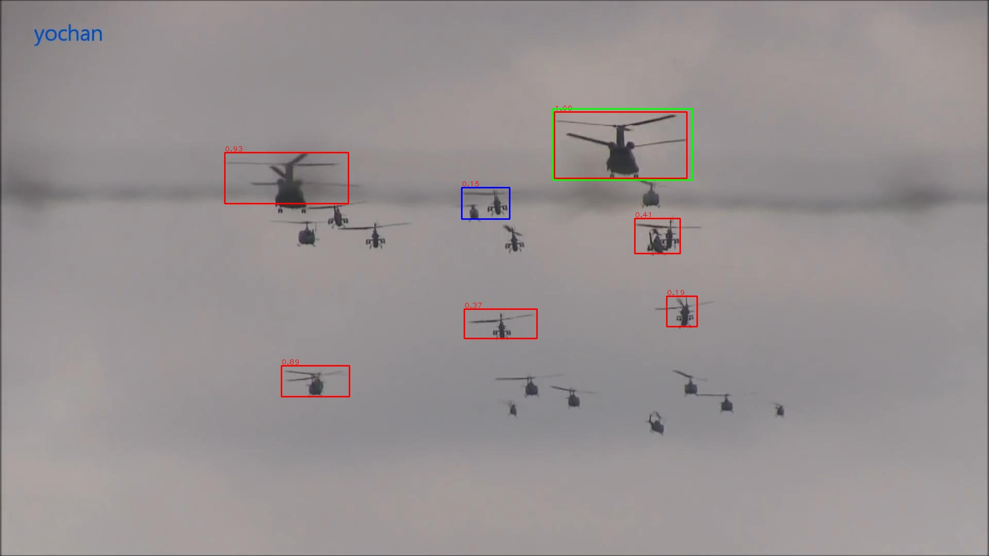
Feature Similarity Result-Find TP Wrongly

Slide 11
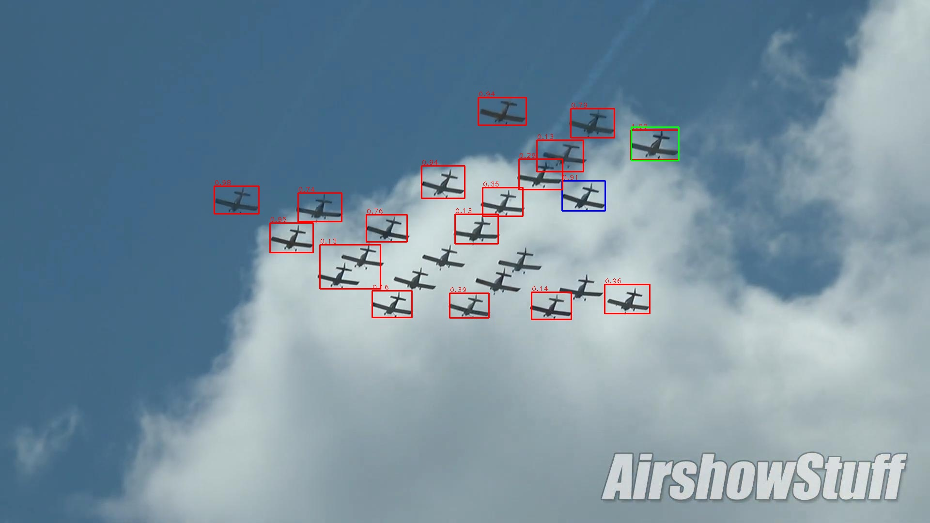
Feature Similarity Result-Find TP Wrongly

Slide 12
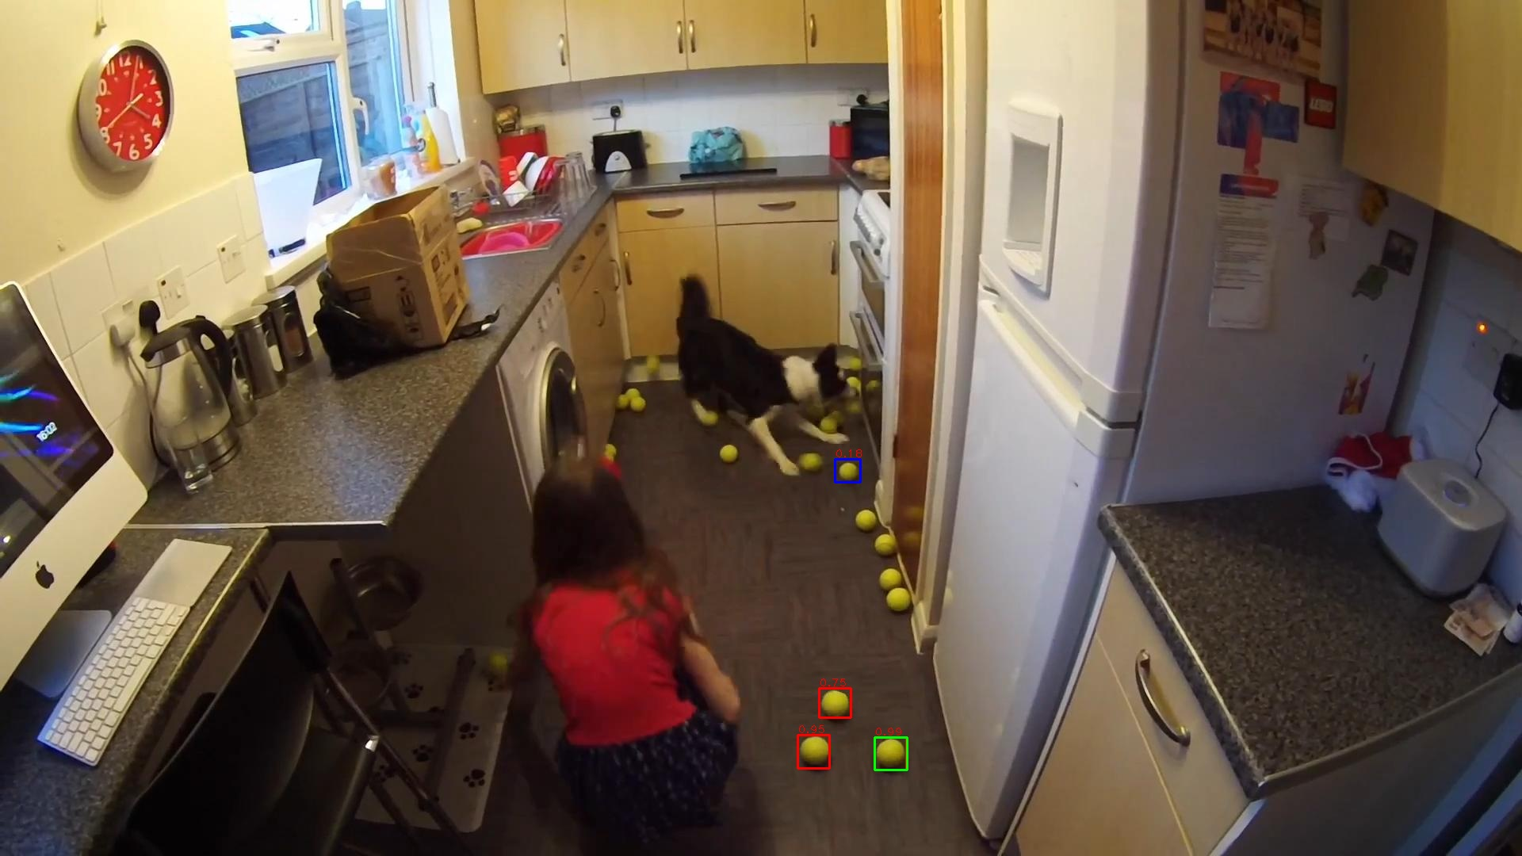
Feature Similarity Result-Find TP Wrongly

Slide 13
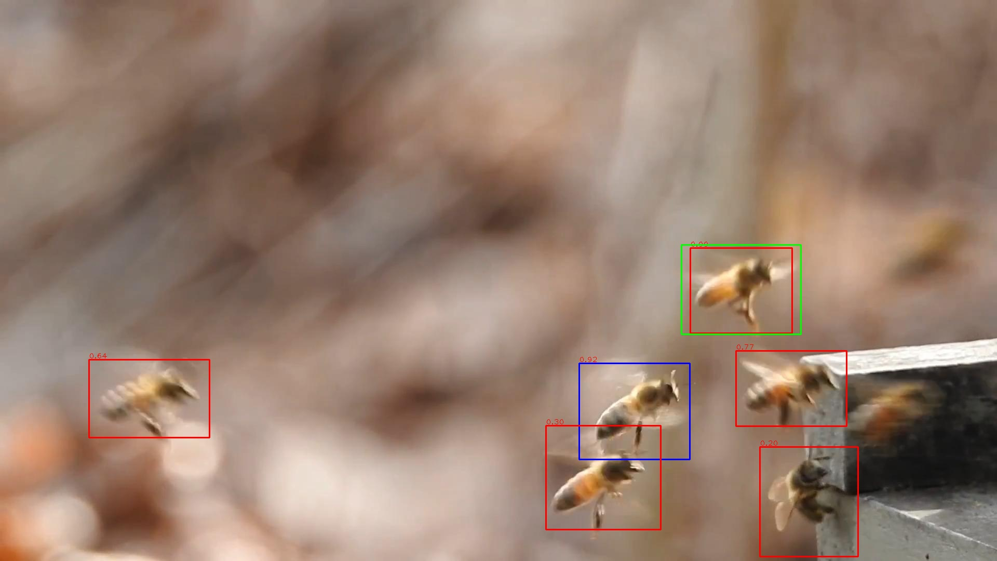
Feature Similarity Result-Find TP Wrongly

Slide 14
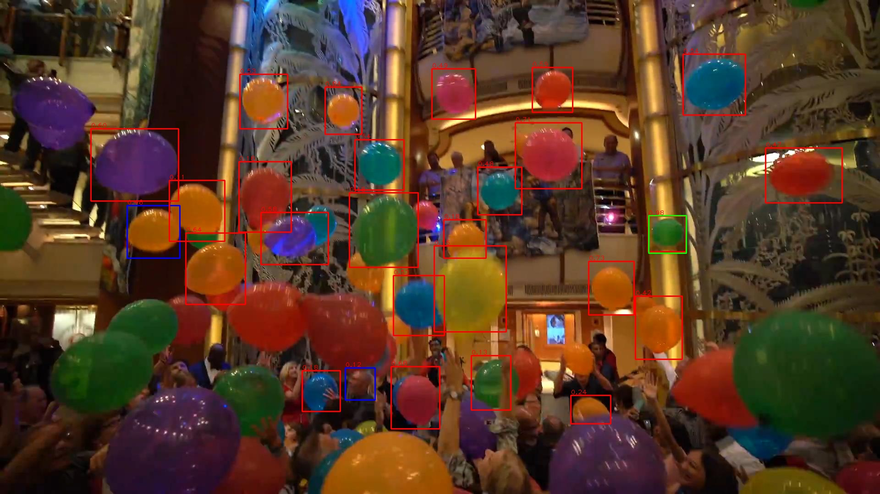
Feature Similarity Result-Find TP and FP

Slide 15
Spatial Relation Result-Find FP
Motivation: Some FP even have similar feature with other results, so that feature only can not work. But the box far from other boxes could be FP(param:use_temp_n_3_c_auto).
This is a very strong assumption, and directly use the hard version only finds the FP in car-1 image.

Slide 16
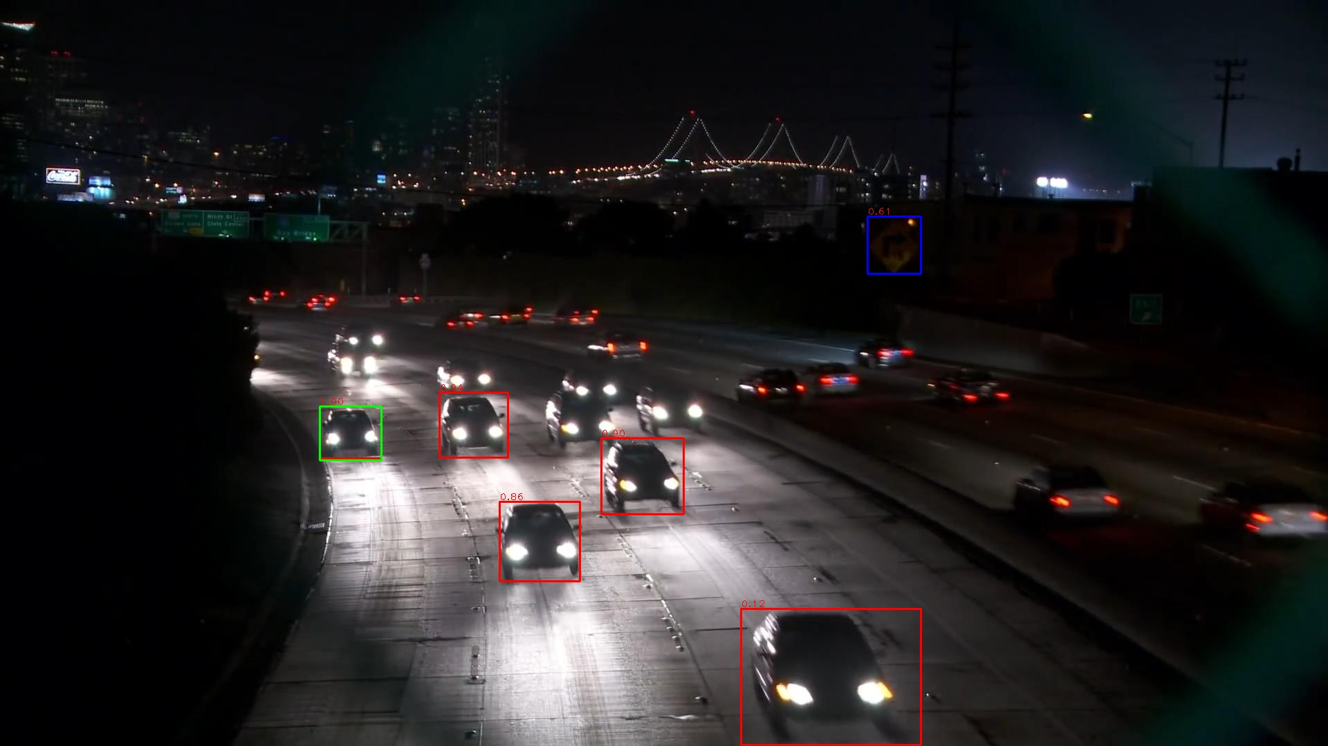
Spatial Relation Result-Find FP

Slide 17

Spatial Relation Result-Find TP Wrongly

Slide 18
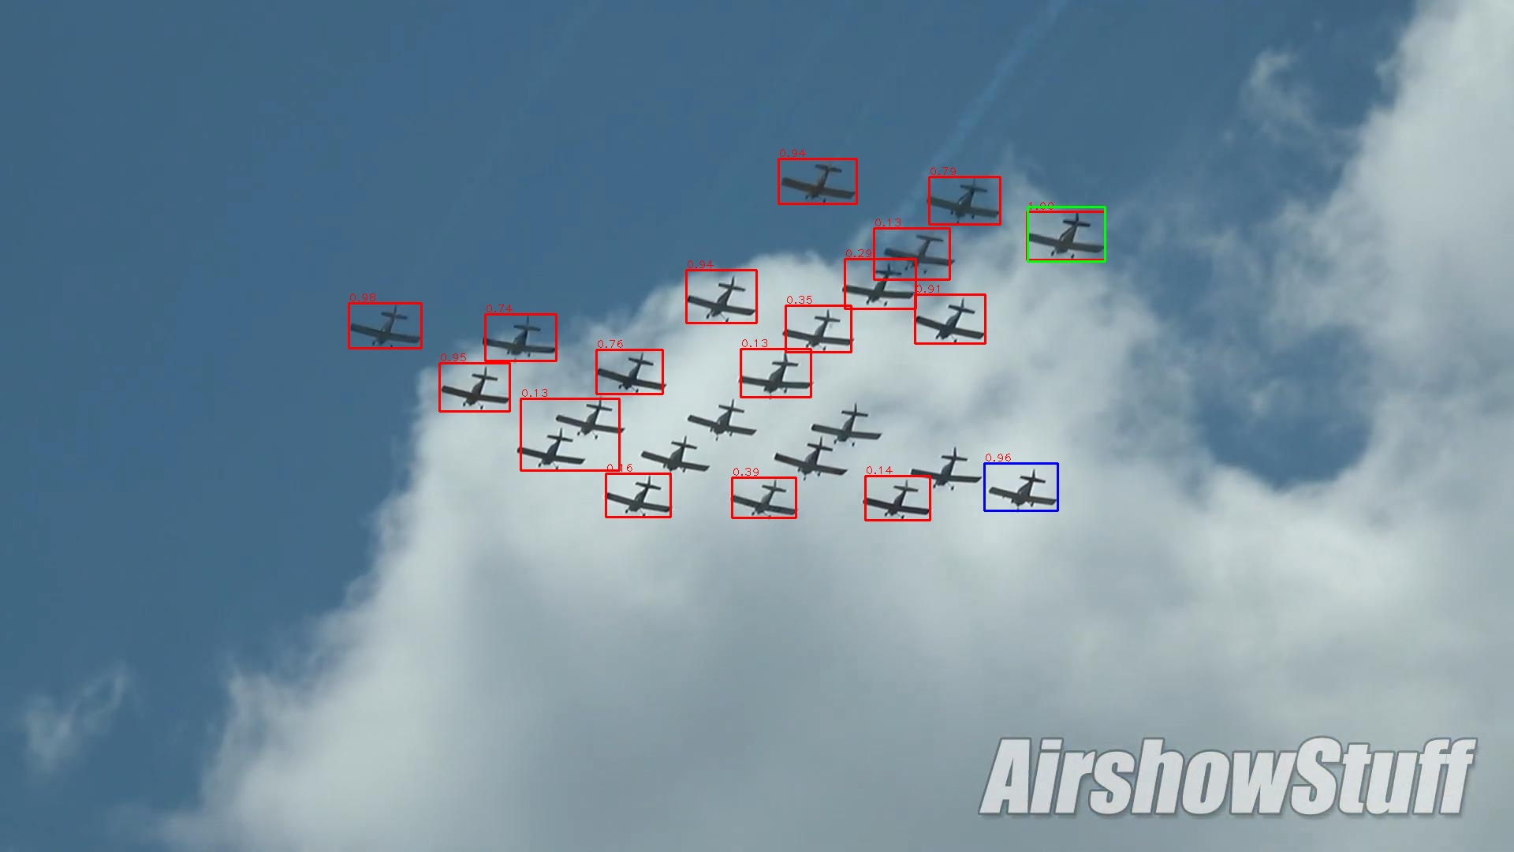
Spatial Relation Result-Find TP Wrongly

Slide 19
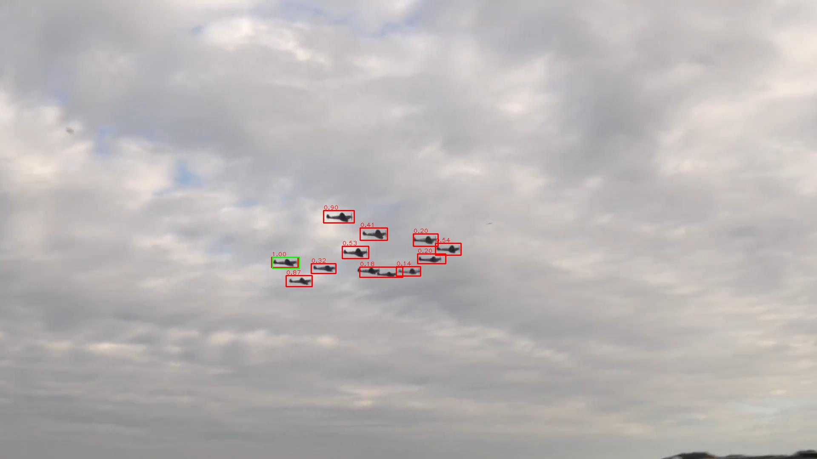
Spatial Relation Result-No Output

Slide 20
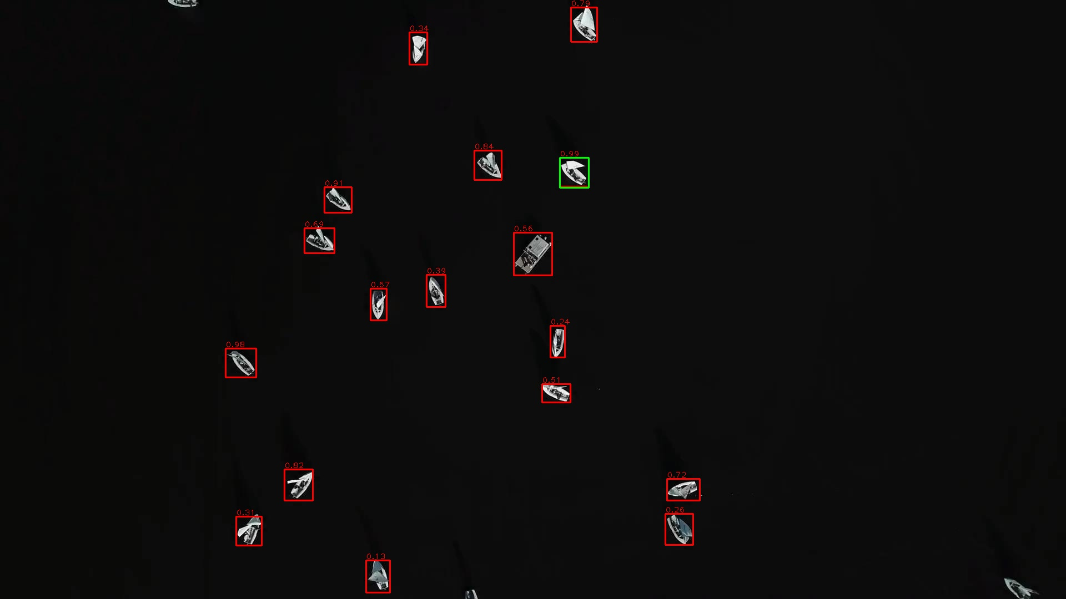
Spatial Relation Result-No Output

Slide 21
Continue
Use original score to weight the FP score output by LOF, so that high score template could be protected, but the weight is sensitive, since we also want to remove high score FP
Test some other tools in outlier detection, for spatial and scale.
These evidences should be used together to find FP, and remove less TP in the process, although some TPs could be recovered in the following iteration process.

Slide 22
End
End and Thanks!

