Slide 1
Weekly Report
程文胜 2020.11.21-11.27

Slide 2
Weekly Report
Abstract
Content
End

Slide 3
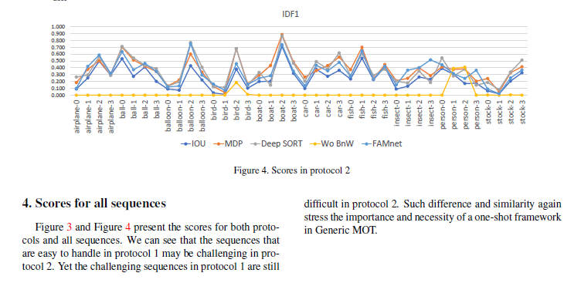
Abstract
This week I mainly spent time on revising our supplementary material and make the video.

Slide 4
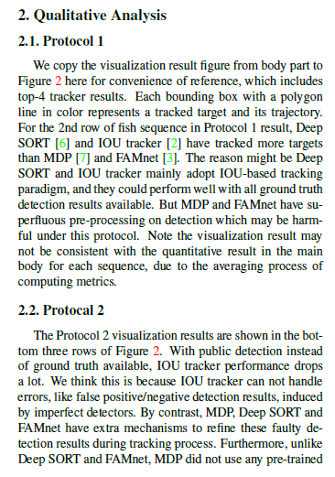
Content
I first revise the explanation of trackers’ performance under Protocal 1 and Protocal 2, to make them more accurate and consist with the statement in main body text.

Slide 5
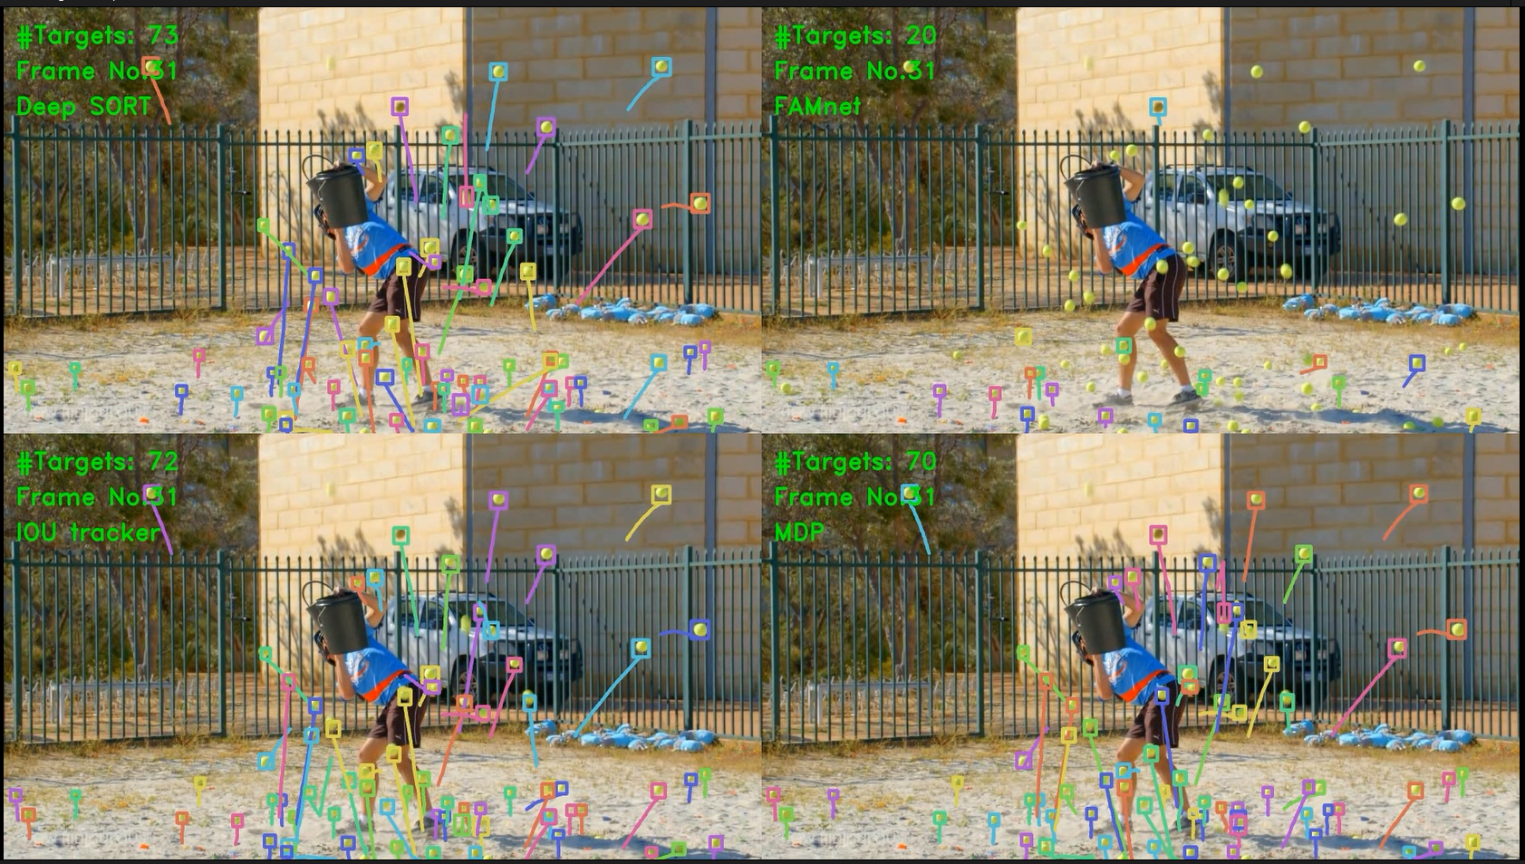
Content
I then revise our video to include more sequences. We use a 2x2 layout in the frame to display 4 trackers’ results at the same time to compress file size. I also borrow senior Peng Chu’s title slides which seem good.
One frame in Protocol 1 result.

Slide 6
Report End
程文胜 11.27

