Slide 1
Weekly Report
程文胜 2020.2.21-2.27

Slide 2
Weekly Report
Abstract
Content
End

Slide 3
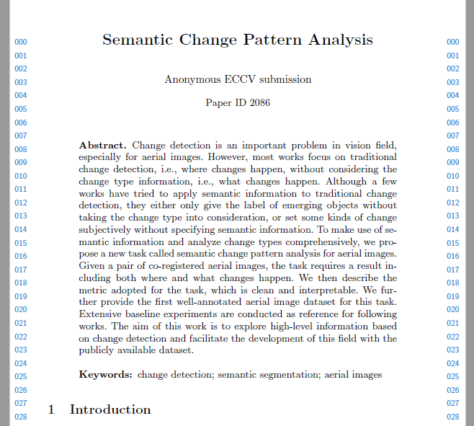
Abstract
This week I mainly put my effort on the conference paper about change detection.

Slide 4
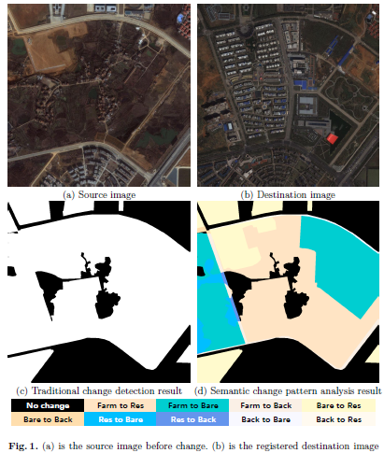
Content
I have finished the draft, registered the paper and submitted to eccv.

Slide 5
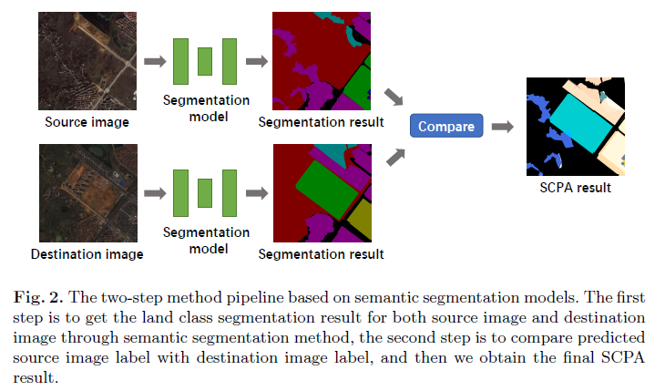
Content
I would think about new models for the task. Also, I would mainly help Lei Xu to finish his paper as soon as possible and submit in time in next week.

Slide 6
Report End
程文胜 VIPG

