Slide 1
Weekly Report
程文胜 2020.6.7-6.25

Slide 2
Weekly Report
Abstract
Content
End

Slide 3
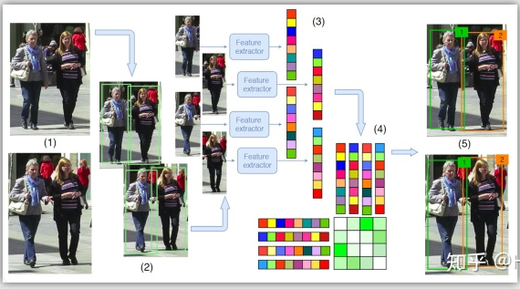
Abstract
In this week, I mainly put my effort on reading the FAMNet and deformable surface tracking paper to get familiar with tracking topic.
MOT overview

Slide 4
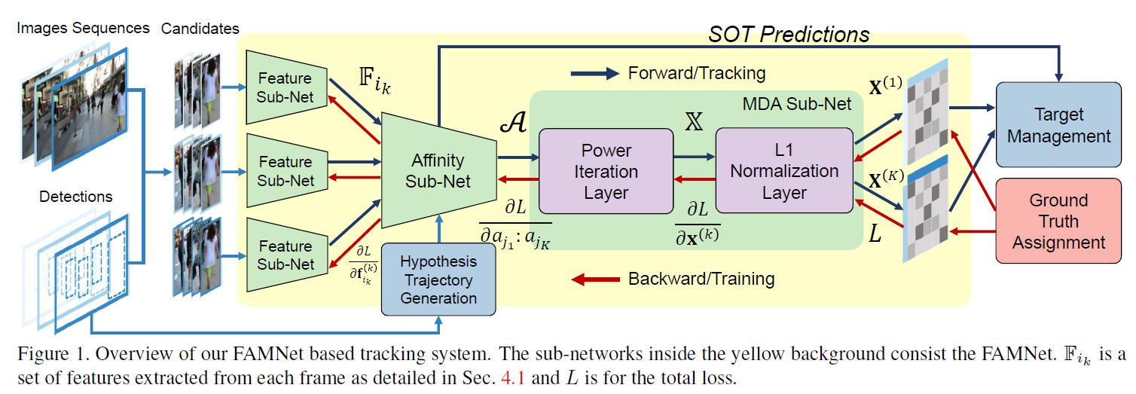
Content
FAMNet combines feature extraction, affinity estimation, and multi-dimensional assignment in a single end-to-end network. The key point is implementing multi-dimensional assignment in an end-to-end way with the rank 1 tensor approximation method.

Slide 5
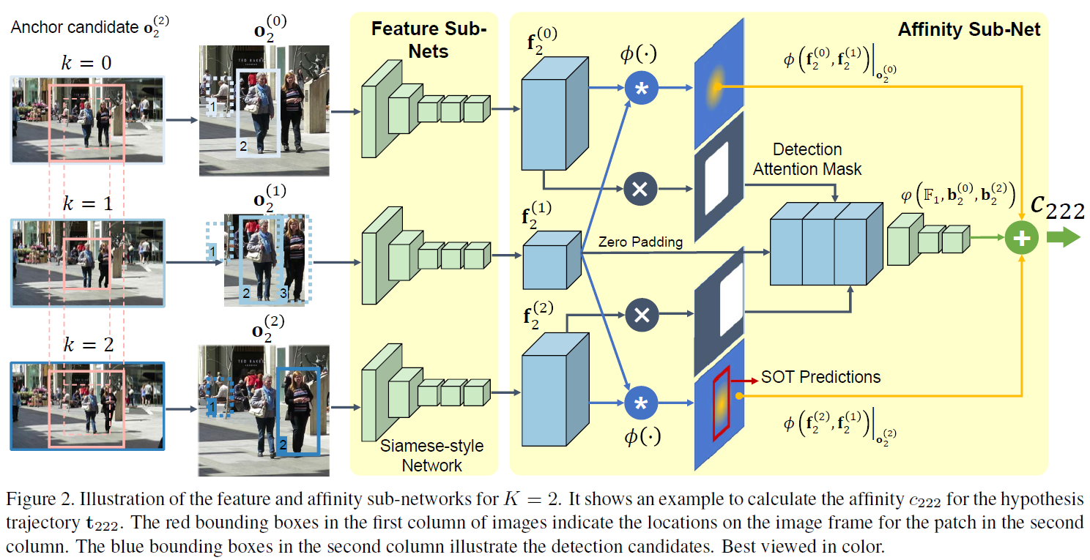
Content
The affinity sub-network takes the features of candidates and hypothesis trajectories as input, and generates the affinity tensor as output.

Slide 6
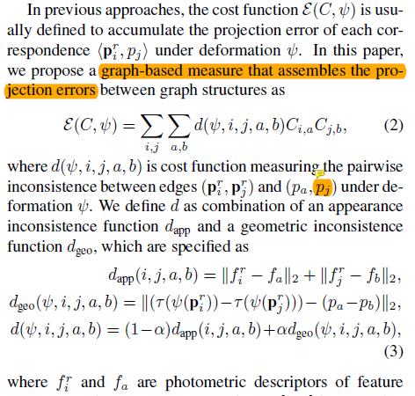
Content
Deformable surface tracking paper solves feature correspondence, outlier rejection and shape reconstruction problems at the same time. A property is modeling keypoint correspondence and shape reconstruction in line with pairwise projection errors between graph structures, instead of conventional unary projection errors between keypoint sets. This is due to graph matching task itself.

Slide 7
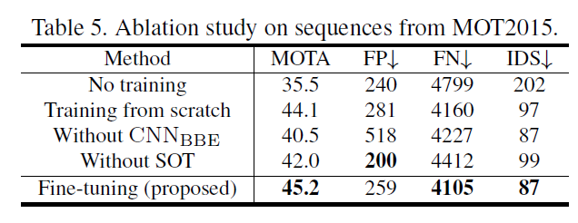

Discussion
For FAMNet, although it implements data association in end-to-end method, it seems that the end-to-end R1TA method didn’t benefit the tracking performance directly. The binary mask and the SOT refinement seem to contribute more to the accuracy.

Slide 8
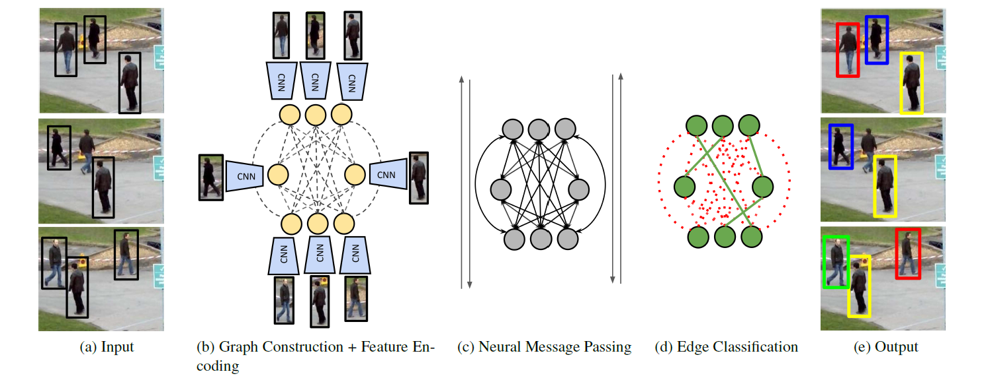
Discussion
It seems that graph is useful for MOT problem, and “Learning a Neural Solver for Multiple Object Tracking” deals with MOT by GNN end to end. Can we use graph matching for the task? E.g., CNN features of detected target as node, and (1) the distance between 2 targets of 1 frame as edge, but the distance may vary a lot depends on the motion direction, or (2) the geometry relation between targets of adjacent frames as edge, following the paper above, and the center node would be used twice.

Slide 9
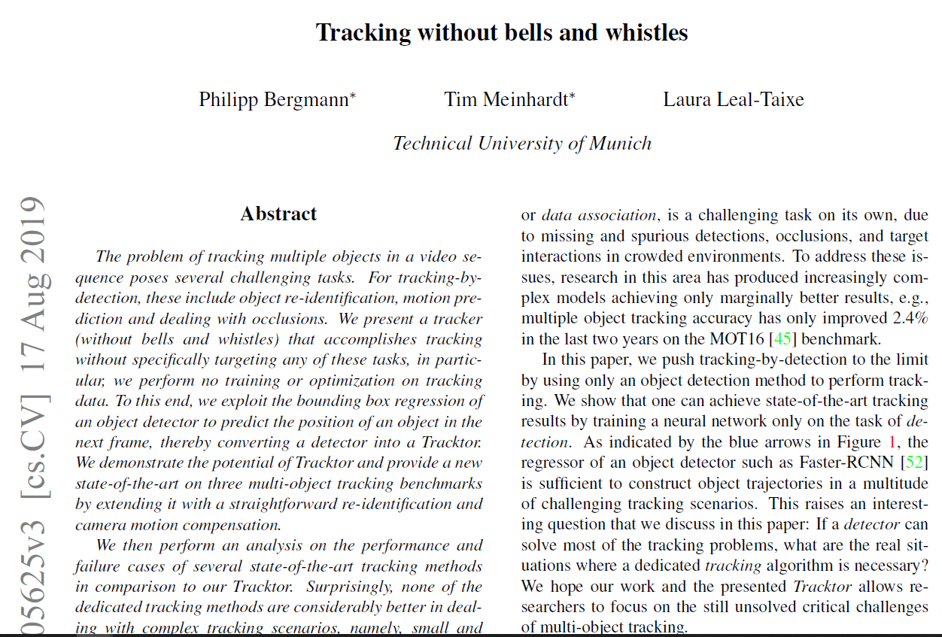
Discussion
Which way to go? Focus on the data association method, or use detector only without any optimization method for data association. I think the second way is also promising due to powerful detectors, and code that is easy to reuse.

Slide 10
Report End
程文胜 6.25

