Slide 1
Weekly Report
程文胜 2021.9.1-9.6

Slide 2
Weekly Report
Abstract
Content
End

Slide 3
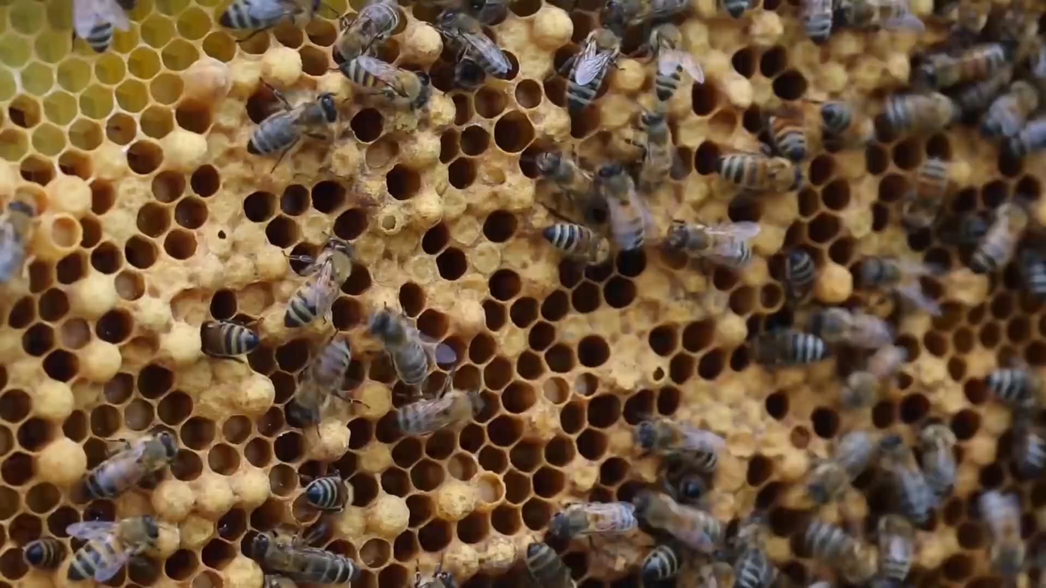
Abstract
Last week I mainly spent time on testing the plan of using baseline’s detection results to train a new detector, using the new detector to detect the next frame, and then generating another new detector.

Slide 4
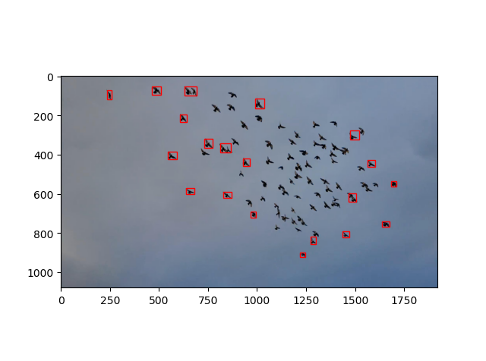
Bird-0 Sequence
I first test on the bird-0 sequence. Specifically, the baseline result of modified Global Track method is used as training sample to train a faster-rcnn model, then the detector is used to detect the next frame.
Baseline result on frame-0
as training sample of faster-rcnn

Slide 5
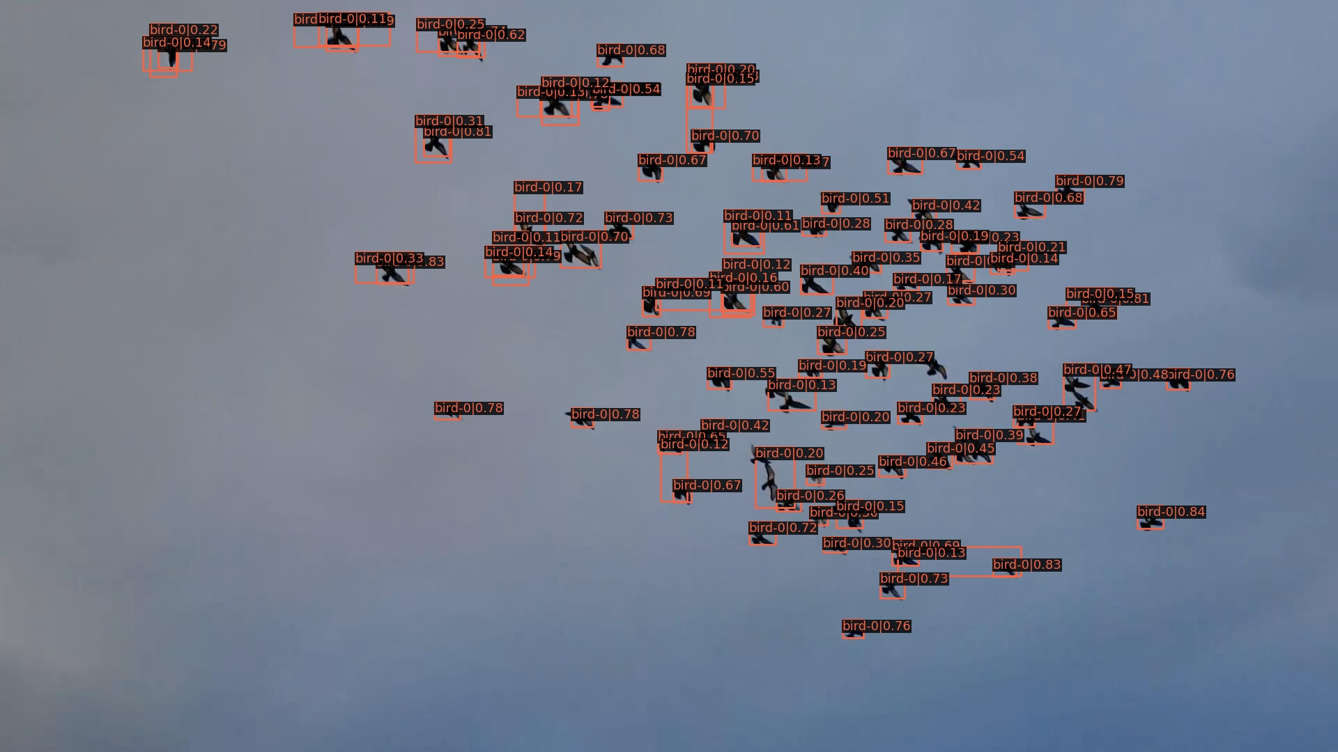
Bird-0 Sequence
The result of faster-rcnn looks better than baseline for the test frame.
Detection result on
frame-1 of trained
faster-rcnn, threshold=0.1

Slide 6

Bird-0 Sequence
But I think this is also related to the pretrained model trained on COCO, which contains the bird category.
Detection result of
Pretrained faster-rcnn, no training on GMOT data.

Slide 7
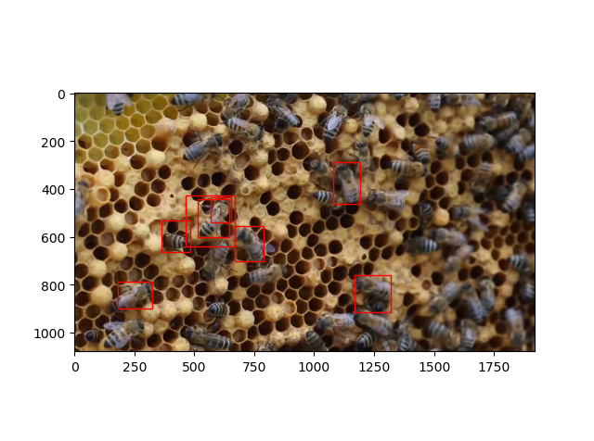
Insect-0 Sequence
To further validate our thought, I test the pipeline on insect-0 sequence, which is not included in classes of COCO dataset.
Baseline result on frame-0
as training sample of faster-rcnn

Slide 8
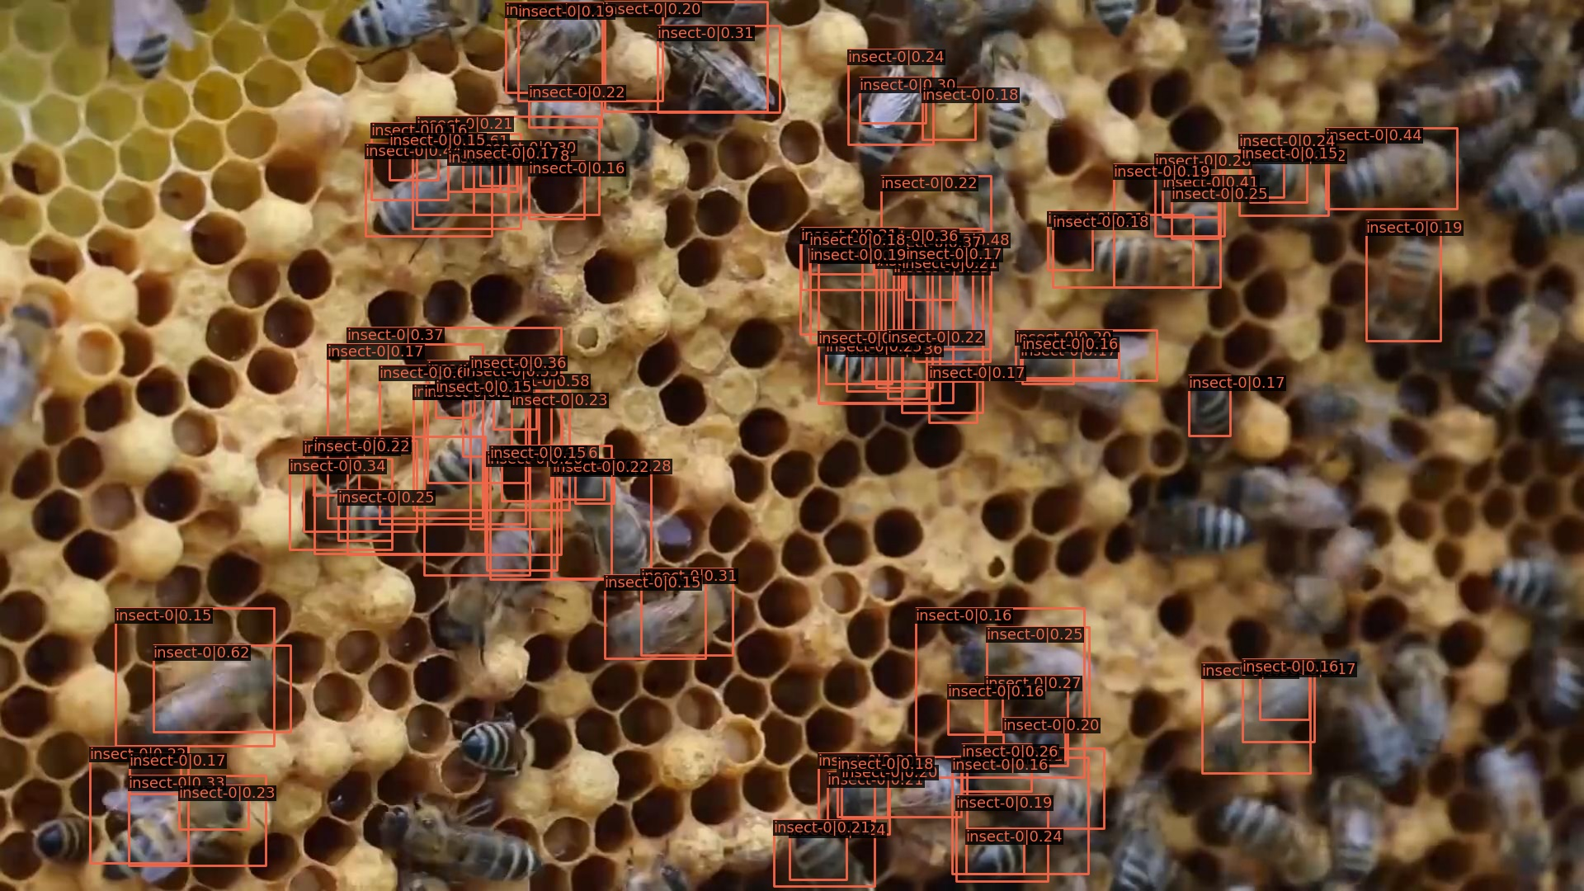
Insect-0 Sequence
The result of faster-rcnn looks better than baseline for the test frame.
Detection result on
frame-1 of trained
faster-rcnn, threshold=0.1

Slide 9
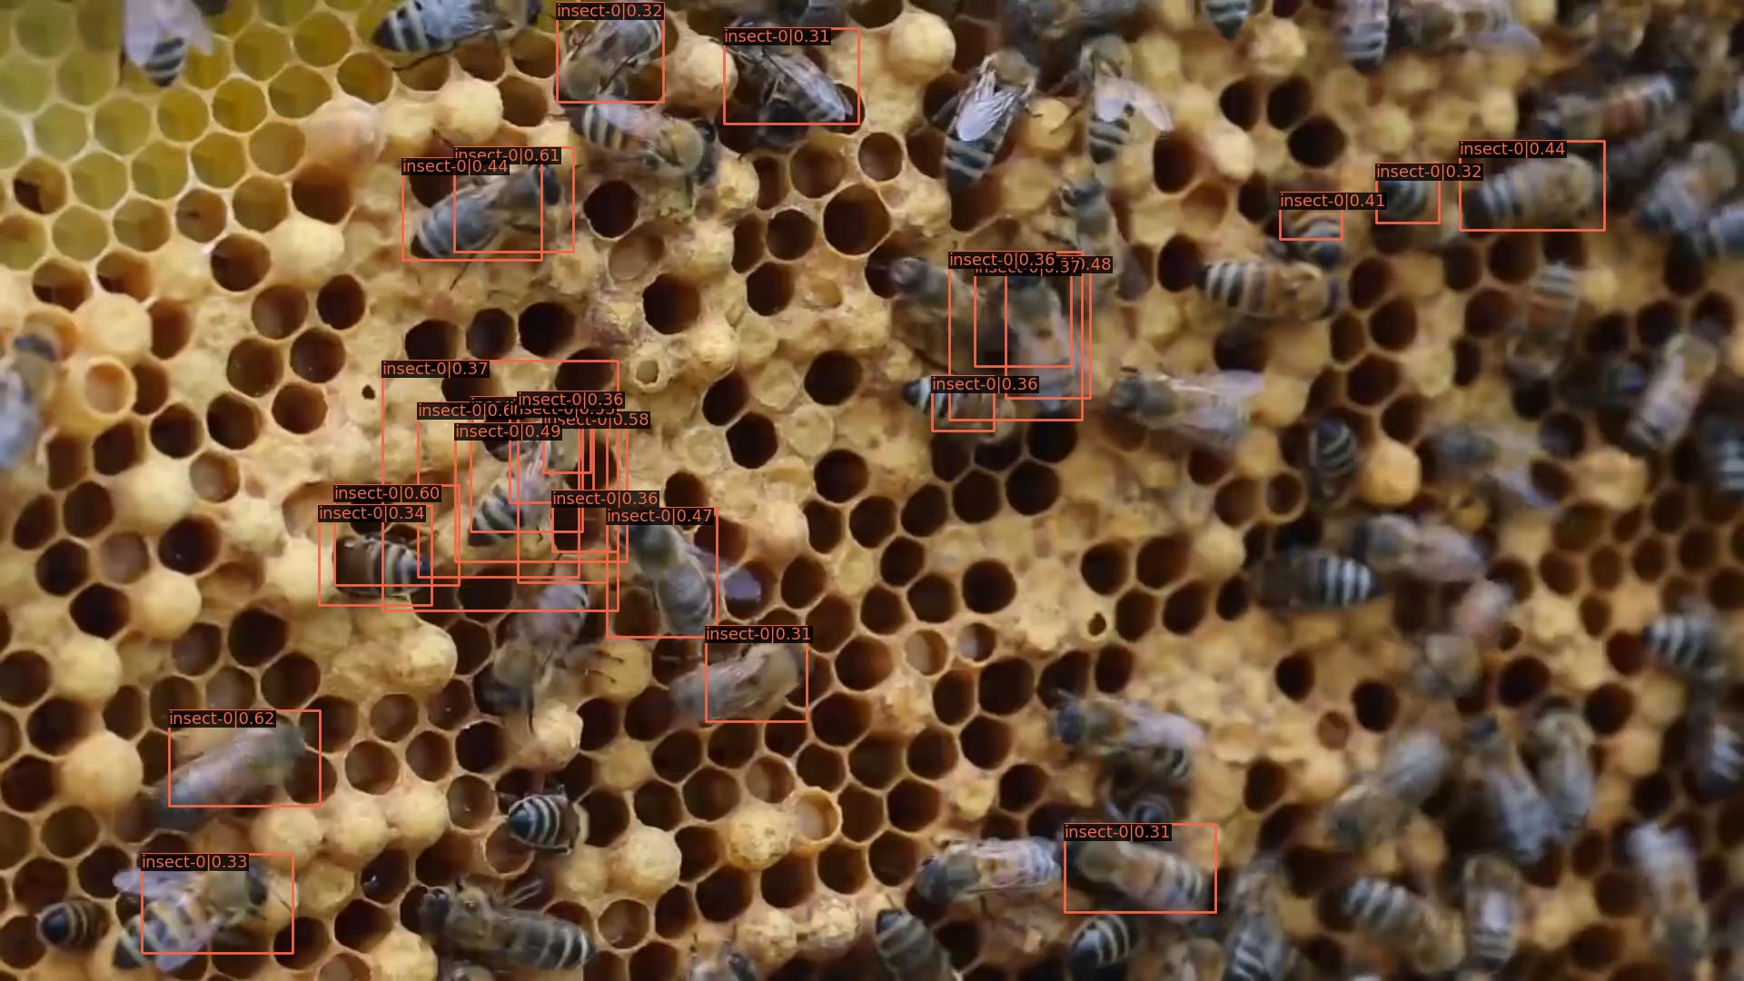
Insect-0 Sequence
The result of faster-rcnn looks better than baseline for the test frame.
Detection result on
frame-1 of trained
faster-rcnn, threshold=0.3

Slide 10
Report End
程文胜 9.6

