Slide 1
Weekly Report
程文胜 2021.9.7-9.15

Slide 2
Weekly Report
Abstract
Content
End

Slide 3
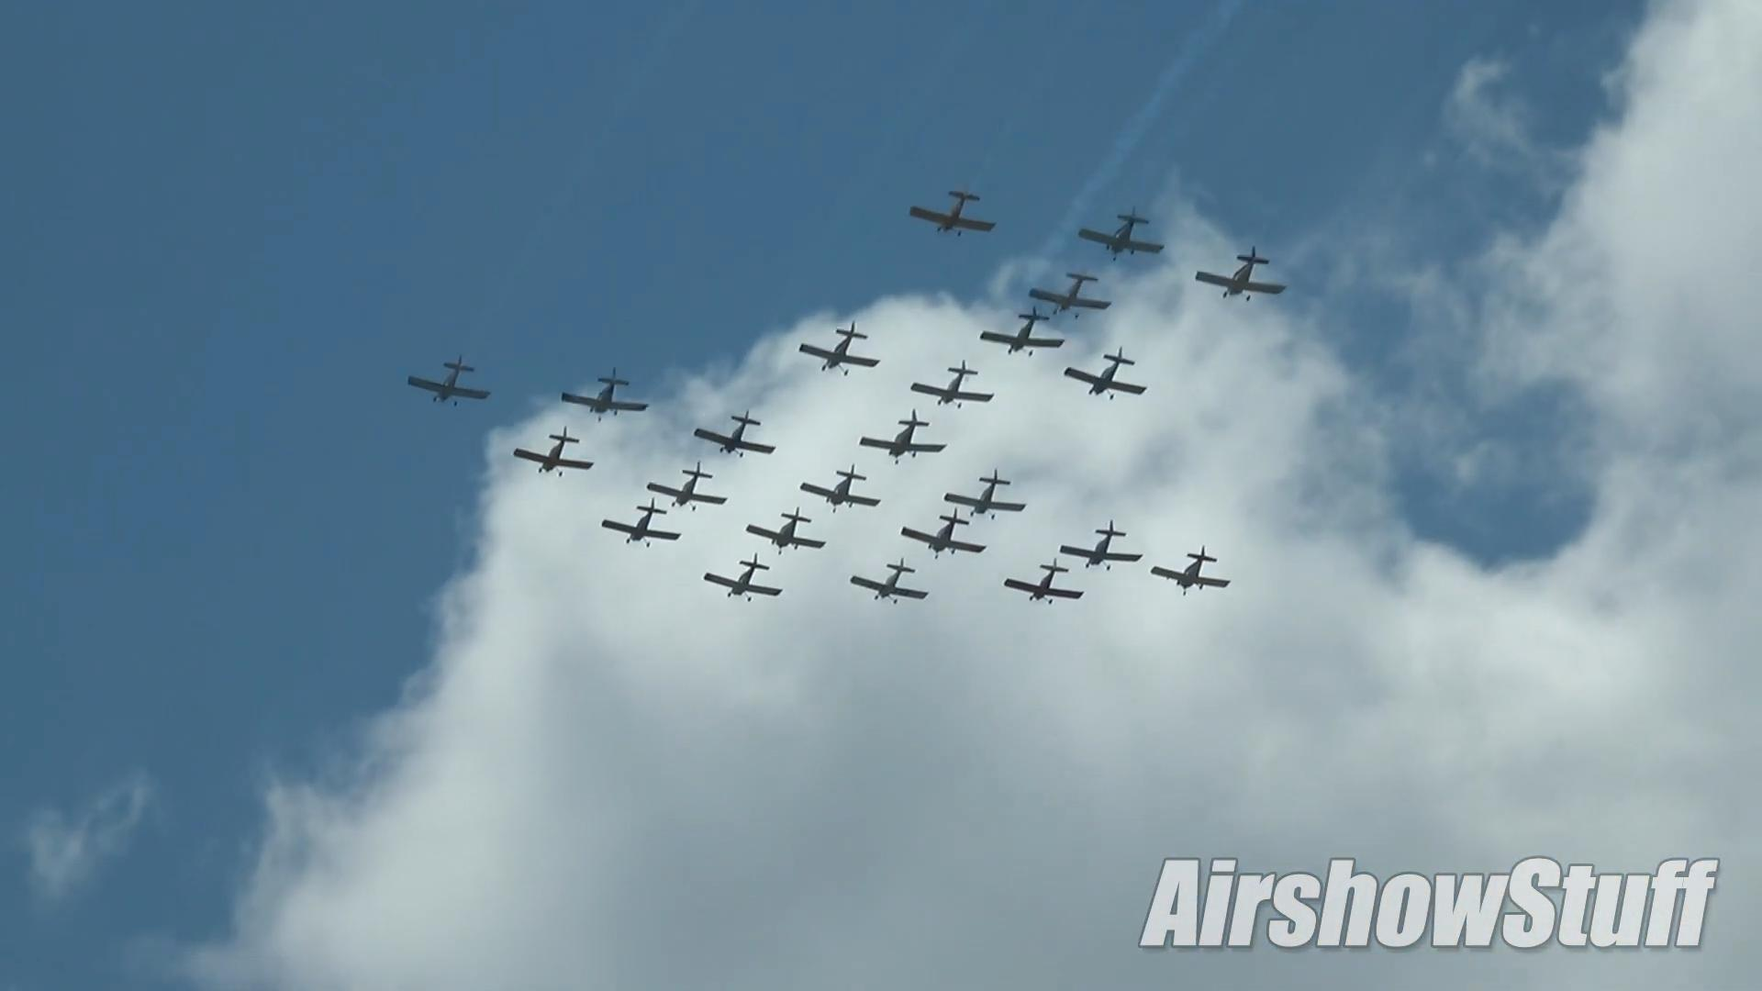
Abstract
Last week I mainly spent time on testing our thought of training a detector with the baseline result on the first image.

Slide 4
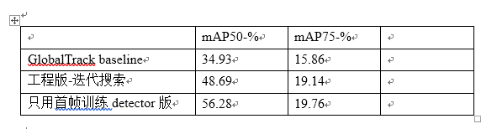
Quantitative Result
The quantitative result on 40 sequences is shown below. Although some classes are seen on COCO, for those classes unavailable on COCO, the way also gets better results.

Slide 5
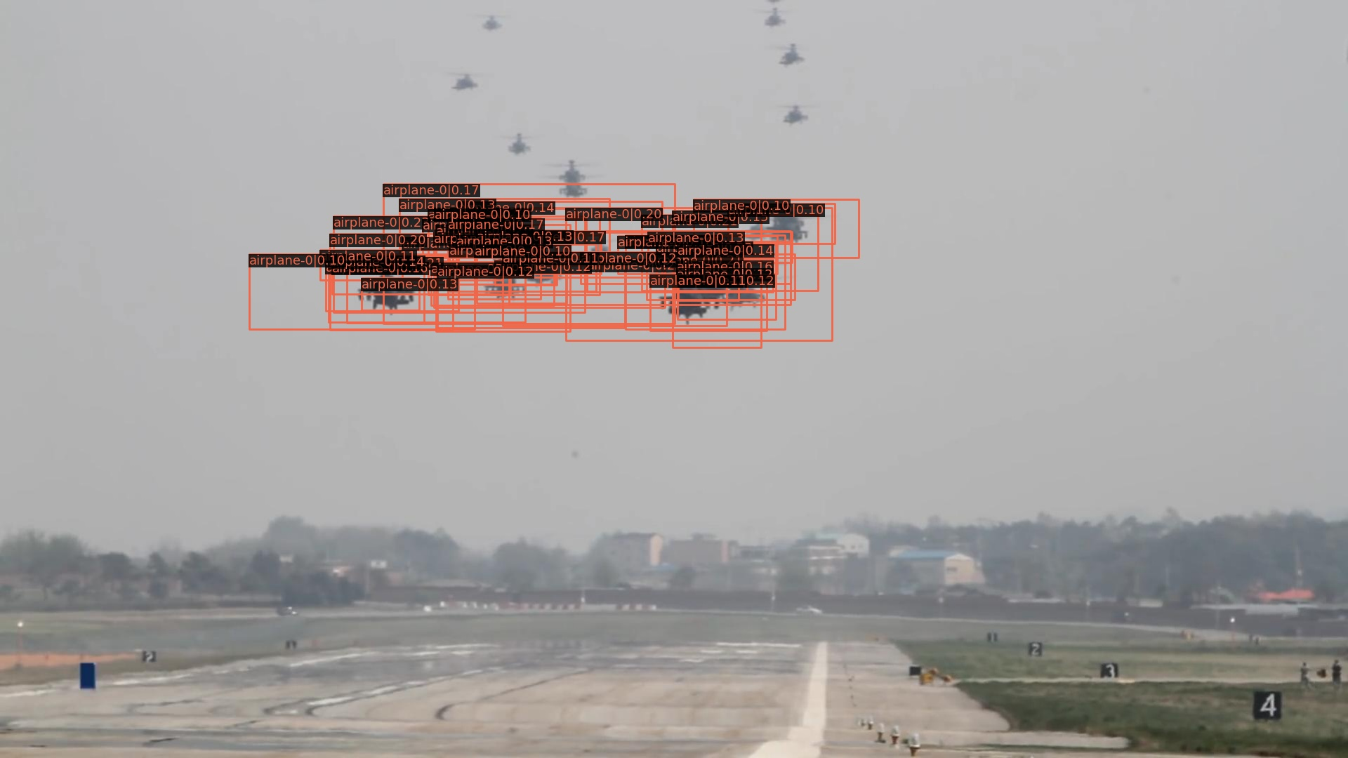
Visual Result
Detection result on frame-1 of trained faster-rcnn, threshold=0.1.

Slide 6
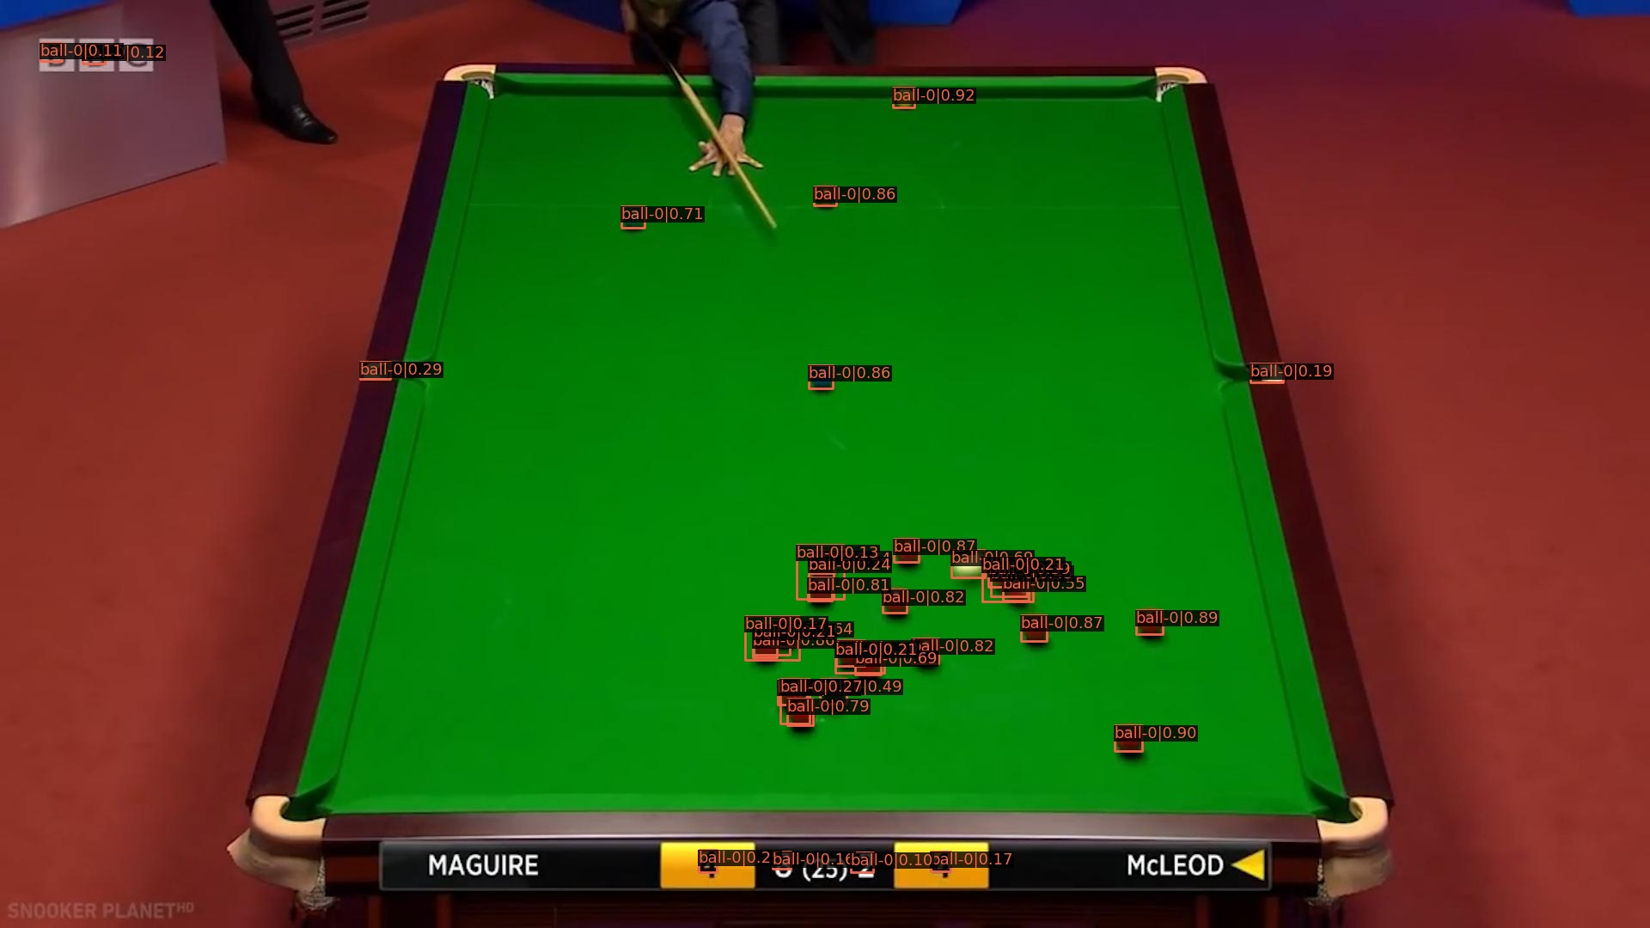
Visual Result
Detection result on frame-1 of trained faster-rcnn, threshold=0.1.

Slide 7
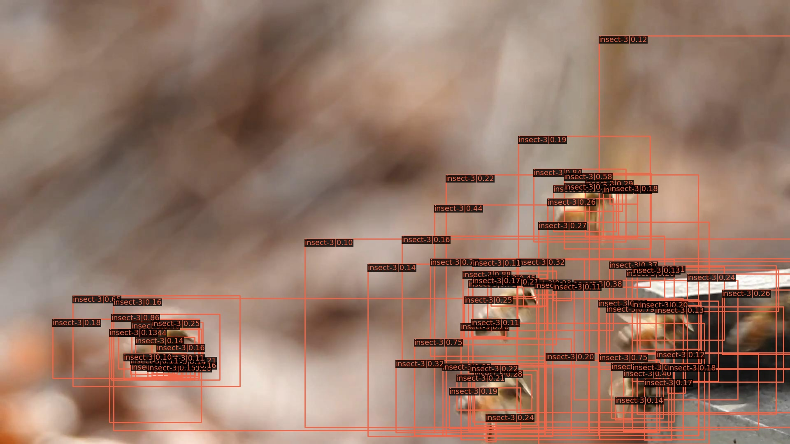
Visual Result
Detection result on frame-1 of trained faster-rcnn, threshold=0.1.

Slide 8
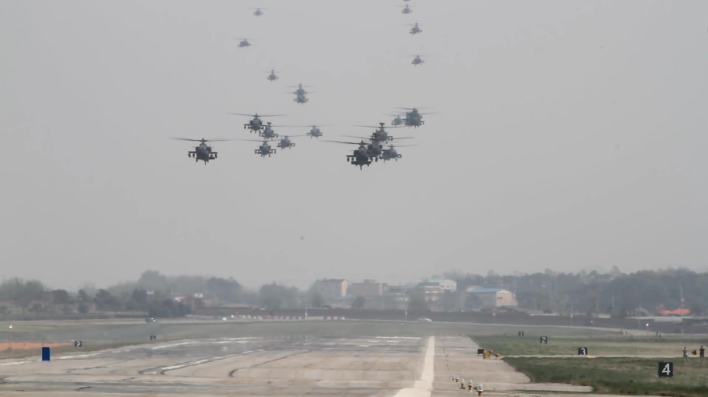
Visual Result
Detection result on frame-1 of trained faster-rcnn, threshold=0.3.

Slide 9
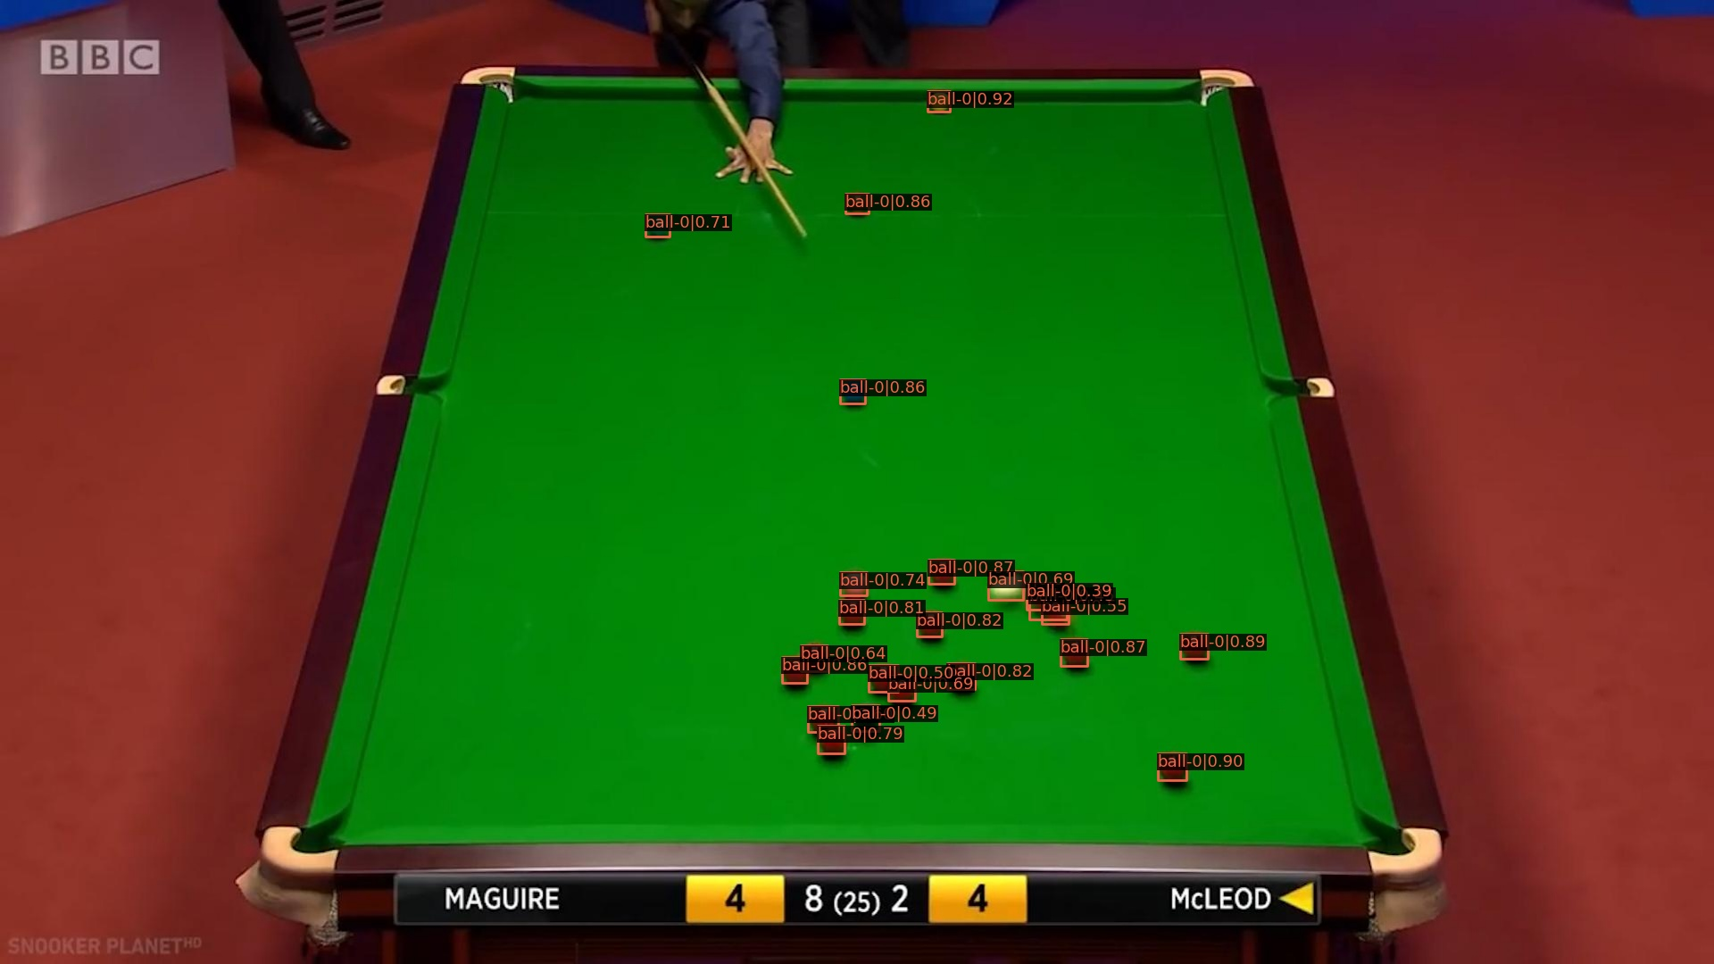
Visual Result
Detection result on frame-1 of trained faster-rcnn, threshold=0.3.

Slide 10
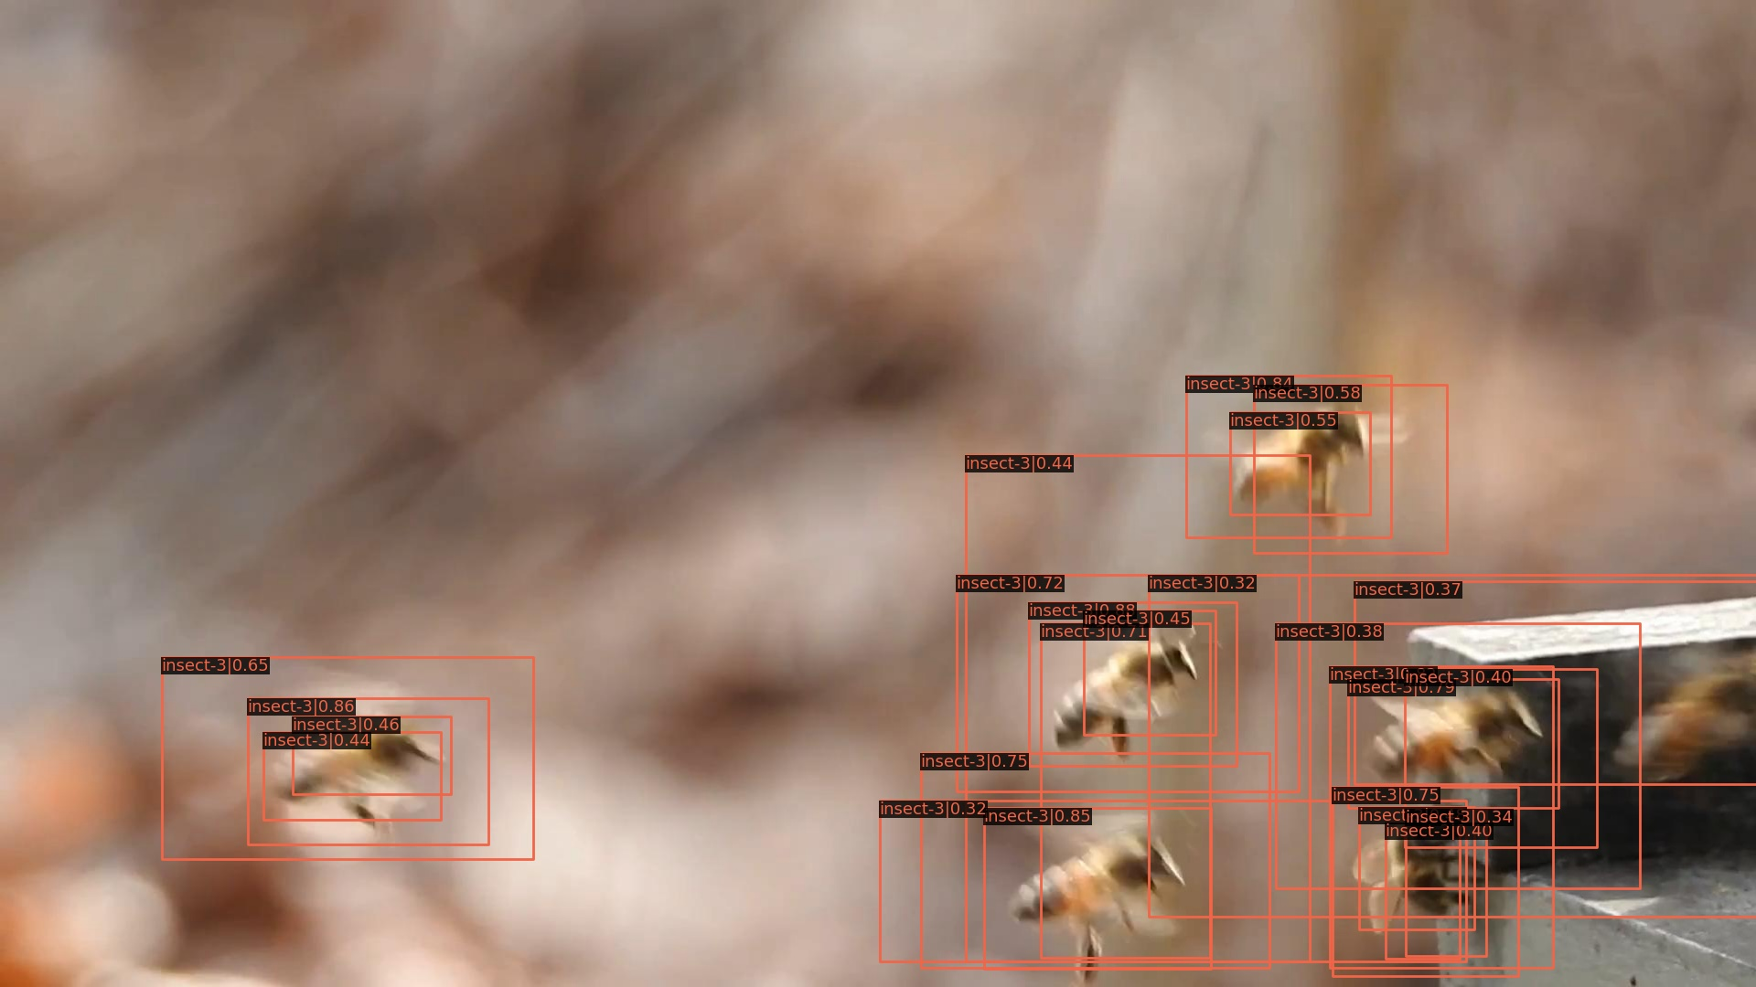
Visual Result
Detection result on frame-1 of trained faster-rcnn, threshold=0.3.

Slide 11
Report End
程文胜 9.15

