Slide 1
Weekly Report
程文胜 2021.3.15-3.21

Slide 2
Weekly Report
Abstract
Content
End

Slide 3
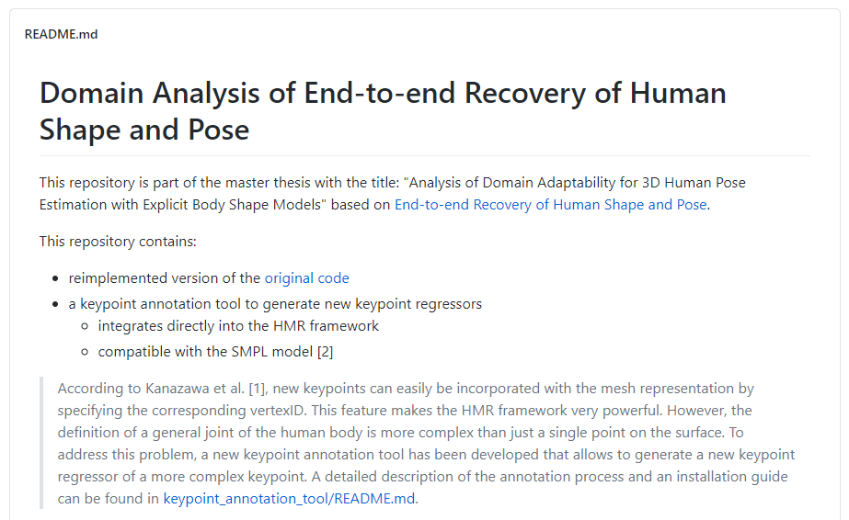
Abstract
Last week I mainly spent time on setting the HMR code environment and running it to get visualization results.

Slide 4
Content
The original code is based on old version python and tensorflow, which requires old version CUDA and cudnn.
For fast downloading, I tried it on Colab. Then I downgraded Colab’s related package, CUDA, cudnn to corresponding version, following the way we did on local machine. But it still reports cudnn error.
Then I turned to other implementations with newer packages, and tried several ones. Finally got one that works.

Slide 5
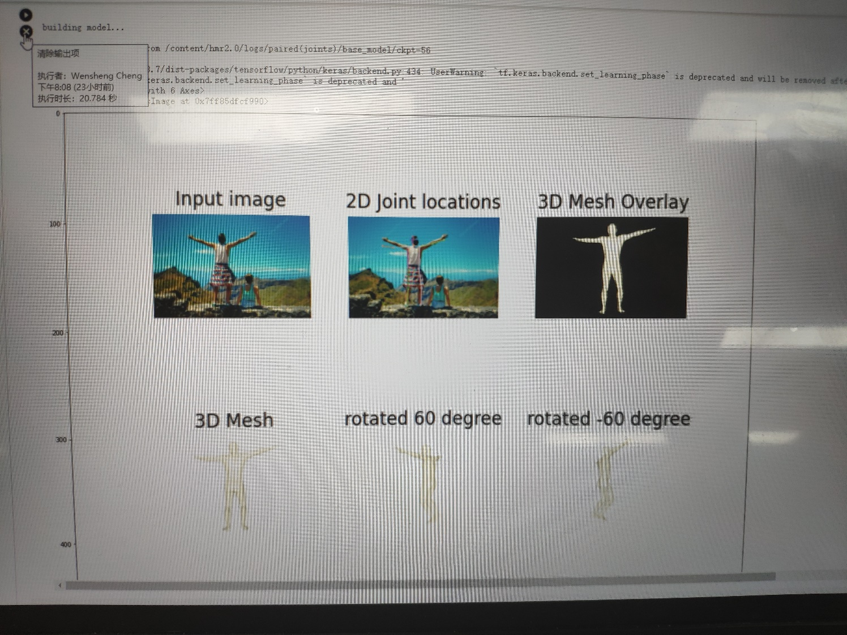
Content
The output is shown below, including the 2D joint estimation and 3D mesh overlay. I picked the image by random, and interestingly this is a failure case. The man’s left arm and knee are estimated wrongly. The wrong limb is due to the model itself. The knee is due to depth ambiguity.

Slide 6
Report End
程文胜 3.21

