Slide 1
Weekly Report
程文胜 2019.5.19-2019.5.25

Slide 2
Weekly Report
Abstract
Content
Discussion

Slide 3

Abstract
This week I mainly put my effort on writing lane extraction journal paper and preparing for team report.

Slide 4
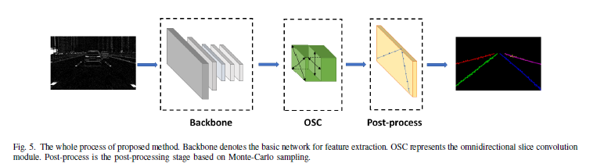
Content
About lane extraction paper, I kept writing it last week. To add content, we did detailed ablation study for verifying the effectiveness of our proposed modules. I also added the motivation of our method.

Slide 5
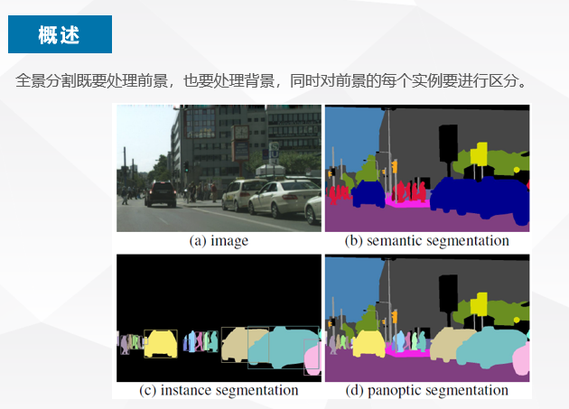
Content
About team report, I made the report of panoptic segmentation. I looked through all related papers accepted by CVPR 2019, and shard them with team members. This is a novel area for remote sensing.

Slide 6
Discussion
Panoptic segmentation is a novel field for remote sensing. ISPRS journal and Remote Sensing journal don’t have related work so far. This is a good chance for our team to occupy the area.
Since there is no panoptic segmentation dataset for remote sensing, it’s necessary to build a new dataset for the task. After building it, we could test our methods on the dataset. It is beneficial for following work and would expand team’s influence a lot.
To guarantee the label quality, we may delegate it to a company. I guess it would be the most efficient way.

Slide 7
Report End
程文胜 VIPG

