Slide 1
Weekly Report
程文胜 2020.8.13-8.21

Slide 2
Weekly Report
Abstract
Content
End

Slide 3
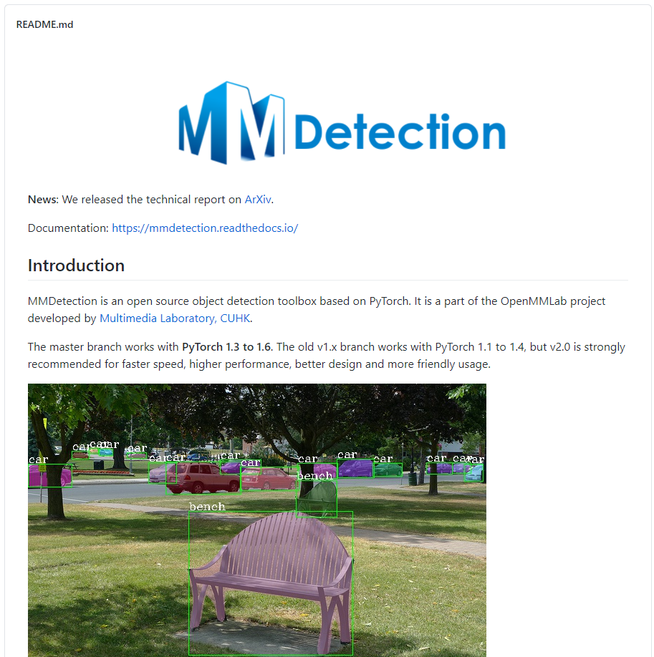
Abstract
In this week, I mainly put my effort on practicing MMDetection benchmark, a flexible framework with strong detection baselines, since the new tracking paradigm heavily depends on detectors.

Slide 4
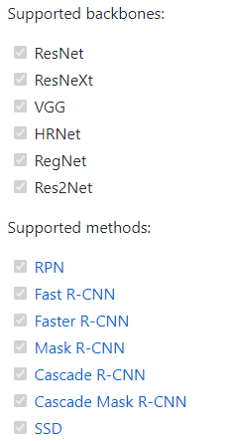
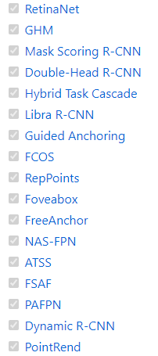
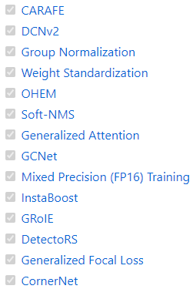
Content
MMDetection is an open source object detection toolbox based on PyTorch. It is a part of the OpenMMLab project developed by Multimedia Laboratory, CUHK.
Chen K, Wang J, Pang J, et al. Mmdetection: Open mmlab detection toolbox and benchmark[J].
arXiv preprint arXiv:1906.07155, 2019.

Slide 5
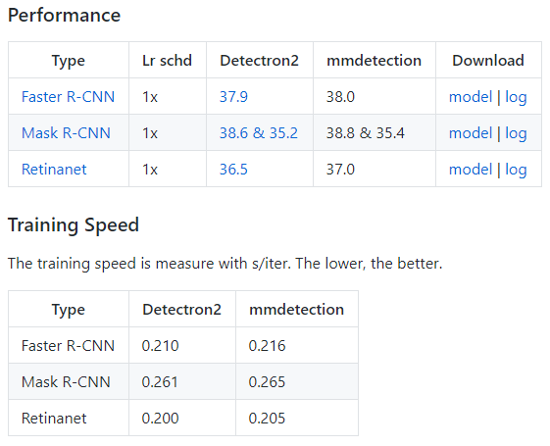

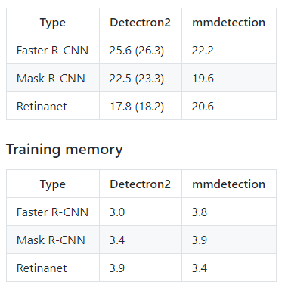
Content
All basic bbox and mask operations run on GPUs. The training speed is faster than or comparable to other codebases, including Detectron2, maskrcnn-benchmark and SimpleDet.

Slide 6
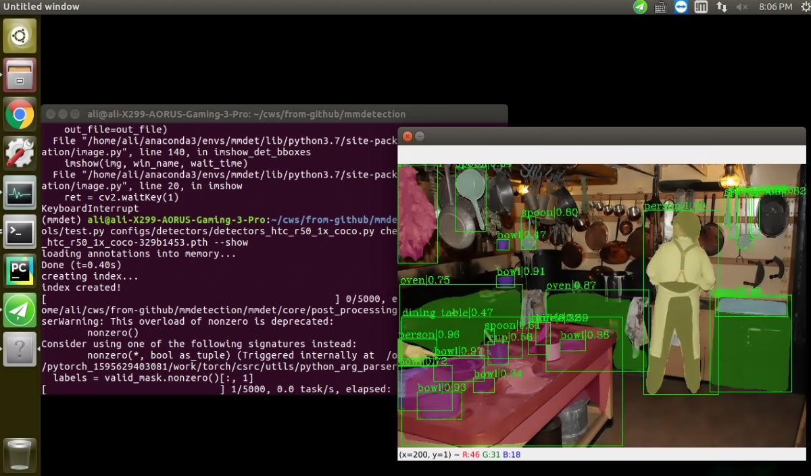
Content
With this codebase, I tested DetectoRS detector, which is a newly released one that achieved SOTA detection on the public dataset. I plan to combine MOT data with the codebase in the next week.
Qiao S, Chen L C, Yuille A. DetectoRS: Detecting Objects with Recursive Feature Pyramid and Switchable Atrous Convolution[J].
arXiv preprint arXiv:2006.02334, 2020.

Slide 7
Report End
程文胜 8.21

