Slide 1
Weekly Report
程文胜 2019.4.14-2019.4.20

Slide 2
Weekly Report
Abstract
Content
Discussion

Slide 3
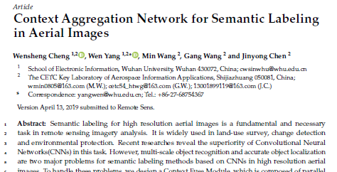
Abstract
This week I mainly put my effort on the workshop camera-ready paper and journal paper.

Slide 4
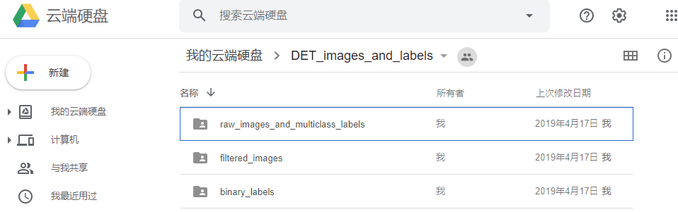
Content
About workshop camera-ready paper, we need to provide raw event data and accumulated images. However, the data size is so large (>30 GB), and I tried many ways to upload it. Finally, I put it on the cloud storage Mega and GoogleDrive.

Slide 5
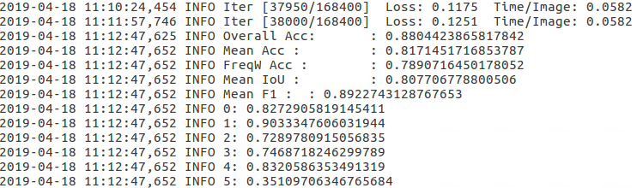
Content
About journal paper, I built the model with dilated ResNet50 and trained it for several days. However, the result didn’t get improved. OA of this model with dilated ResNet is 88.04% vs. 88.77% without dilated ResNet.

Slide 6
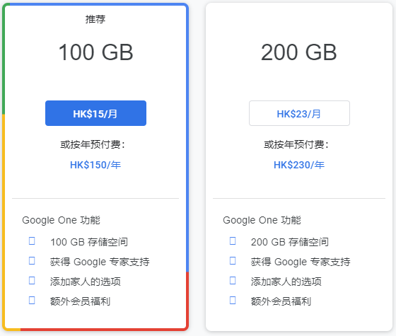
Discussion
When we release datasets, we often choose cloud storage, like GoogleDrive. But the free space storage is only 15 GB, which is not enough for big datasets. I tried NAS of our lab, but Yang Xiangli can’t access it in France and Yu Huai can access it with relatively low speed in USA. So I suggest that we can buy cloud storage for the lab on GoogleDrive, about 100 RMB for 100 GB/year, which is the cheapest of all common services.

Slide 7
Report End
程文胜 VIPG

