Slide 1
Weekly Report
程文胜 2021.2.14-2.21

Slide 2
Weekly Report
Abstract
Content
End

Slide 3
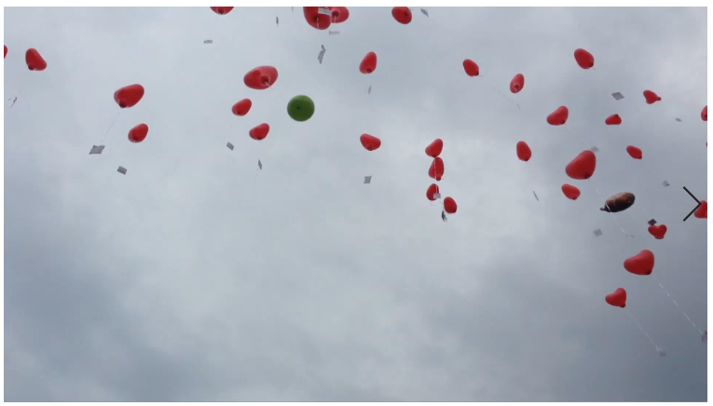
Abstract
Last week I mainly spent time on labeling balloon data, including balloon-0, balloon-1 and balloon-3 sequences.

Slide 4
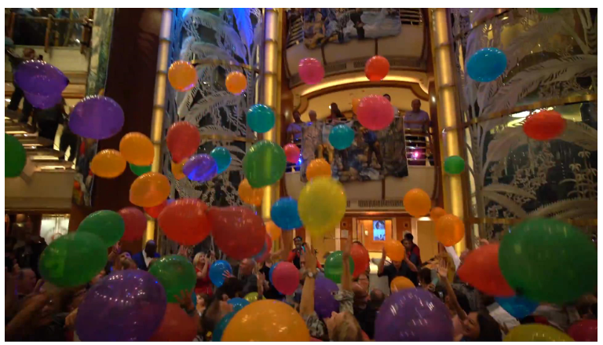
Content
For balloon-0, original annotations only contain balloons with orange color, so I need to add annotations for all the rest balloons with various colors. This sequence is really hard, since the occlusion happens very often and balloons would change their tracks suddenly due to people’s hit.

Slide 5
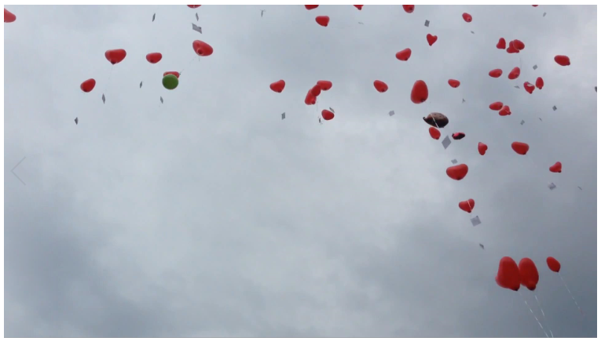
Content
For balloon-1 and balloon-3, all red balloons have been annotated before. There are many white balloons in balloon-1 sequence, and only two green balloons in balloon-1 sequence, which is easier to label the track.

Slide 6
Report End
程文胜 2.21

