Slide 1
Weekly Report
程文胜 2021.2.28-3.8

Slide 2
Weekly Report
Abstract
Content
End

Slide 3
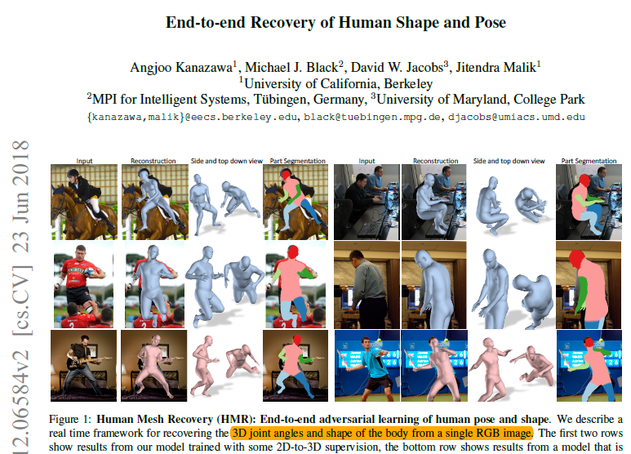
Abstract
Last week I mainly spent time on reading human mesh recovery papers and translating 2 papers for our team’s need in the company.

Slide 4
Content
I mainly took time to read paper “End-to-end Recovery of Human Shape and Pose”. This paper proposes a method to reconstruct human mesh from one single image without paired 2D-to-3D supervision. The reality of reconstructed meshes are improved via adversarial loss, besides the widely used reprojection error.
Although GAN is helpful on generating realistic meshes in an unsupervised way, it’s not as accurate as the supervised method. It can only make it realistic in the semantic meaning, but not targeting a specific 2D image input. If the pose for the 2D image input is rare in the 3D mesh dataset, then it’s hard for the method to get accurate result.

Slide 5
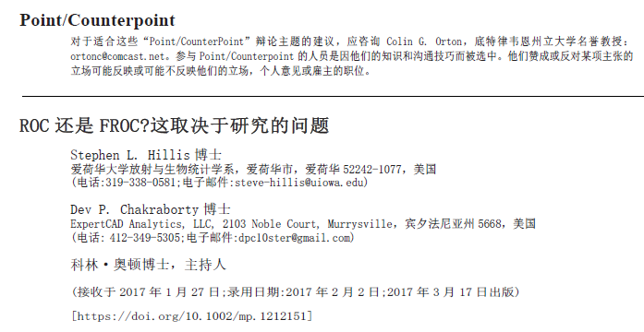
Content
I also spent time on translating two papers. One is about focal loss, a classic paper about dealing with hard negative samples in object detection field. Another is about ROC or FROC, a discussion about which metric is more suitable for clinical reality.

Slide 6
Report End
程文胜 3.8

