Slide 1
Weekly Report
程文胜 2021.3.21-3.29

Slide 2
Weekly Report
Abstract
Content
End

Slide 3
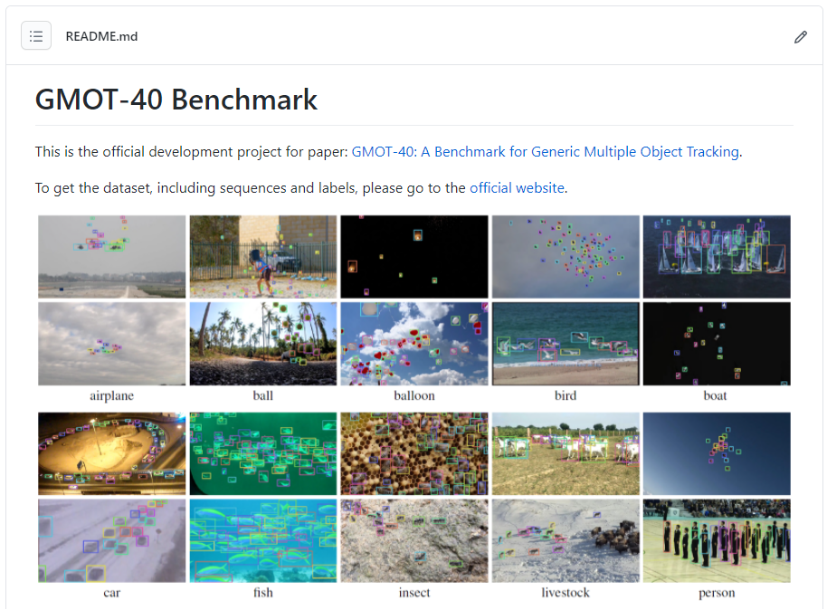
Abstract
Last week I mainly spent time on revising our GMOT final paper and constructing the dataset website.

Slide 4
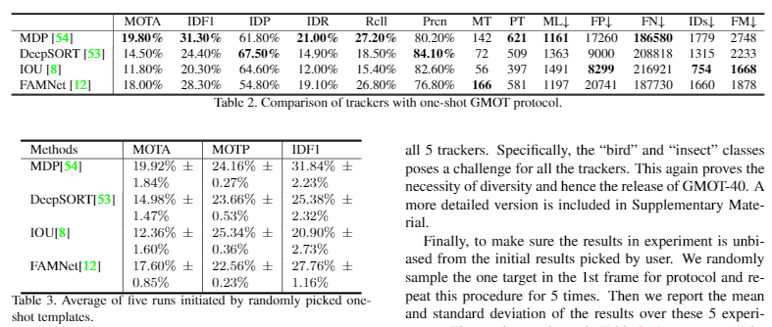
Content
Since we need to remove the old protocol 1 and refine labels, we have changed related statement and re-run all experiments to get the table data.

Slide 5
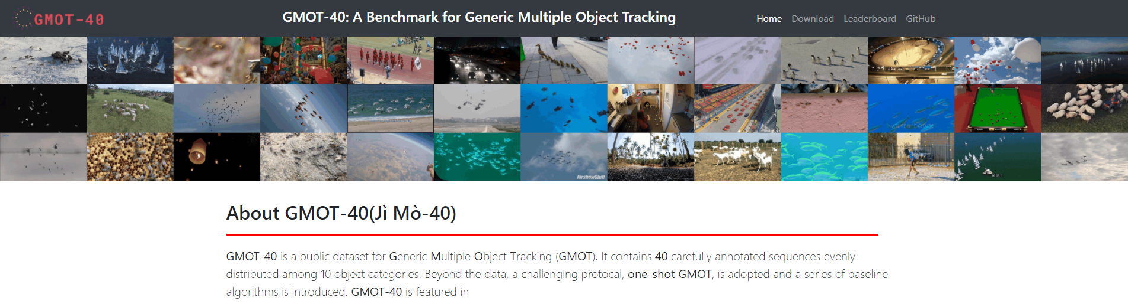
Content
I create two web projects for our dataset. One is the GitHub project, which is the link included in the paper. It provides the place for users to discuss. Another one is the dataset website, which is for downloading data and showing leaderboard. In this way, we can alter the website later in the future when needed, without changing the link in the paper.

Slide 6
Report End
程文胜 3.29

