Slide 1
Weekly Report
程文胜 2021.3.29-4.5

Slide 2
Weekly Report
Abstract
Content
End

Slide 3
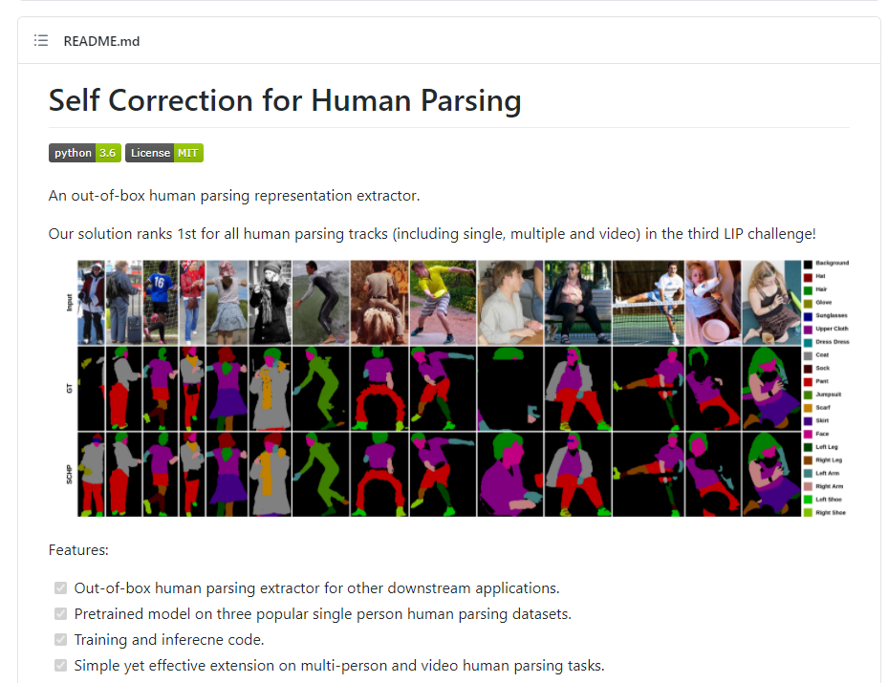
Abstract
Last week I mainly spent time on running part segmentation code, which we plan to use in our later work.

Slide 4
Content
Mesh recovery consists of 2 parts, pose estimation and shape estimation. Pose estimation can be refined by 2D keypoints information, but shape information is not directly supervised in most current methods.
Therefore, we plan to use 2D keypoints information to refine 2D part segmentation result, since 2D keypoints information is more accurate than segmentation result, and then use both information to supervise the training of mesh recovery.

Slide 5
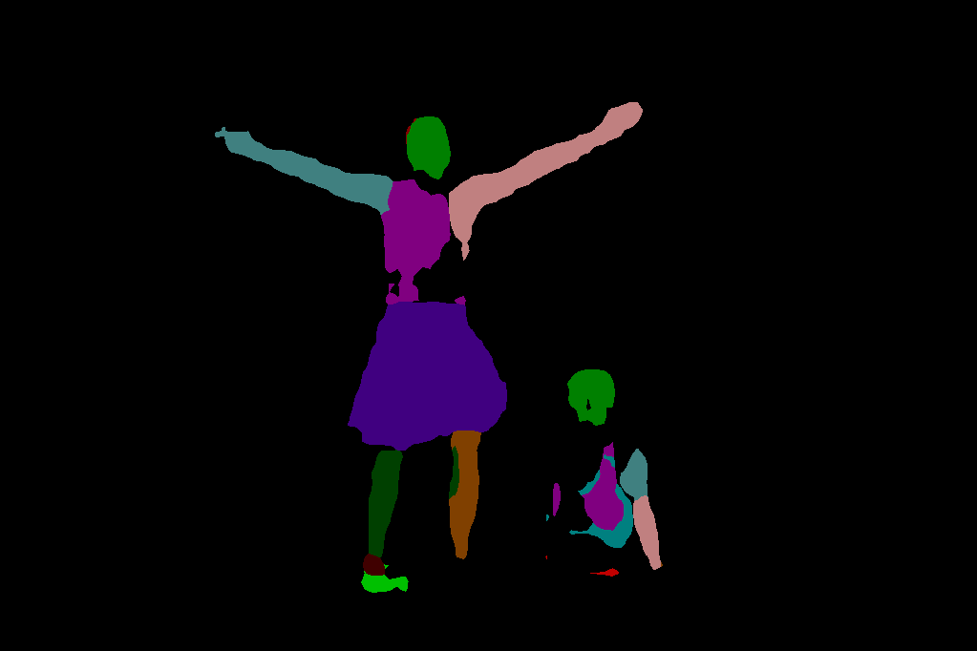



Content
Iteration
Predict
2D Part segmentation
Predict
Refine
Input
Mesh output
Predict
Iteration
2D keypoints

Slide 6
Report End
程文胜 4.5

