Slide 1
Weekly Report
程文胜 2021.4.13-4.19

Slide 2
Weekly Report
Abstract
Content
End

Slide 3
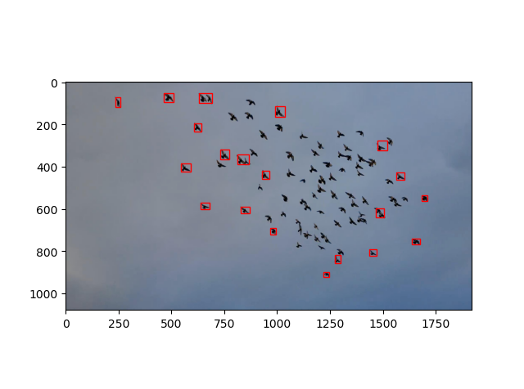
Abstract
Last week I mainly spent time on trying our baseline method, which uses the searching results of the first frame as templates, and then merges the results.

Slide 4
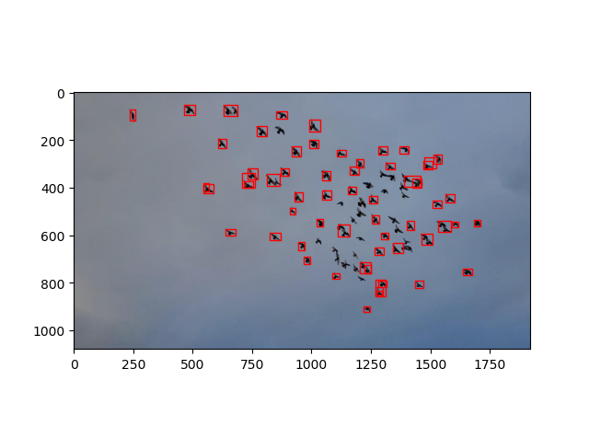
Content
The very basic idea has increased detection recall a lot, and the mAP-50 and mAP-75 are raised a lot.
Original GlobalTrack
Baseline

Slide 5
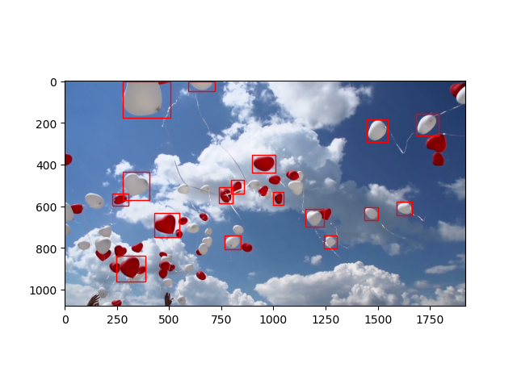
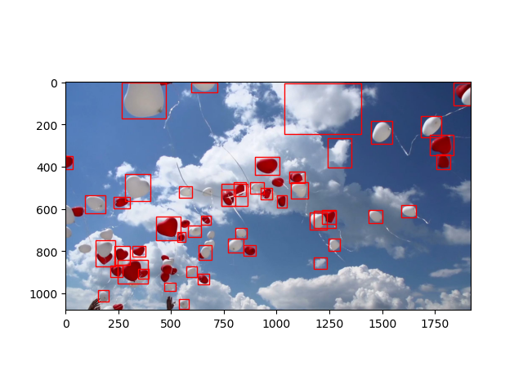
Content
Original GlobalTrack
Baseline

Slide 6
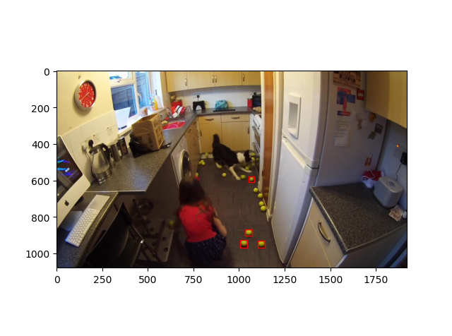

Content
Original GlobalTrack
Baseline

Slide 7
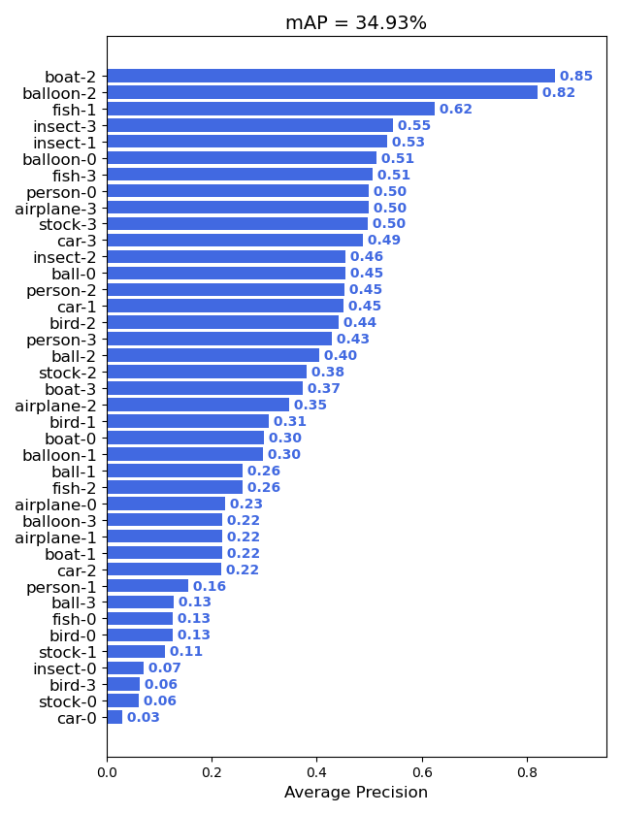
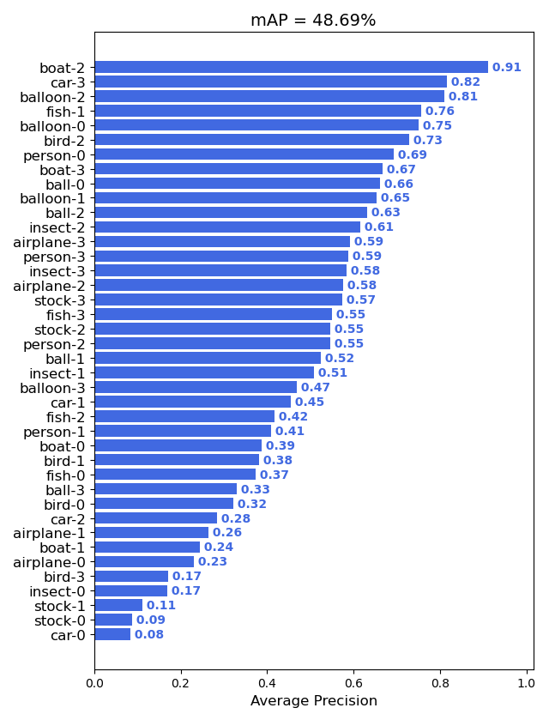
Content
Original GlobalTrack mAP-50
Baseline mAP-50

Slide 8
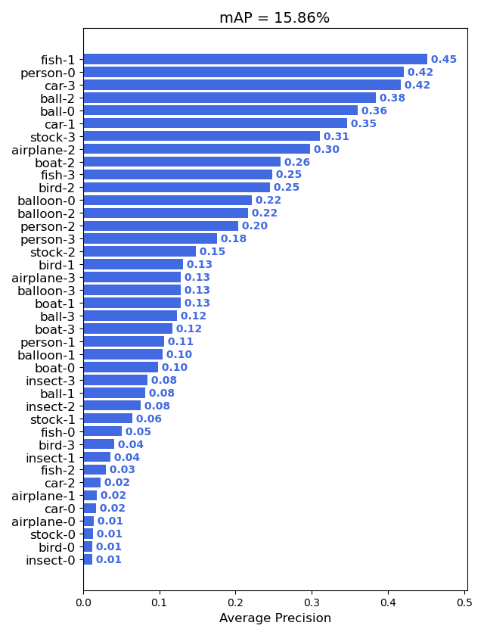
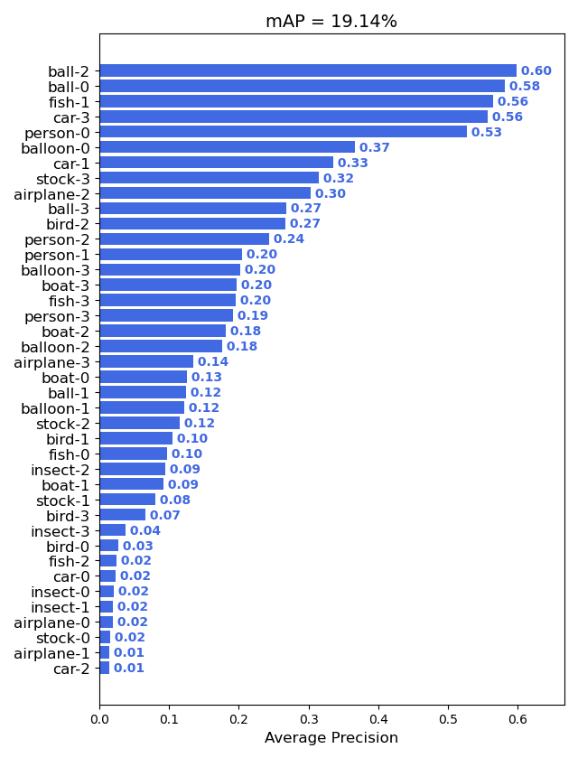
Content
Original GlobalTrack mAP-75
Baseline mAP-75

Slide 9
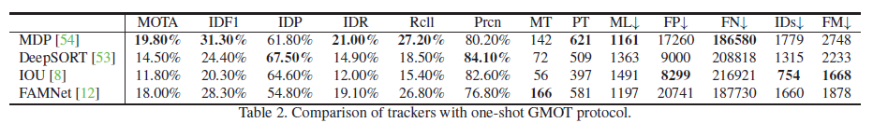
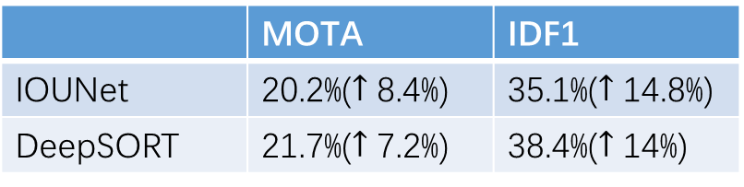
Content
I also let senior Hexin help me test the MOT metrics, and these metrics also increase a lot. Still, we need to use a more modern technique to upgrade our method.
 | MOTA | IDF1
IOUNet | 20.2%($↑$ 8.4%) | 35.1%($↑$ 14.8%)
DeepSORT | 21.7%($↑$ 7.2%) | 38.4%($↑$ 14%)

Slide 10
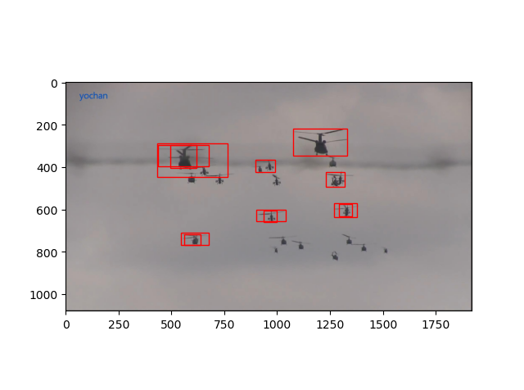
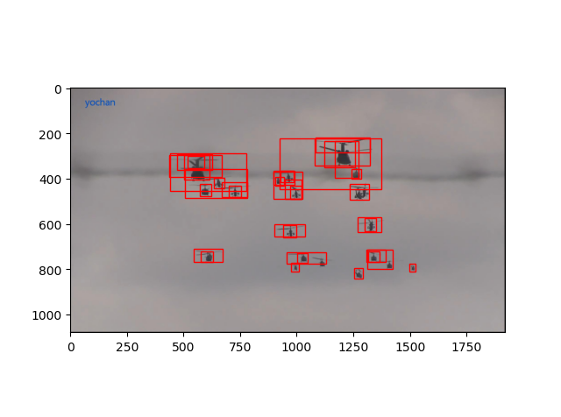
Content
The problem is, the false positive cases also increase a lot. We may set a higher confidence threshold when taking results as new templates to alleviate the problem.
Original GlobalTrack
Baseline

Slide 11
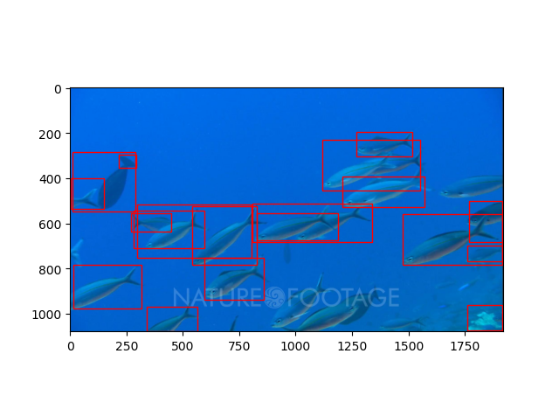
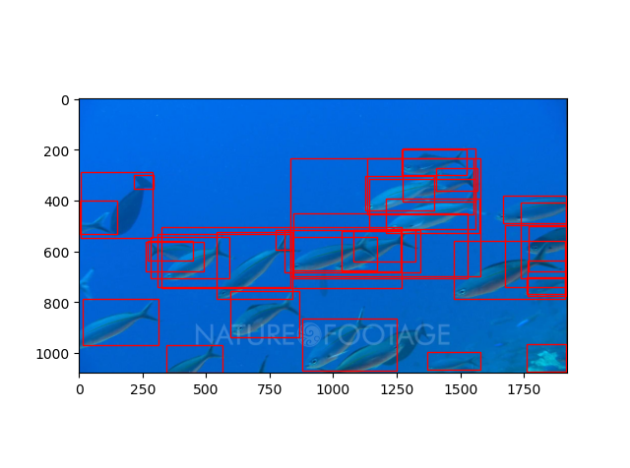
Content
Original GlobalTrack
Baseline

Slide 12
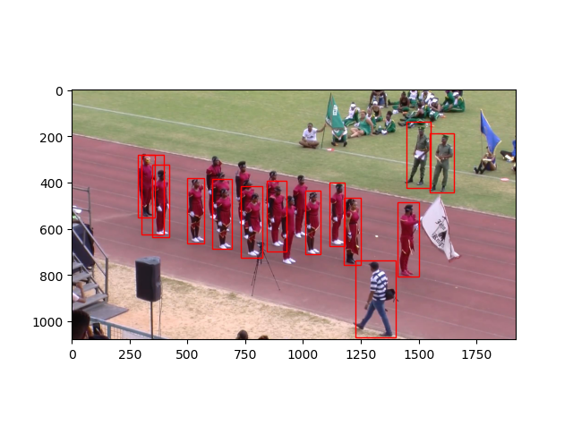
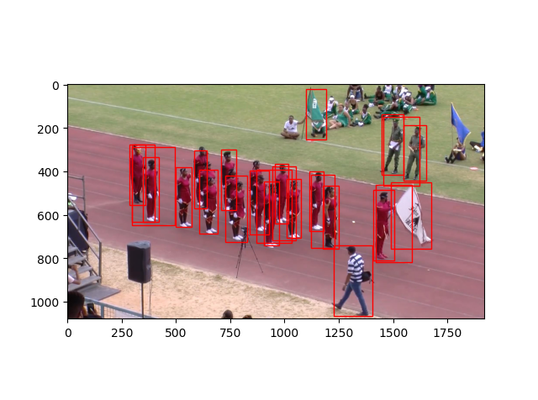
Content
Original GlobalTrack
Baseline

Slide 13
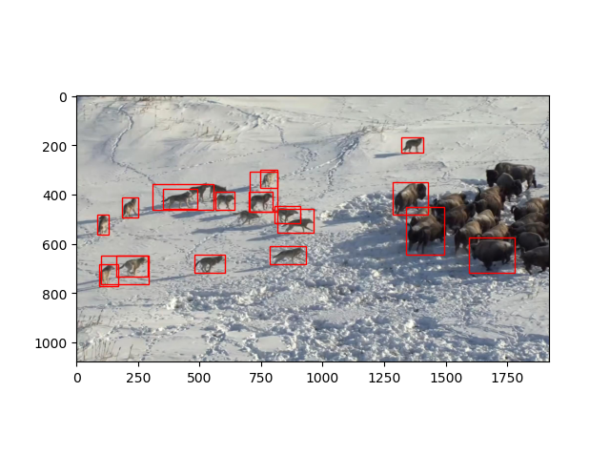
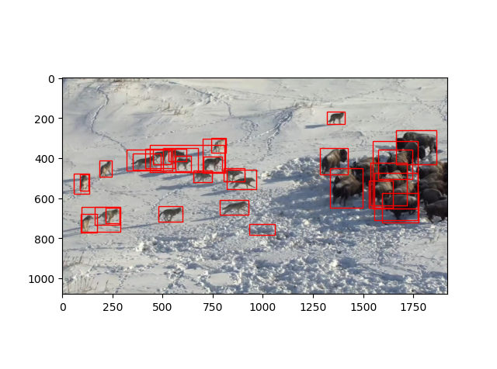
Content
Original GlobalTrack
Baseline

Slide 14
Report End
程文胜 4.19

