Slide 1
Weekly Report
程文胜 2021.4.19-4.26

Slide 2
Weekly Report
Abstract
Content
End

Slide 3
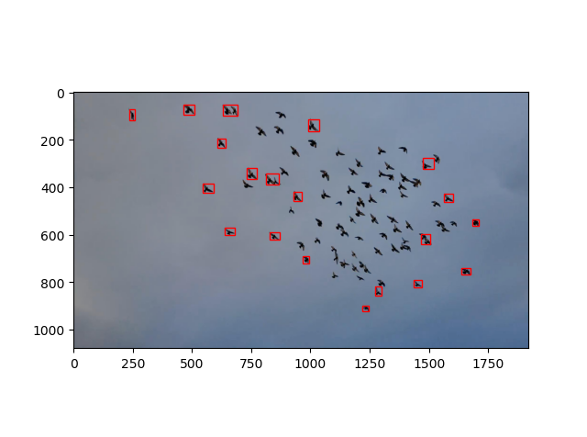
Abstract
Last week I mainly spent time on trying our baseline method with different thresholds, and analyzing the distribution of searching results.

Slide 4
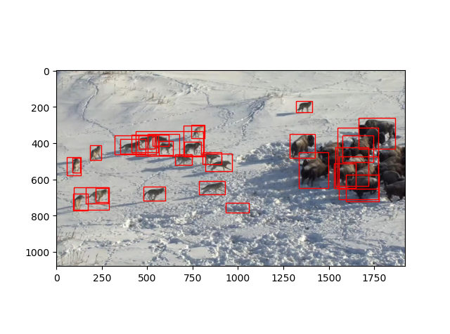
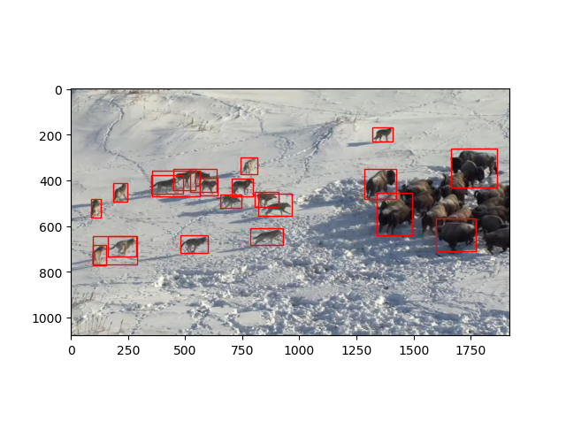
Content
I first tried to use a higher threshold to filter out those false positive searching results. However, some true positive samples also have low confidence score, and the total performance drops down, compared with a lower threshold.
Conf threshold=0.1
Conf threshold=0.2

Slide 5
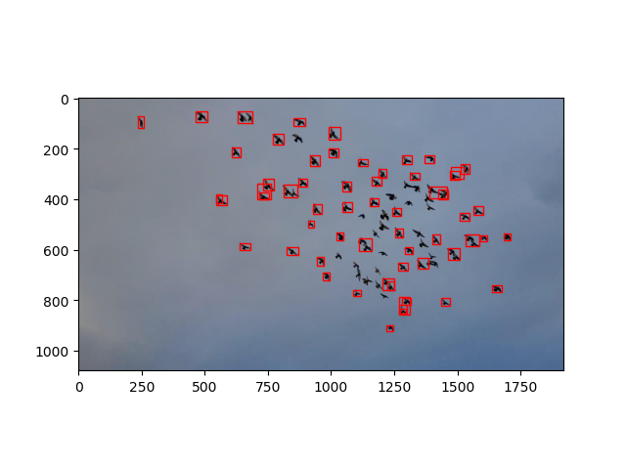
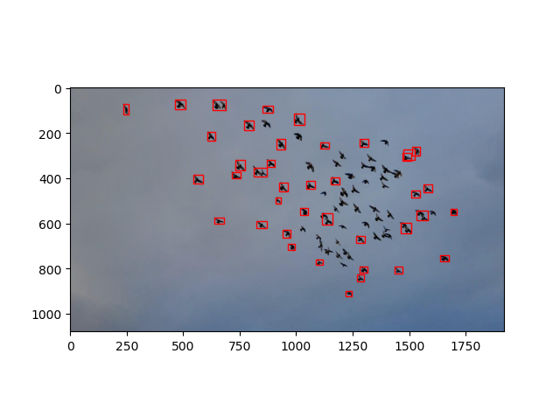
Content
Conf threshold=0.1
Conf threshold=0.2

Slide 6
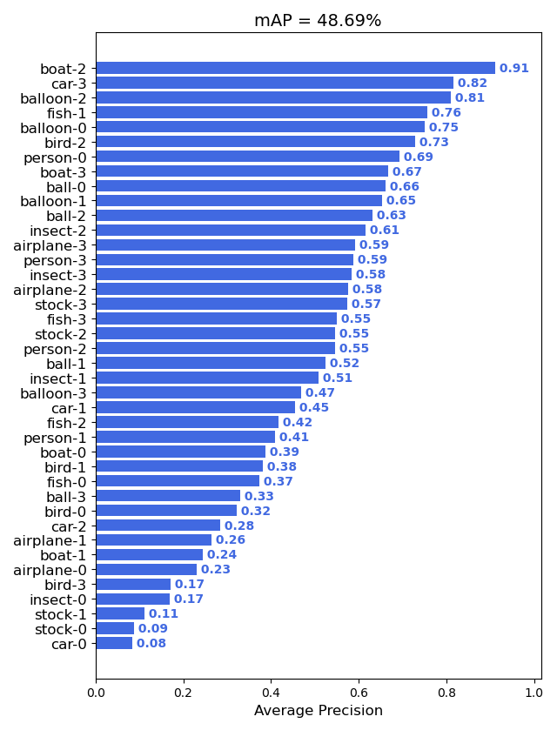
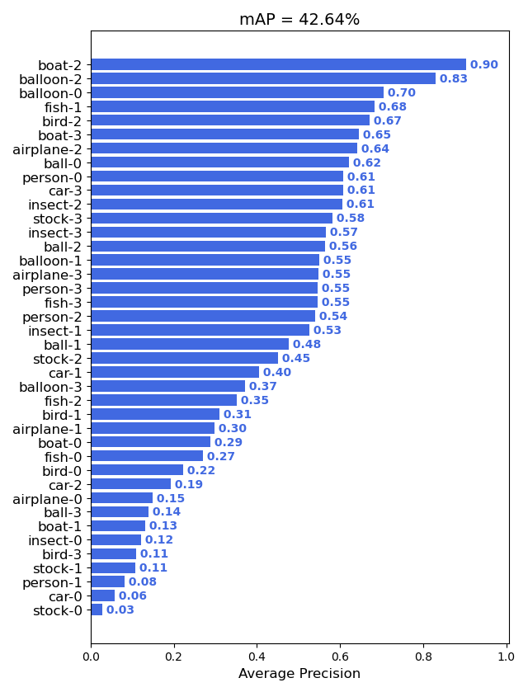
Content
Conf threshold=0.1
Conf threshold=0.2

Slide 7
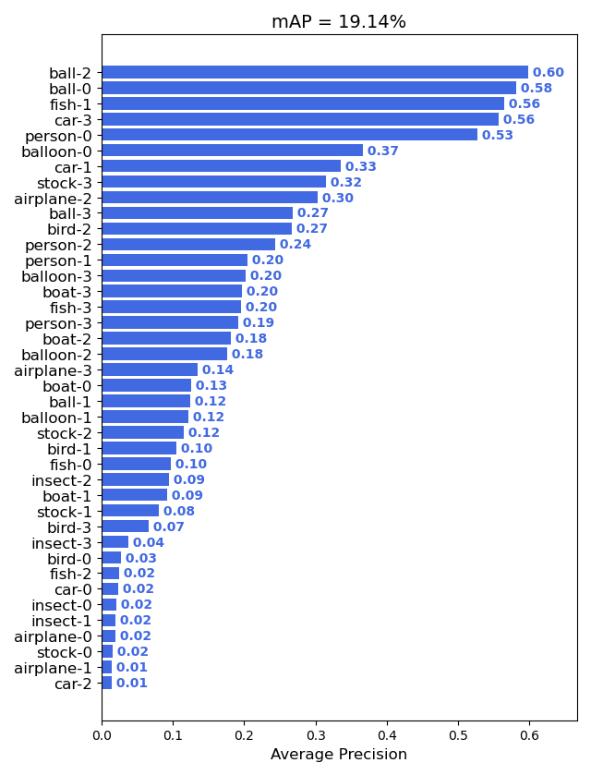
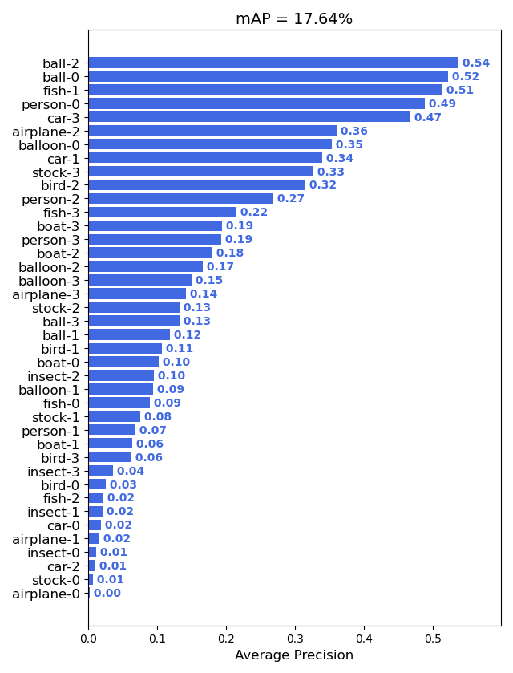
Content
Conf threshold=0.1
Conf threshold=0.2

Slide 8
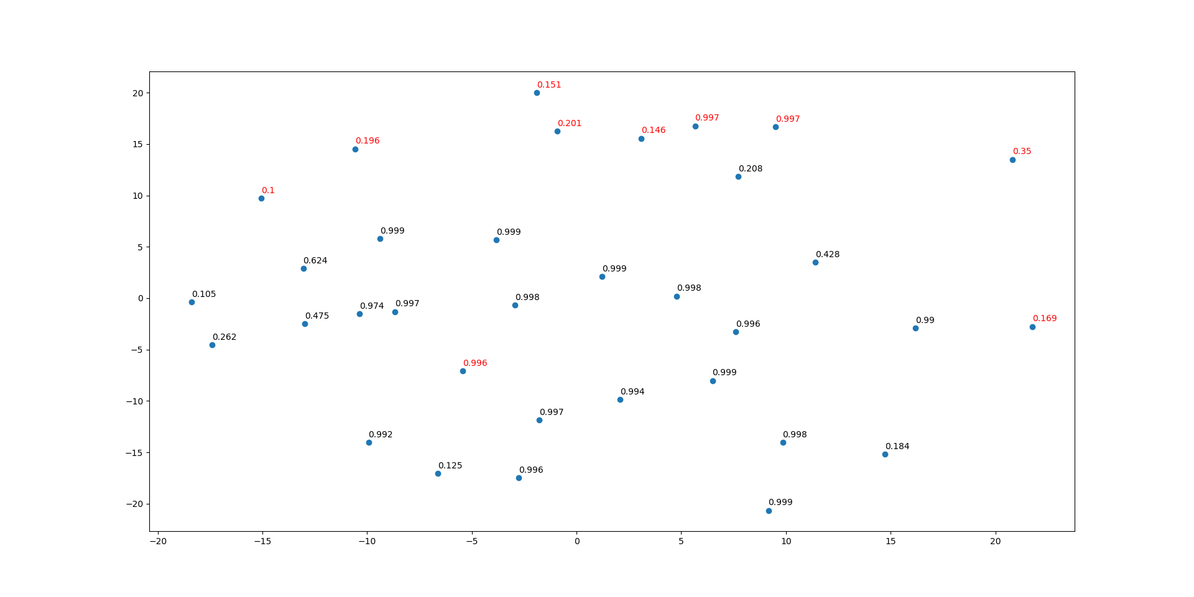
Content
I then checked the feature distribution of searching results, and draw their distribution by MDS.
Stock-3 sequence

Slide 9
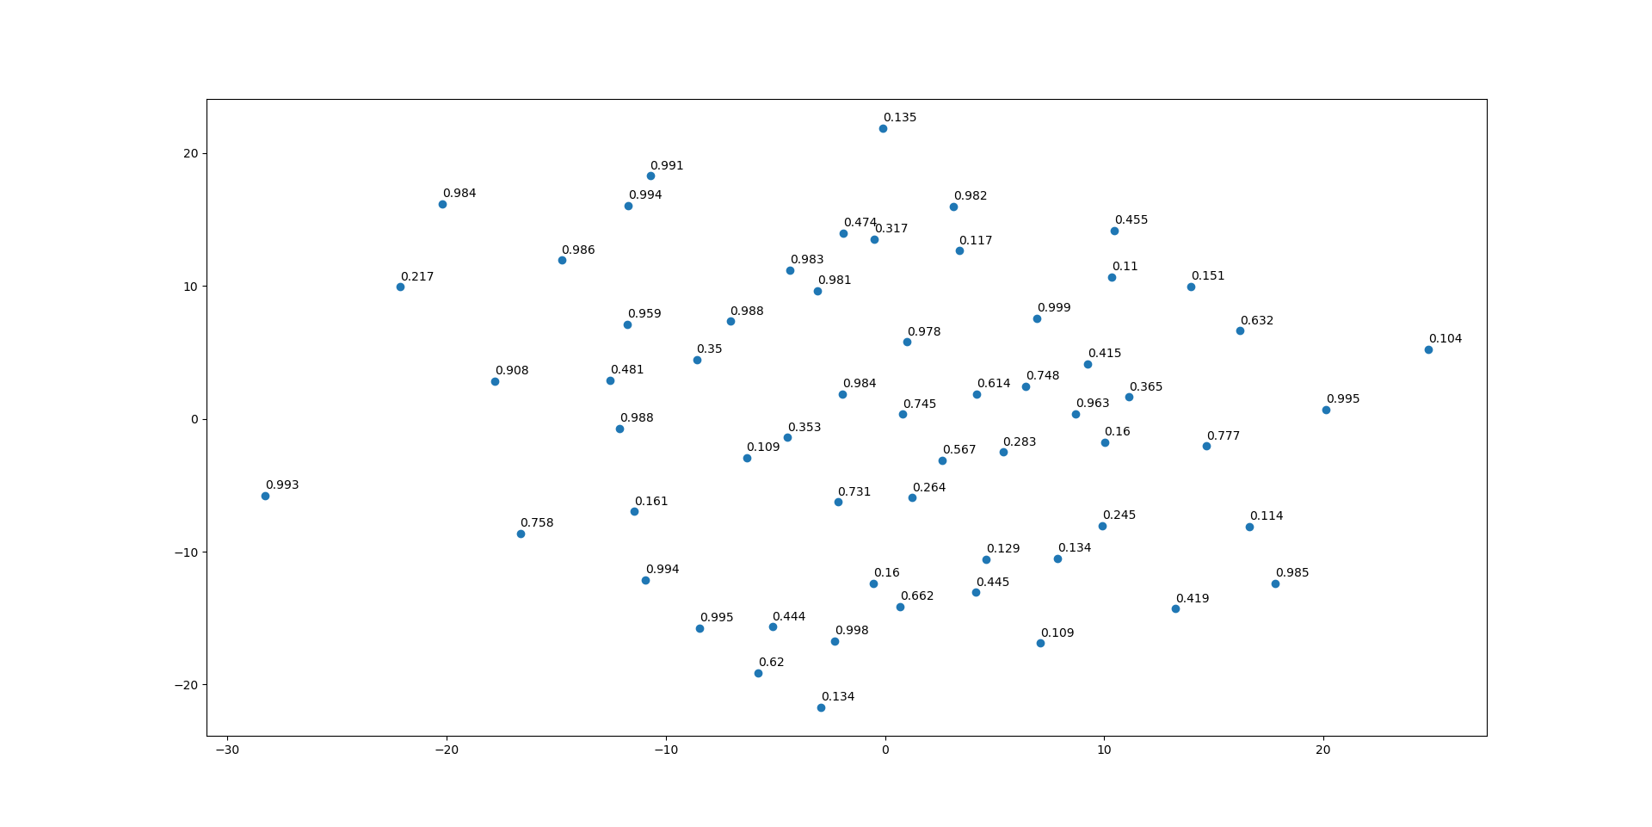
Content
I then checked the feature distribution of searching results, and draw their distribution by MDS.
Bird-0 sequence

Slide 10
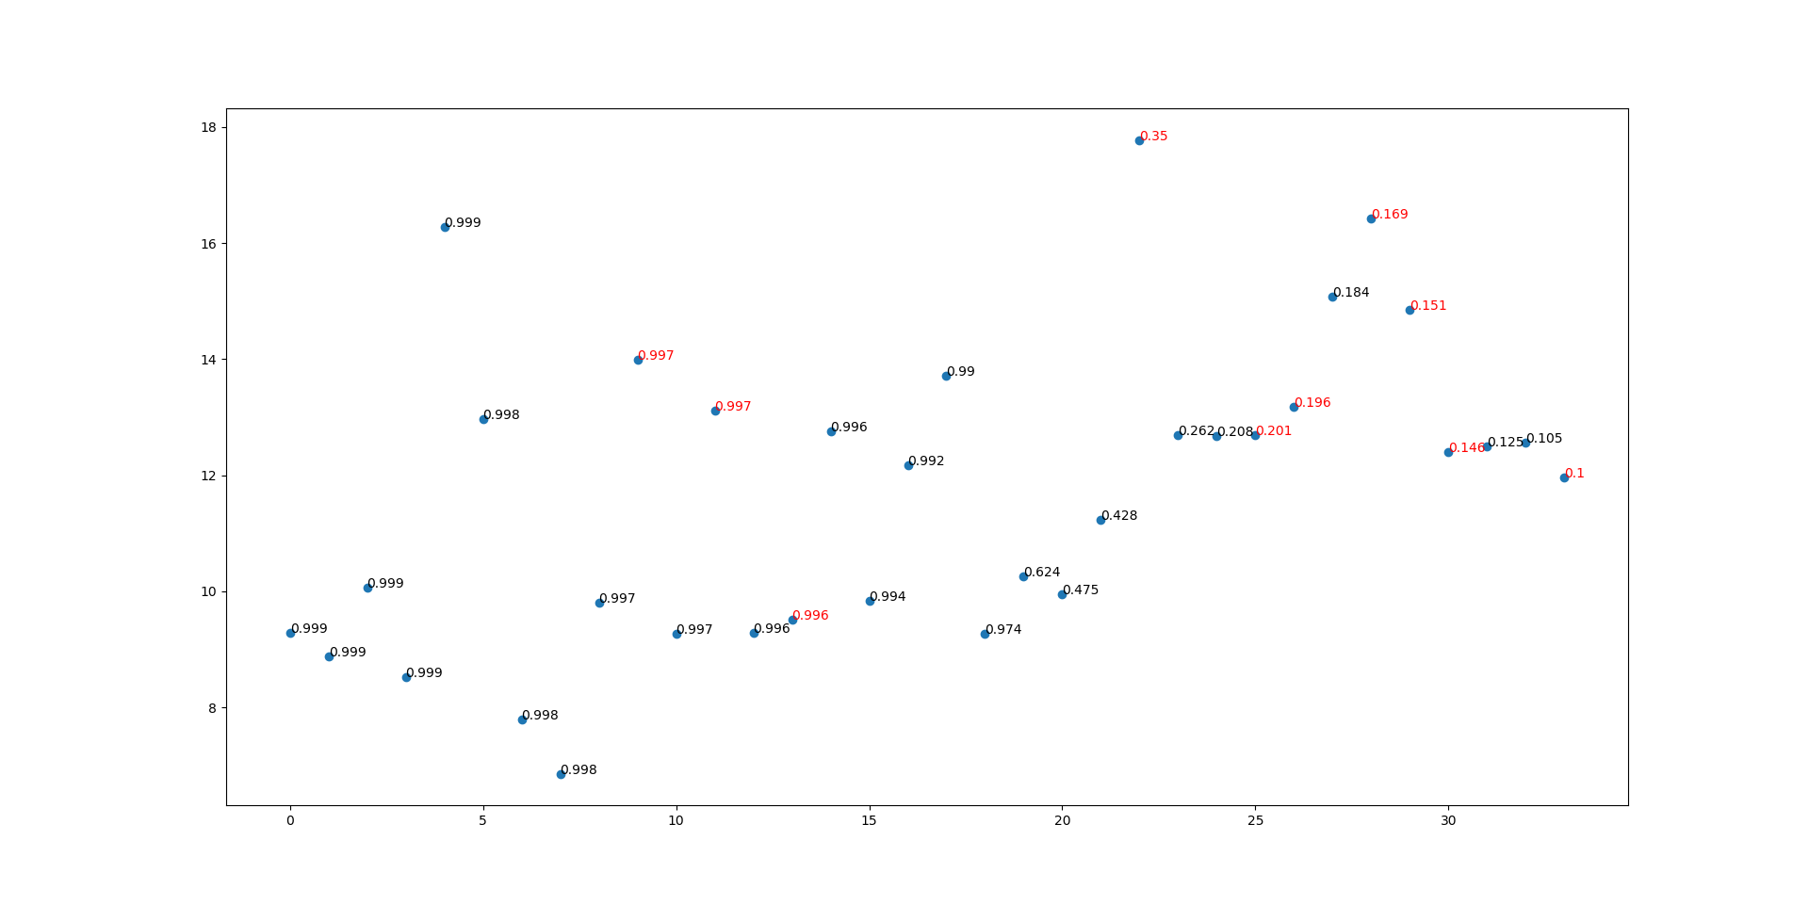
Content
I also draw the pairwise distance between the mean vector and these feature vectors of searching results.
Stock-3 sequence

Slide 11
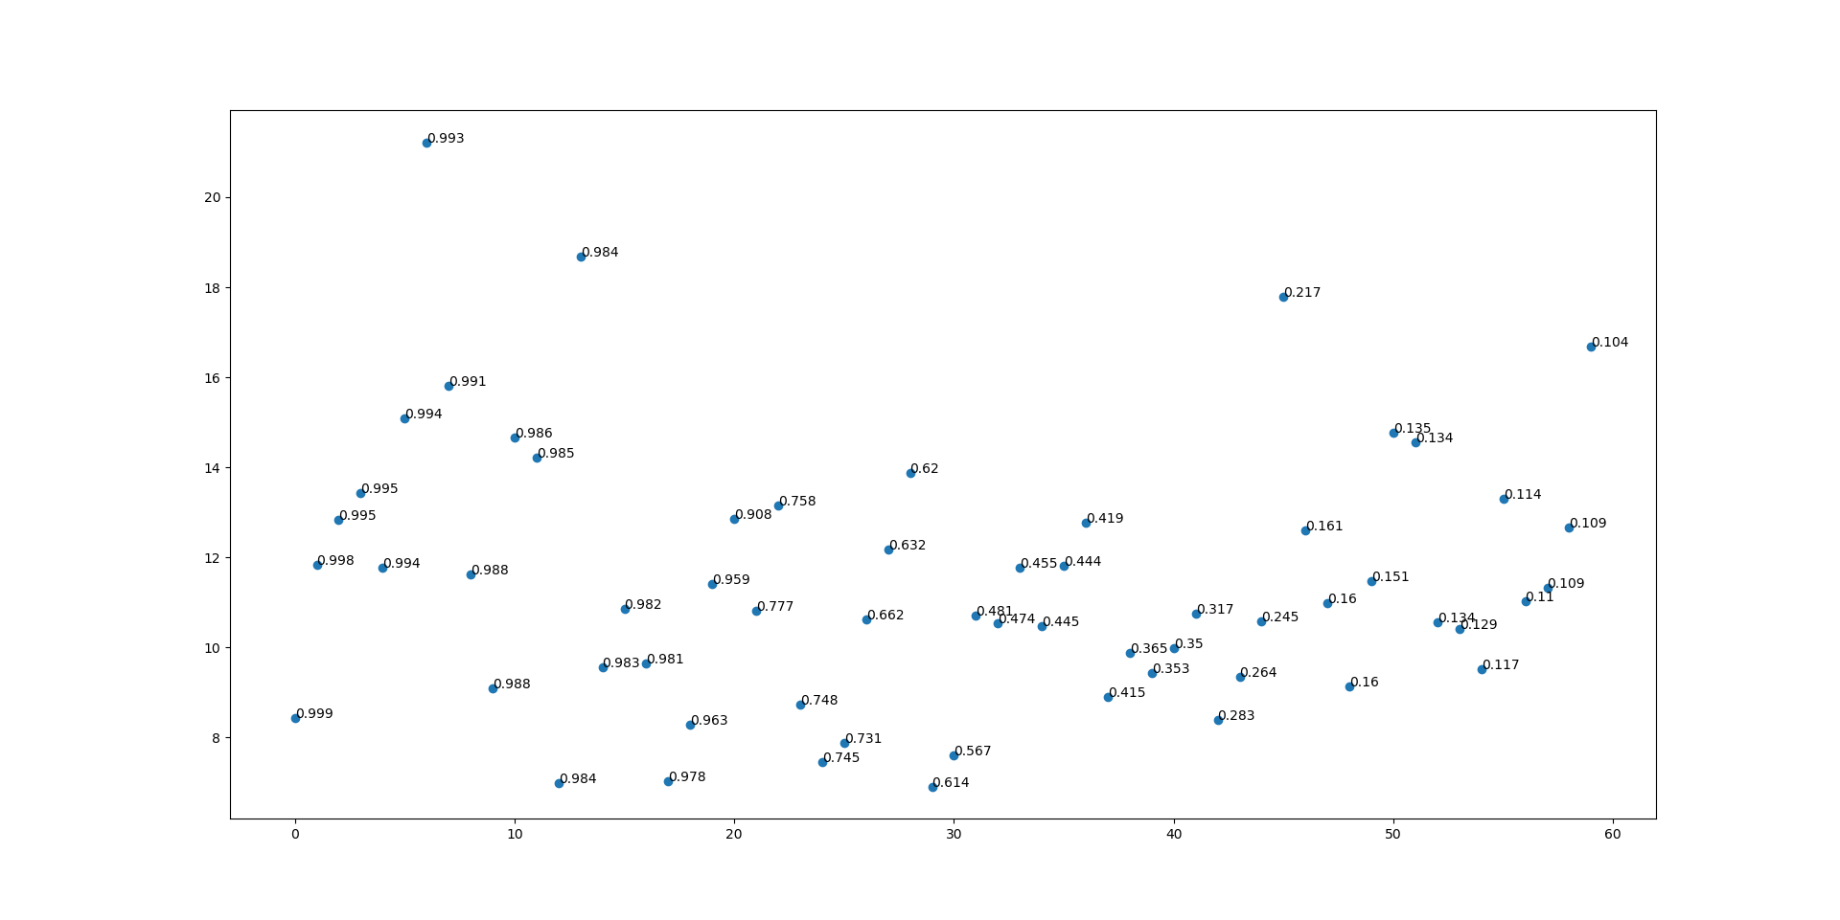
Content
I also draw the pairwise distance between the mean vector and these feature vectors of searching results.
Bird-0 sequence

Slide 12
Report End
程文胜 4.26

