Slide 1
Weekly Report
程文胜 2021.5.3-5.17

Slide 2
Weekly Report
Abstract
Content
End

Slide 3
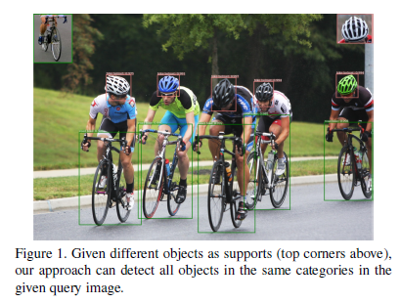
Abstract
Last week I mainly spent time on checking related fields, like few shot object detection and video object detection.

Slide 4
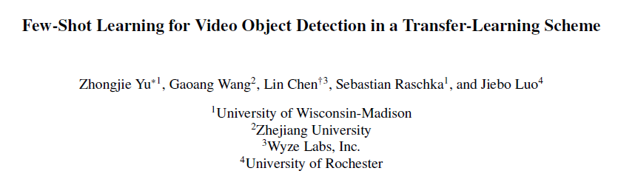
Content
Few shot video object detection is a new task. First two papers on this task appeared in March and April of this year.

Slide 5
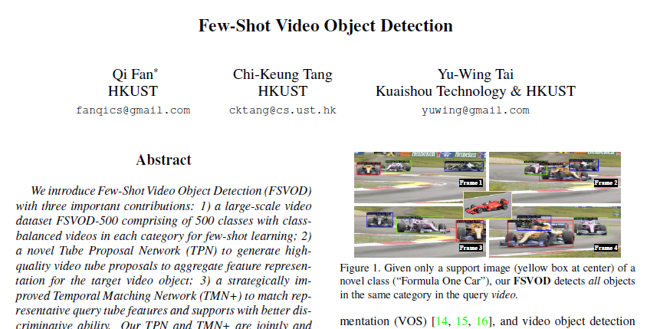
Content
Few shot video object detection is a new task. First two papers on this task appeared in March and April of this year.

Slide 6
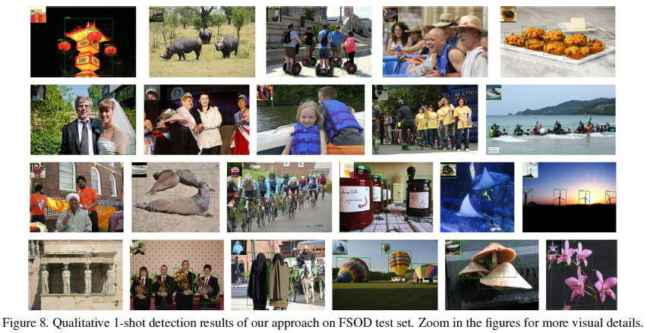
Content
Since the works are very new, and no project is available. I would try the image detection work, and try to add video related feature to image detection method for our task.

Slide 7
Report End
程文胜 5.17

