Slide 1
Weekly Report
程文胜 2021.5.25-5.31

Slide 2
Weekly Report
Abstract
Content
End

Slide 3
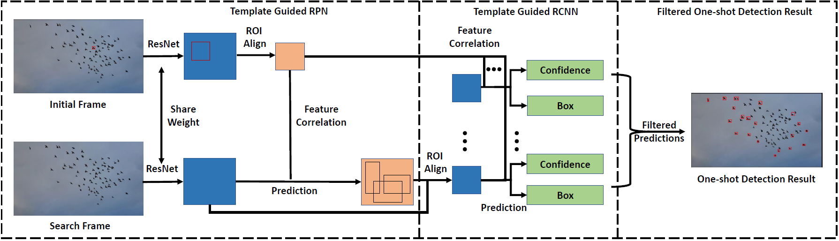
Abstract
Last week I mainly spent time on thinking about possible solution, and found related tools might be useful in our method.

Slide 4
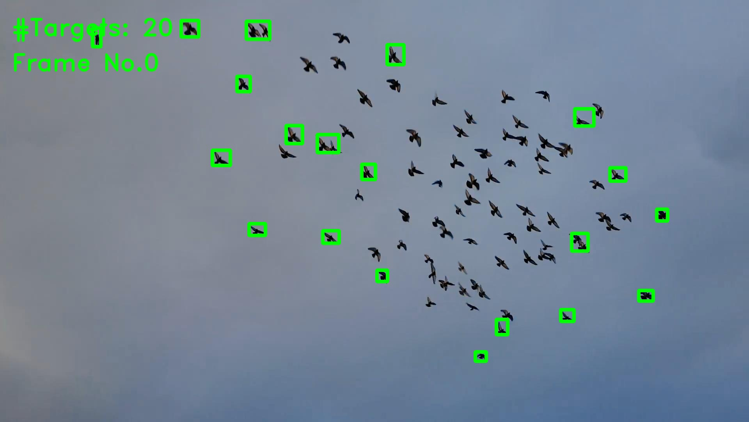
Content
After discussion with Senior Fan Yang, we plan to learn the deformation of these instances of the same target. Since the drawback of SOT baseline is the template cannot cover much feature space.

Slide 5
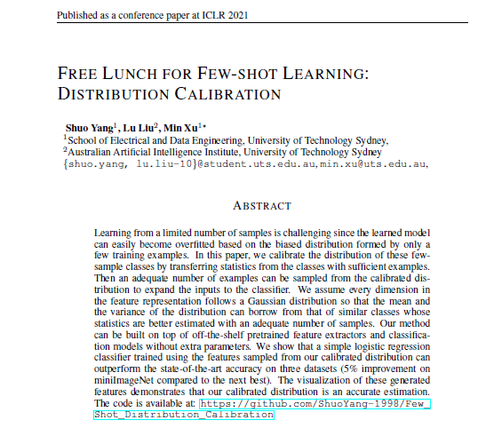
Content
Then I found one recent paper about few shot learning that tries to boost support images with features sampled from a calibrated feature distribution under Gaussian assumption. I plan to try this in the next week.

Slide 6
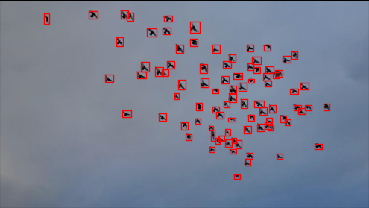
Content
One following problem is efficiency. With many samples, we need to reasonably choose a subset of them as the template bank, so as to reduce the tracking time and improve the efficiency.

Slide 7
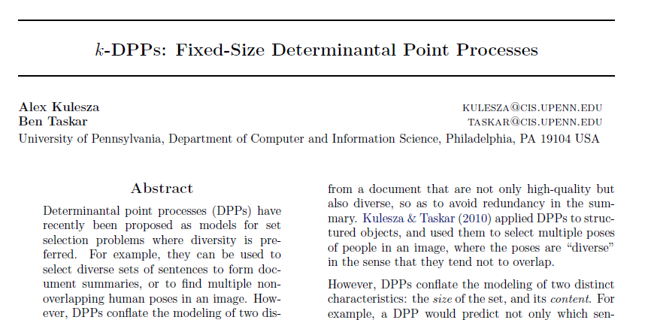
Content
One possible method for this is determinant point process(DPP), which I occasionally found in the NAS paper form our group. This is a classic method and has a solid math background.

Slide 8
Report End
程文胜 5.31

