Slide 1
Weekly Report
程文胜 2020.4.11-4.17

Slide 2
Weekly Report
Abstract
Content
End

Slide 3
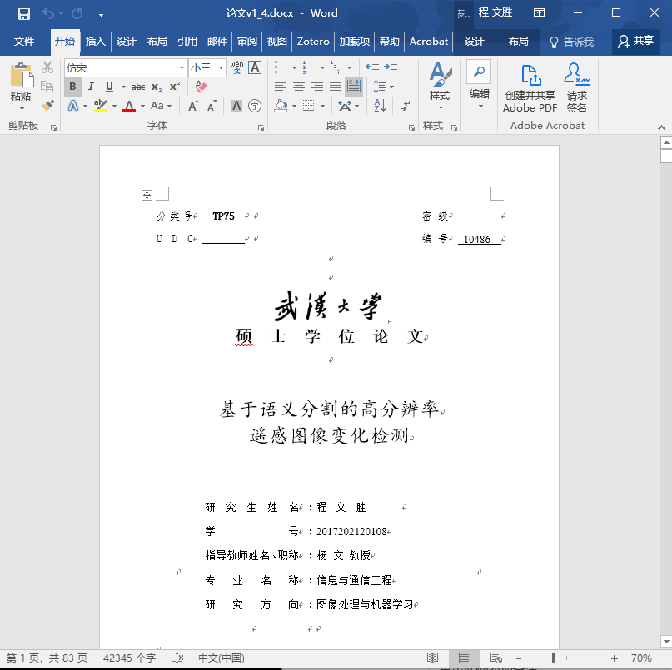
Abstract
This week I continue to revise the thesis.

Slide 4
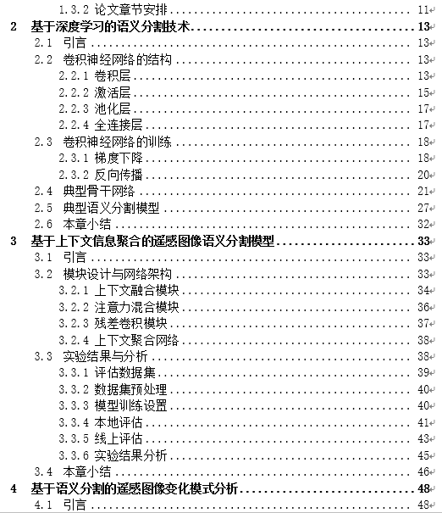
Content
Since the SCPA task can also be regarded as a kind of change detection task, I change the “change monitoring” in the title into “change detection” for simplicity. Then the title would also be consistent with the introduction part, which would make the thesis structure clearer. I also transfer some content of chapter 3 to chapter 2, and change the title of chapter 2 accordingly.

Slide 5
Report End
程文胜 VIPG

