Slide 1
Weekly Report
程文胜 2020.9.27-10.3

Slide 2
Weekly Report
Abstract
Content
End

Slide 3
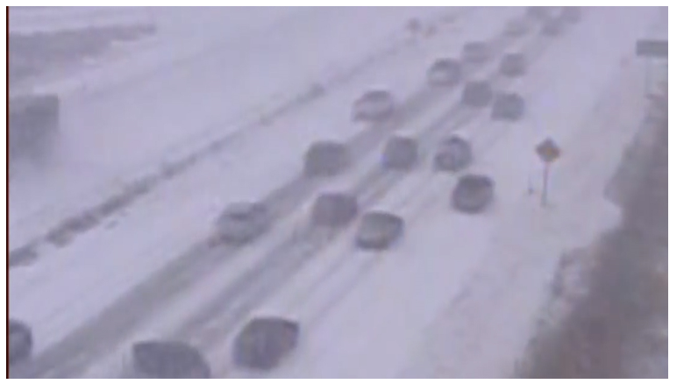
Abstract
In this week, I also put my effort on labeling the MOT images. I finished labeling the car-2 sequence. The sequence is collected on a snowy day.

Slide 4
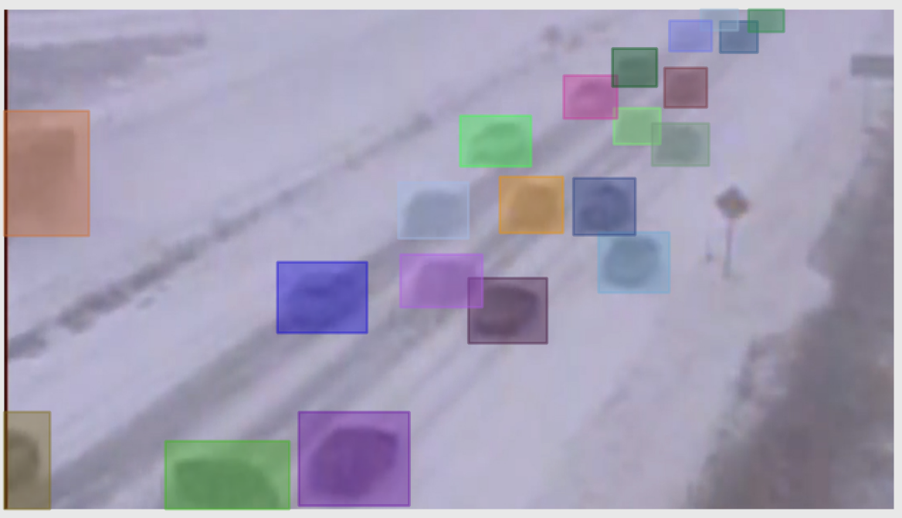
Content
Due to the strong snow, the image looks very blurred, and some cars are occluded by snow partially. There is also a car accident. So this means the objects are kind of similar with the background, and this is a challenge for mot trackers.

Slide 5
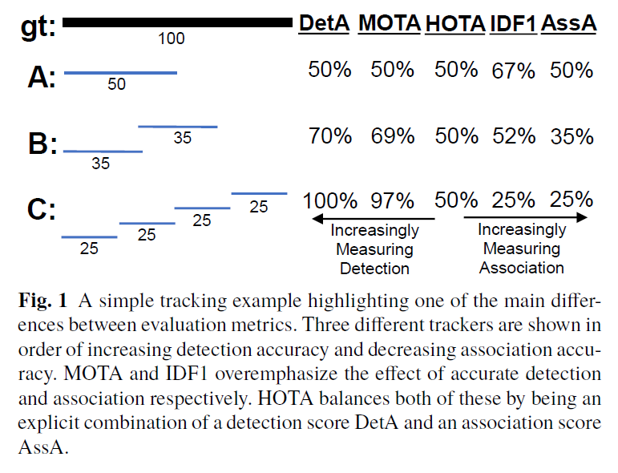
Content
I also checked the HOTA paper. It proposed a set of 5 sub-metrics, and combined them into a unified HOTA metric. It has 2 unique advantages over existing metrics, monotonicity and
error type differentiability. Since it provided evaluation python code, we can use it directly.

Slide 6
Report End
程文胜 10.3

