Slide 1
Weekly Report
程文胜 2020.11.7-11.14

Slide 2
Weekly Report
Abstract
Content
End

Slide 3
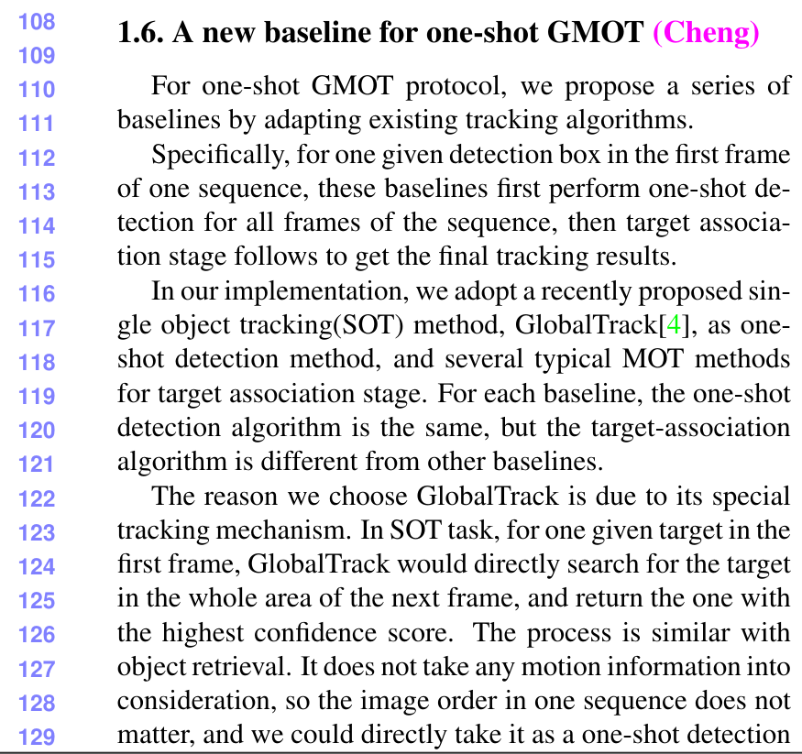
Abstract
This week I mainly spent time on writing our paper draft and refine some details. We basically finished the initial version of our draft. Next days we would revise it further and make it better.

Slide 4
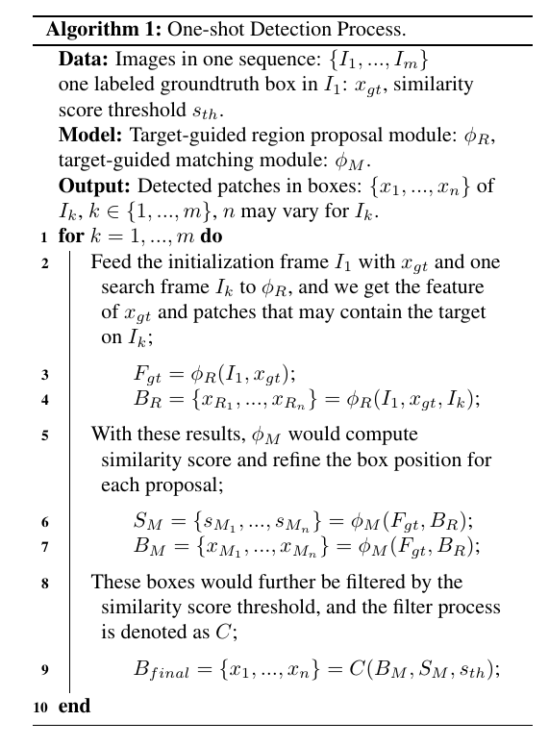
Content
I then wrote the new baseline part. In fact, we propose a series of baselines, and I mainly introduce our pipeline and net architecture. I also add an algorithm figure to make our method more clear and mathematical.

Slide 5
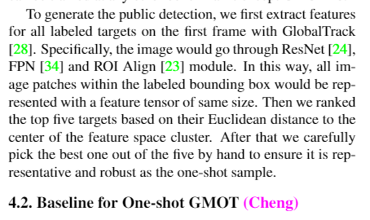
Content
I firstly revised our annotation description for one-shot GMOT. I describe how we get the feature and how we choose the one box in brief. Hence the part would become more complete and convincing.

Slide 6
Report End
程文胜 11.14

