Slide 1
Weekly Report
程文胜 2020.11.14-11.21

Slide 2
Weekly Report
Abstract
Content
End

Slide 3
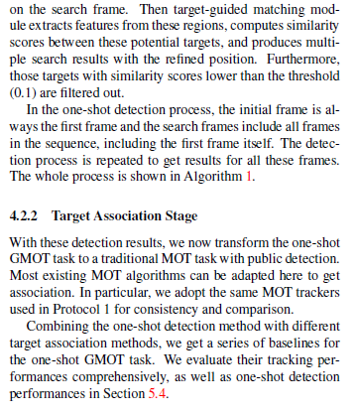
Abstract
This week I mainly spent time on revising our paper and writing supplementary material.

Slide 4
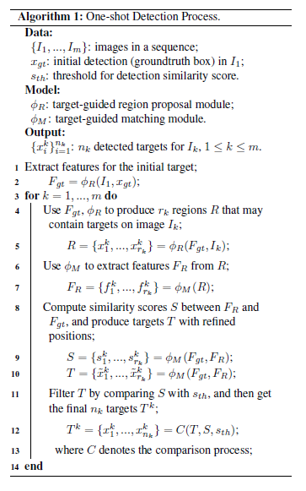
Content
I first revise the baseline section, rephrase the one-shot detection process statement and re-draw the algorithm graph to make it more clear and readable.

Slide 5
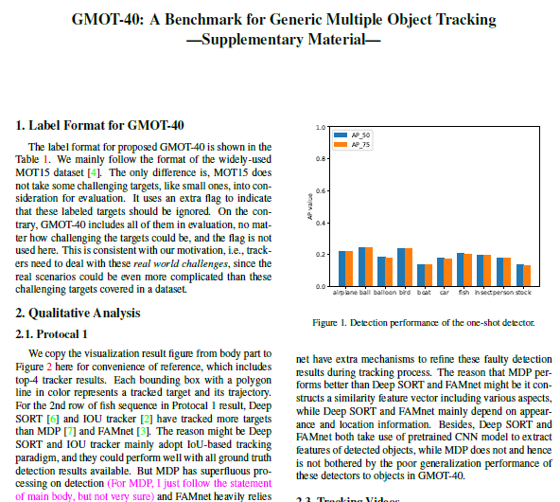
Content
After submitting the main paper, I focus on writing supplementary material. We have 3 sections in supplementary file, label format, qualitative results, and one-shot detection performance. I uploaded it to our Overleaf folder.

Slide 6
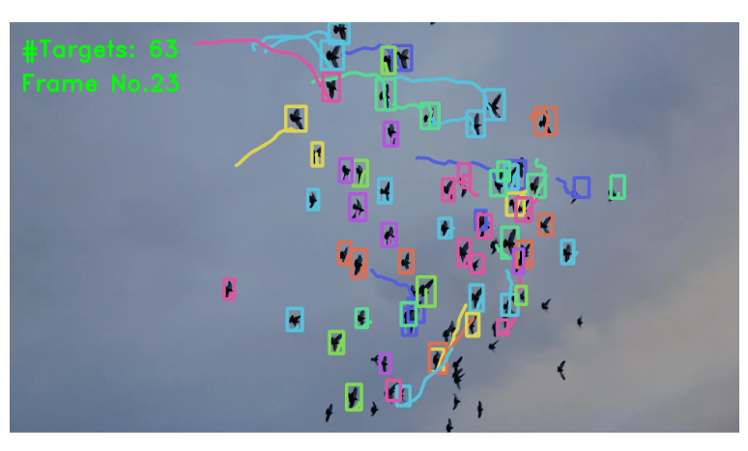
Content
I also make 8 videos(64MB in total<100MB limit) for the bird-0 sequence of 4 trackers in 2 protocols. Each bounding box and the polyline in color represent the tracked target and trajectory.
Deep SORT Protocol 1 result.

Slide 7
Report End
程文胜 11.21

