Slide 1
Weekly Report
程文胜 2020.1.8

Slide 2
Weekly Report
Abstract
Content
End

Slide 3
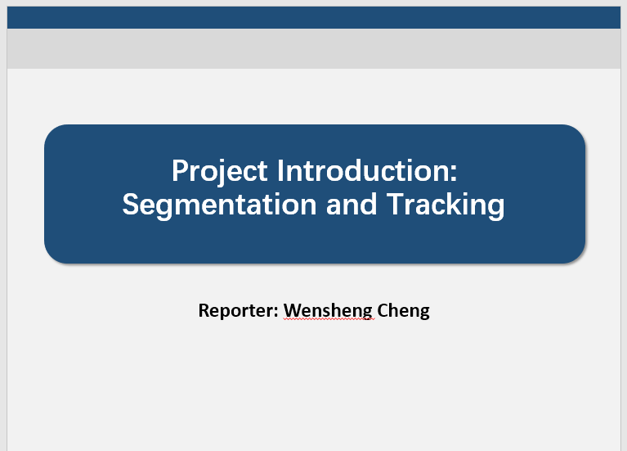
Abstract
These days I mainly spent time on preparing for the internship interview, and reading the motion prediction paper.

Slide 4
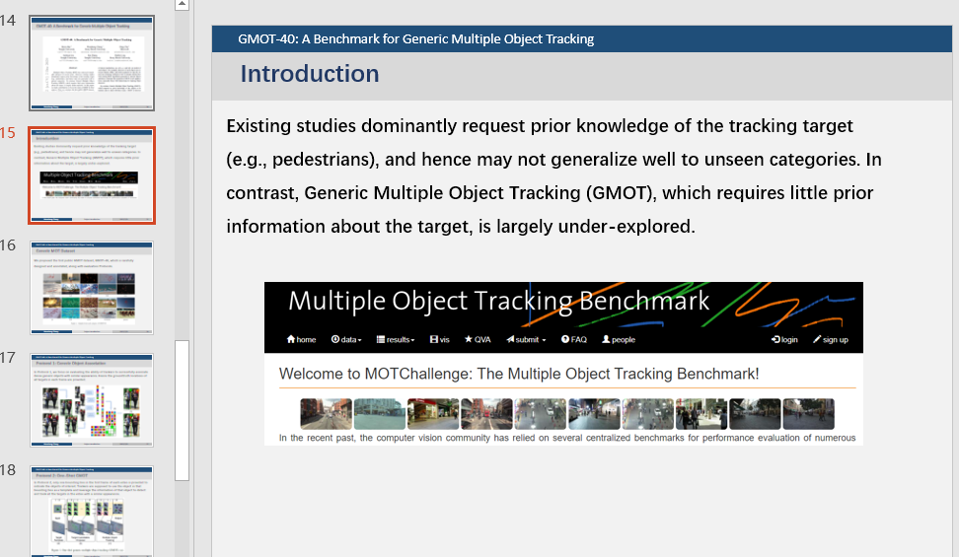
Content
I first prepared for the internship interview, hosted by senior Yang Fan. We mainly discussed my previous projects and talked about related questions. HR said he would send me related files on next Monday.

Slide 5
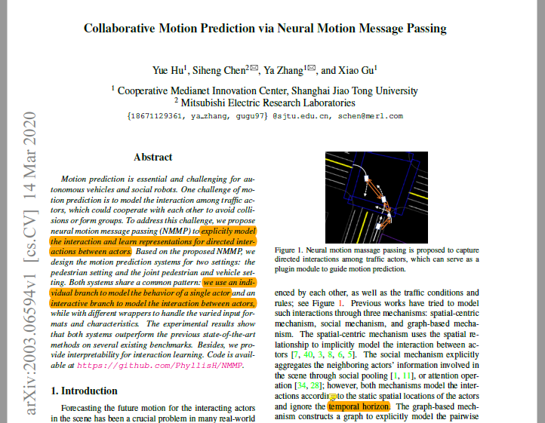
Content
I then checked the motion prediction paper, published on CVPR 2020. It uses neural-message-passing-based networks to predict actors’ motion, considering their interactions as well.

Slide 6
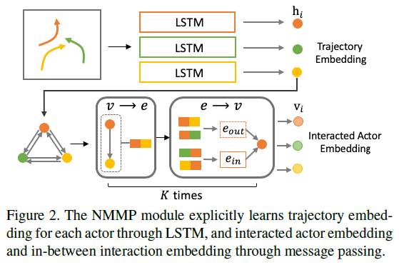
Content
It takes the observed trajectories of traffic actors as input, and produces the feature representations for both actors and their
corresponding interactions. I think we need to adjust it somehow, since the original version takes the observed trajectories as input, which is different from MOT setting.

Slide 7
Report End
程文胜 1.8

