Slide 1
Weekly Report
程文胜 2019.12.13-12.20

Slide 2
Weekly Report
Abstract
Content
End

Slide 3
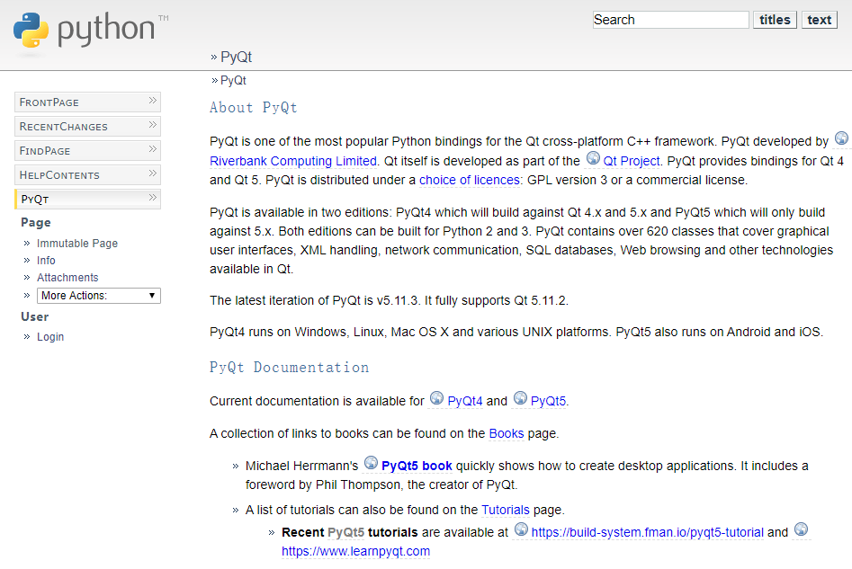
Abstract
This week I mainly put my effort on pyqt5 for GUI design.

Slide 4
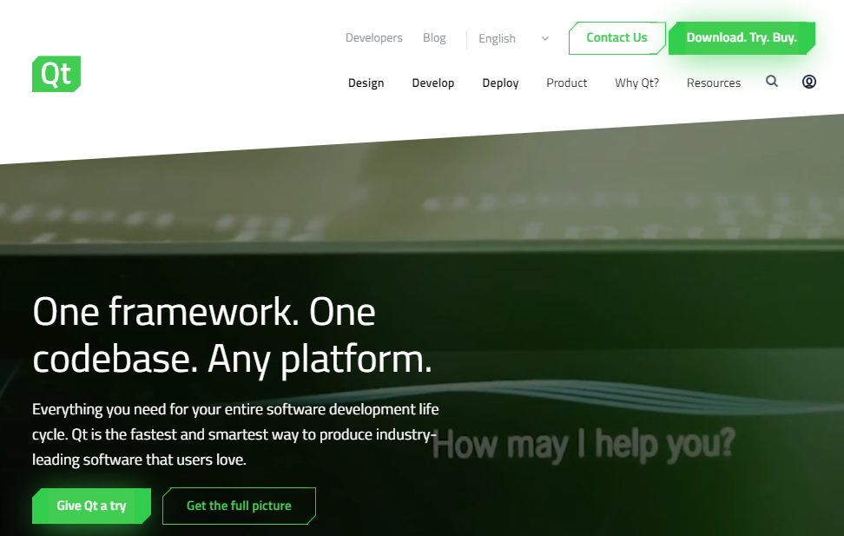
Content
Qt is a cross-platform framework for app development. It features the GUI interface, which is convenient for developers to create GUI application.

Slide 5
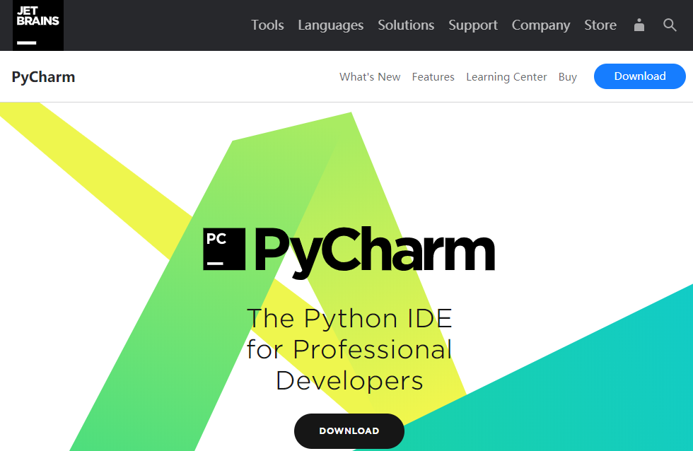
Content
This week I set up the environment for pyqt development, including pycharm, pyqt5 package, and qtdesigner. Qtdesigner is used for create the GUI and pycharm is used to create operations.

Slide 6
Report End
程文胜 VIPG

