Slide 1
Weekly Report
程文胜 2019.2.9-2020.2.15

Slide 2
Weekly Report
Abstract
Content
End

Slide 3
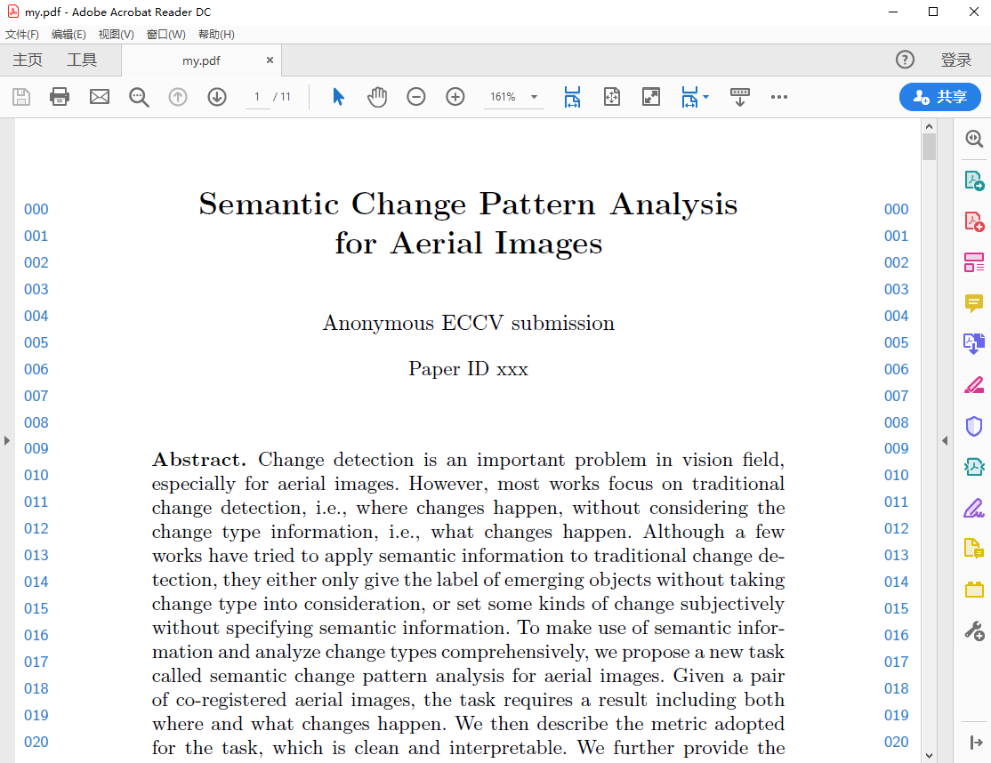
Abstract
This week I mainly put my effort on the new paper about change detection.

Slide 4
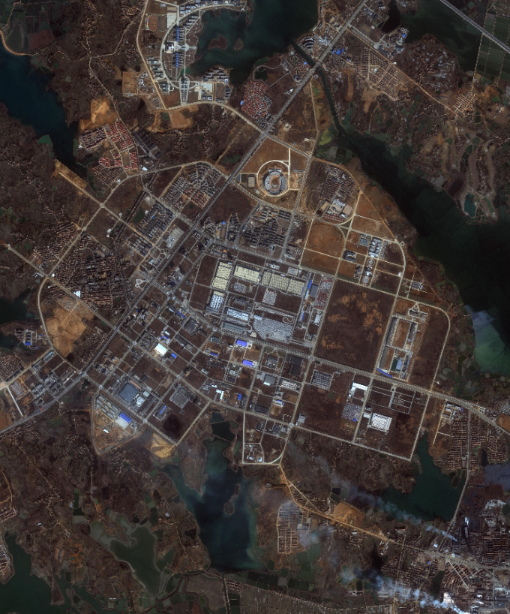
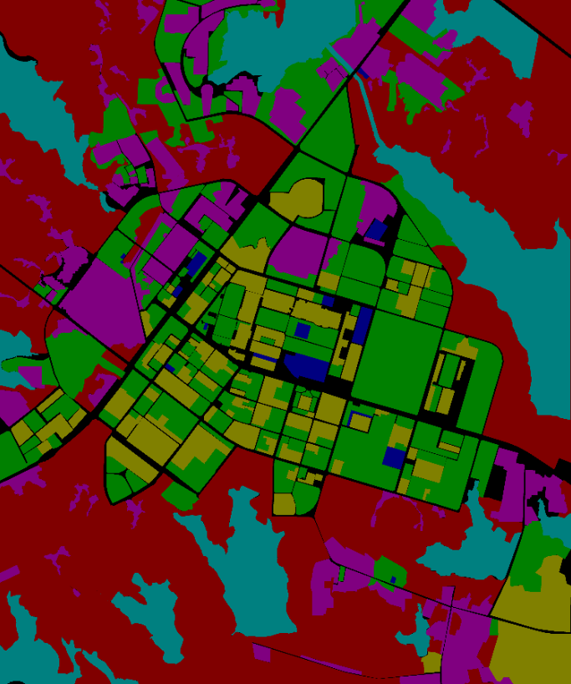
Content
I have finished the main body of the paper, and Zhang Yan has helped me on labeling the Wuhan images.

Slide 5
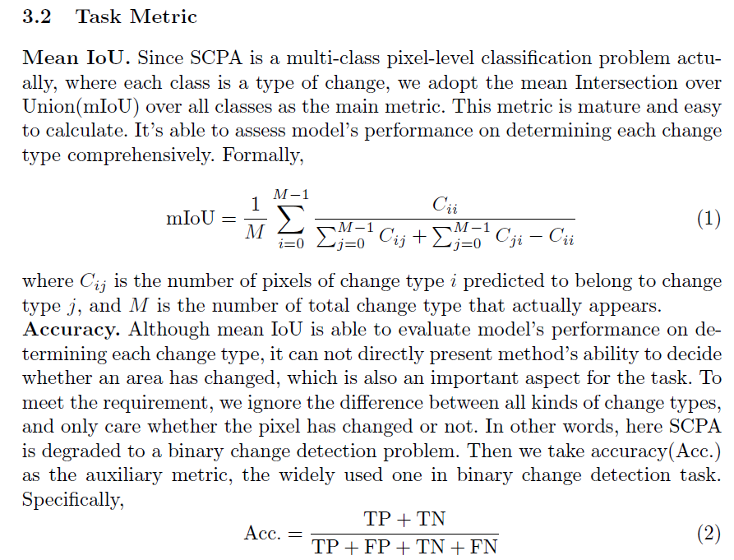
Content
I have read related papers carefully, and found that existing works are not the same with our thought. So this is still a new task, which is a good message. But the new metric I tried before is not proper, and existing mIoU metric is enough to evaluate the task, hence we adopt the existing one. Next week I plan to do all experiments and get the first draft of the paper.

Slide 6
Report End
程文胜 VIPG

