Slide 1
Weekly Report
程文胜 2018.11.18-11.23

Slide 2
Weekly Report
Abstract
Content
Discussion

Slide 3
Abstract
This week I mainly put my effort on improving semantic segmentation results of Shanghai SAR image and doing change detection task.
As planned last week, I tried random rotation and multi-scale method, then got corresponding result.
SAR image for testing

Slide 4
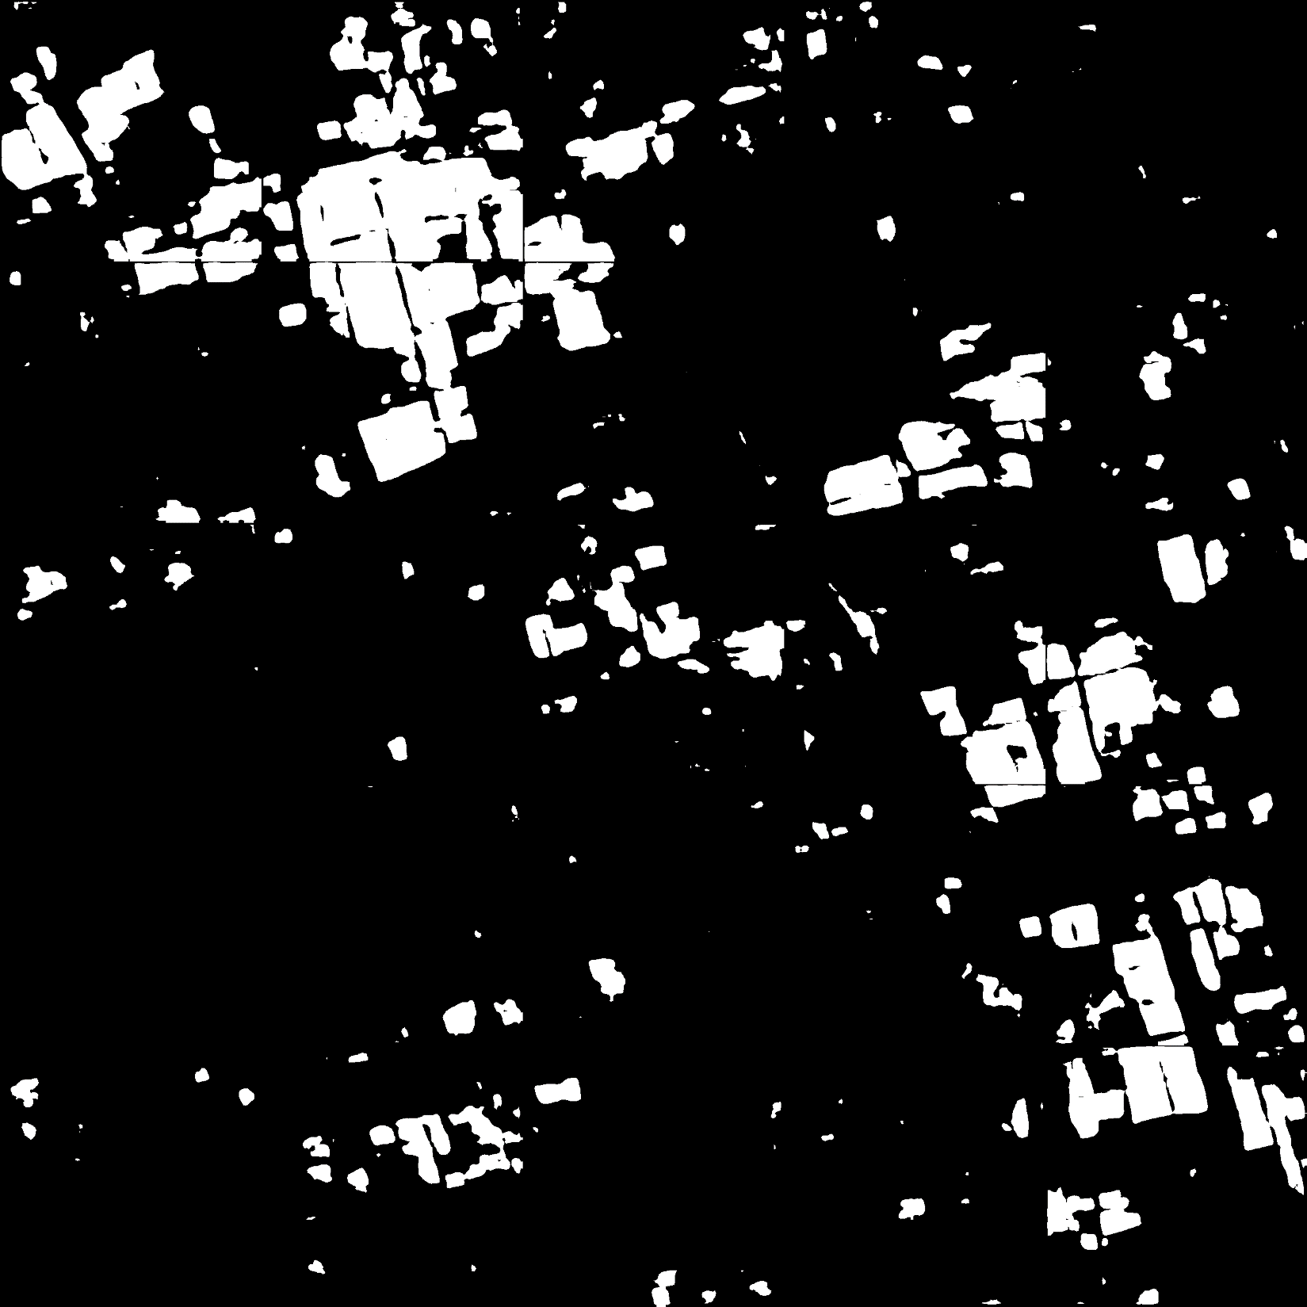
Content
For semantic segmentation, to improve segmentation accuracy, I tried random rotation and multi-scale methods.
Random rotation proved useful, and it gained 0.7% improvement, which is obvious for CNN methods.
Multi-scale method didn’t make sense, and I tried both downsampling and upsampling then fused them. However it didn’t work.
Segmentation result of down-
sampled image(50% original size)

Slide 5
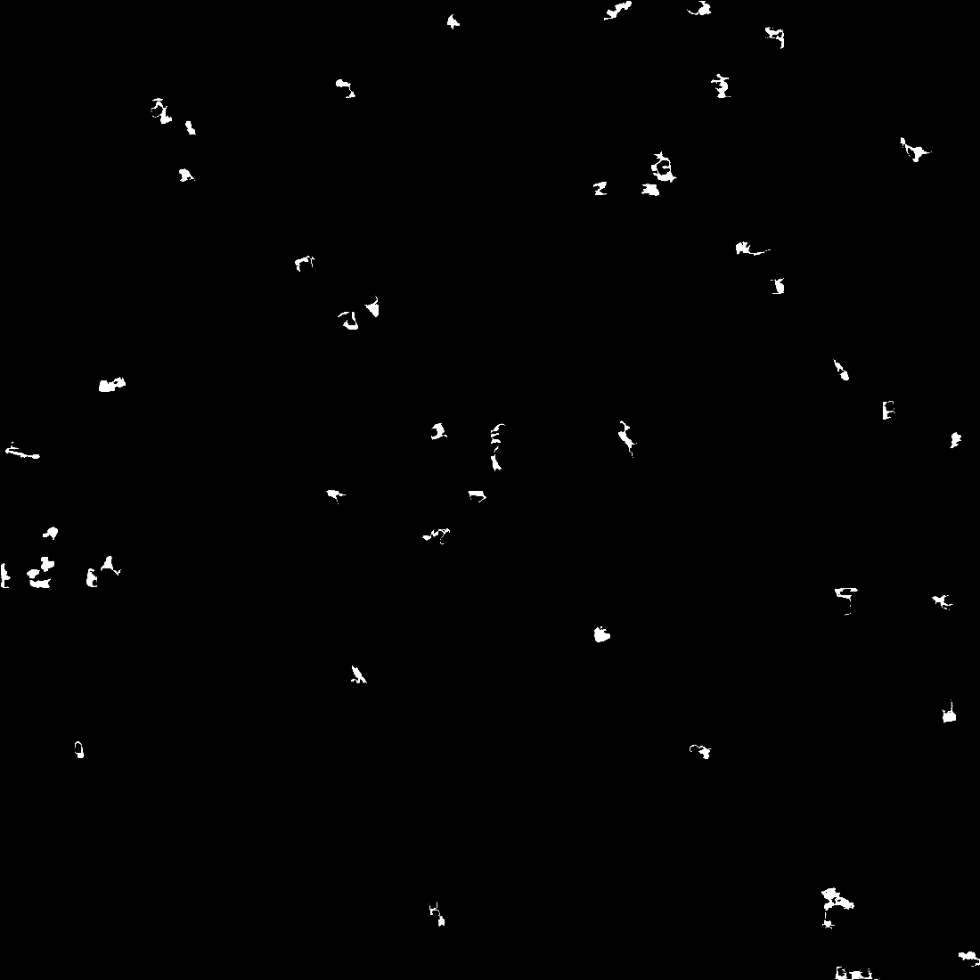
Content
For change detection, we adopt 2 images of the same area, which are September and December images.
With the semantic segmentation model trained in other areas, we extract building parts in these two images, then subtract them directly.
After filtering out small areas, the image on the right is the change detection of these two images.
Change detection result

Slide 6

Discussion
For multi-scale method, many papers, especially those harnessing Pascal VOC dataset, have reported large improvement to 2%. But for SAR image, when we downsample images, tiny objects would be remove and hence the performance would be affected.
About evaluation metric, I added global accuracy(~84%) and kappa coefficient(0.62), besides F1 score(0.73).
For the lab project, we need to adjust demonstration style to show change detection result more intuitively and give audience a better impression.

Slide 7
Report End
程文胜 VIPG

