Slide 1
Weekly Report
程文胜 2019.9.14-9.21

Slide 2
Weekly Report
Abstract
Content
Discussion

Slide 3
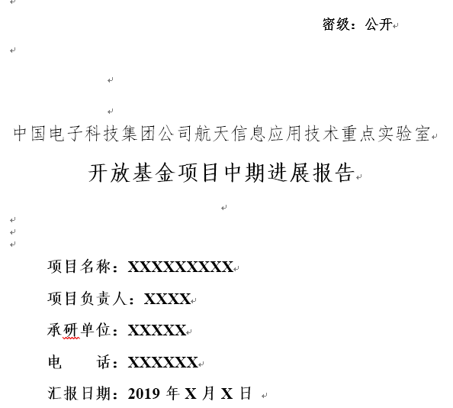
Abstract
This week I mainly put my effort on writing CETC 54 project file and doing programming job with Zhang Ruixiang.

Slide 4
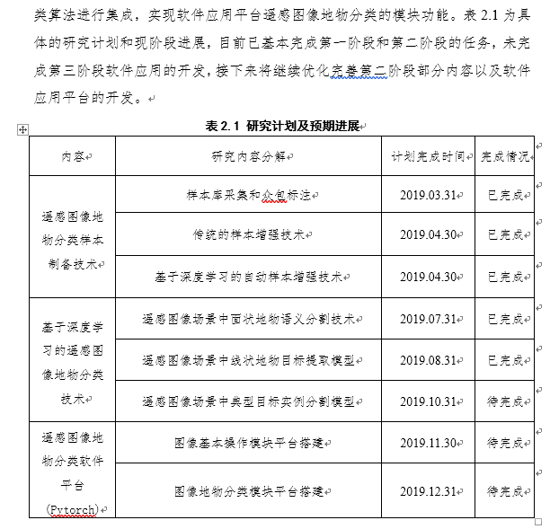
Content
Chief. Wang Min gave me the uodated document model, then Zhang Ruixang and I have prepared the document file per the document model.

Slide 5
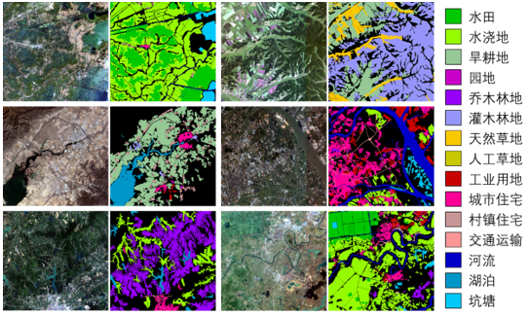
Content
We also cleaned up the GID data and tried road extraction model on the data set. The result is ok. About instance segmentation of building, we plan to do it in the final examination.
GID data

Slide 6
Report End
程文胜 VIPG

